Slide 1
A Survey of Multifragment Rendering
Eurographics 2020 STAR Papers
A. A. Vasilakis* K. Vardis* G. Papaioannou
Department of Informatics,
Athens University of Economics & Business, Greece
*These authors contributed equally to this work
Notes:
Hello and welcome to the presentation of our survey paper with title: A Survey of Multifragment Rendering

Slide 2
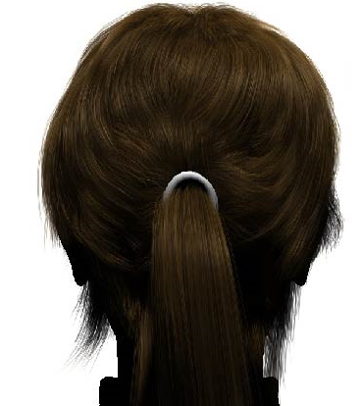
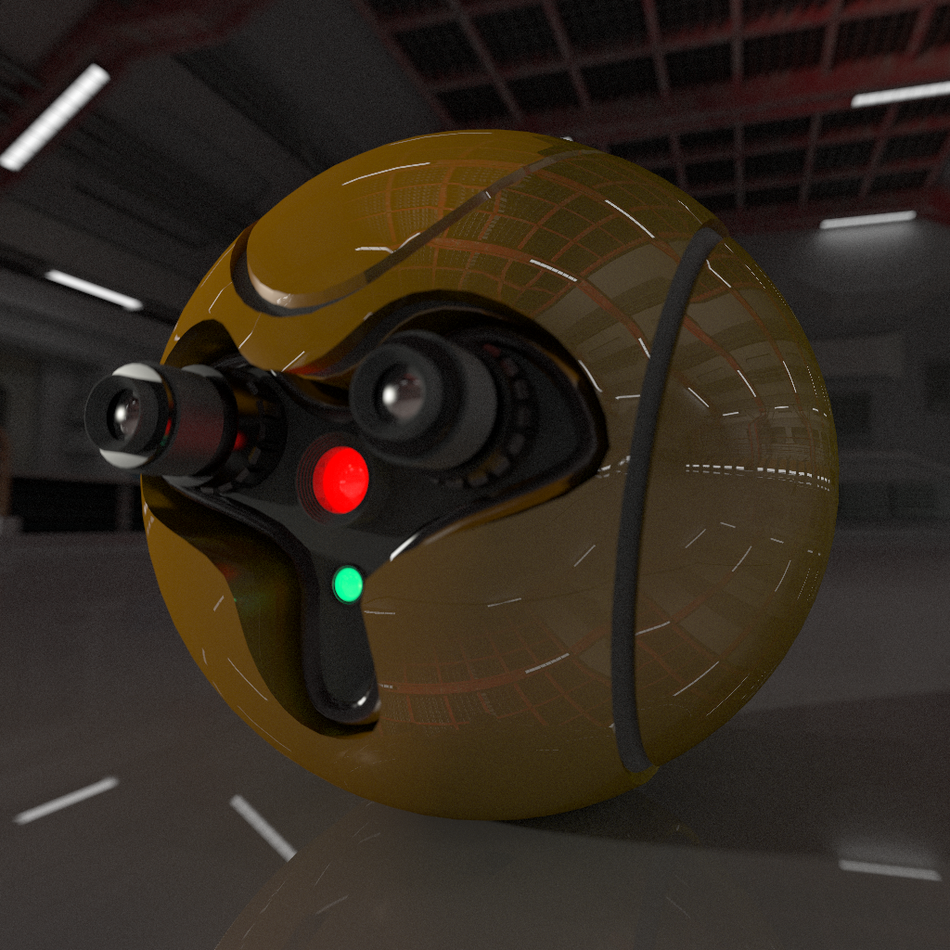
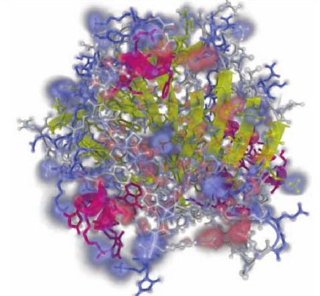
Multifragment Rendering
[JCLR19]
[VVP16b]
[LFS*15]
Notes:
Multifragment rendering is a family of rasterisation-based image synthesis techniques, that is responsible for the delivery of numerous complex visual phenomena in interactive and real-time rendering.
The main advantage of these approaches is that they compute information of hidden layers, essentially augmenting the traditional primary visibility determination stage.
With this survey, we provide an overview and insight into this exciting field of research.

Slide 3
Outline
Part 1
Introduction
Fundamentals
Part 2
Construction
Operations
Applications
Part 3
Discussion
Conclusion
Notes:
The presentation is split into three main parts. First, we will define and present the multifragment rendering pipeline, clarify what this STAR focuses on. Then we will generalise MFR as a visibility determination problem and, finally, define a conceptual rendering pipeline for it.
In the next part, we elaborate and discuss this pipeline. We will detail construction strategies for the various methods, the core operations that can be performed on the data and, finally, their mapping to the respective applications.
In the last part, we will discuss some existing and hopefully exciting open problems and challenges and conclude by presenting opportunities for future research directions.

Slide 4
What the STAR is about
Part 1.1 Introduction
Definition: Multifragment rendering (MFR) describes the algorithms and data structures that maintain and process multiple per-pixel fragments that:
Correspond to the same location (pixel) in image-space
Are captured from the same viewpoint
Notes:
Some clarification first: multifragment methods describes the algorithms and data structures that are used to produce, maintain and process sets of geometry fragments associated with a single image, from the same location in image space and from the same viewpoint

Slide 5
What the STAR is about
Part 1.1 Introduction
Definition: Multifragment rendering (MFR) describes the algorithms and data structures that maintain and process multiple per-pixel fragments that:
Correspond to the same location (pixel) in image-space
Are captured from the same viewpoint
It does not describe:
Multi-view methods
e.g. cubemap rendering, layered depth images (LDIs) [SGHS98]
Voxelisation techniques
Notes:
Some clarification first: multifragment methods describes the algorithms and data structures that are used to produce, maintain and process sets of geometry fragments associated with a single image, from the same location in image space and from the same viewpoint
Therefore, it does not contain methods that process information from multiple viewpoints.
It does not describe data structures addressable in object-space, such as voxelisation techniques.
As such, we do not address such techniques in our survey.

Slide 6
What the STAR is about
Part 1.1 Introduction
Definition: Multifragment rendering (MFR) describes the algorithms and data structures that maintain and process multiple per-pixel fragments that:
Correspond to the same location (pixel) in image-space
Are captured from the same viewpoint
It does not describe:
Multi-view methods
e.g. cubemap rendering, layered depth images (LDIs) [SGHS98]
Voxelisation techniques
Has also other names in the literature:
Deep G-buffers [MMNL16], Layered Fragment Buffer [KLZ12], etc.
Sometimes MFR methods are also referred to as LDIs.
Notes:
Some clarification first: multifragment methods describes the algorithms and data structures that are used to produce, maintain and process sets of geometry fragments associated with a single image, from the same location in image space and from the same viewpoint
Therefore, it does not contain methods that process information from multiple viewpoints.
It does not describe data structures addressable in object-space, such as voxelisation techniques.
As such, we do not address such techniques in our survey.
Storing multiple per-pixel fragments has also been described with other names in the literature, such as Deep GBuffers, Layered Fragment Buffer, etc.
Here, we avoid complicating matters further and use the term MFR since it neither makes any assumption on the data type that is captured and stored nor contains the notion of multiple viewpoints.

Slide 7
MFR pros and cons
Part 1.1 Introduction
Pros:
Allows effects that require computations from hidden layers
Examples include: transparency, global illumination, CSG, collision detection, etc.
Rasterisation-based
Exploits GPU-accelerated pipeline
Arbitrary dynamic content support
Fast direct visibility resolve
Tessellation, instancing, blending can be synergistically used
Supported in commodity graphics hardware
Even more powerful effects with hybrid rendering approaches
Cons:
Rasterisation-based :)
works on sampled geometric data - approximate solutions (not always [WHL15,VVP16])
Typically, more expensive to evaluate
Notes:
The main reason MFR has been exploited in the past is due to their numerous benefits:
First, by exploiting information from hidden layers, numerous phenomena can be simulated. Examples include transparency, GI, CSG and others

Slide 8
MFR pros and cons
Part 1.1 Introduction
Pros:
Allows effects that require computations from hidden layers
Examples include: transparency, global illumination, CSG, collision detection, etc.
Rasterisation-based
Exploits GPU-accelerated pipeline
Arbitrary dynamic content support
Fast direct visibility resolve
Tessellation, instancing, blending can be synergistically used
Supported in commodity graphics hardware
Even more powerful effects with hybrid rendering approaches
Cons:
Rasterisation-based :)
works on sampled geometric data - approximate solutions (not always [WHL15,VVP16])
Typically, more expensive to evaluate
Notes:
The main reason MFR has been exploited in the past is due to their numerous benefits:
First, by exploiting information from hidden layers, numerous phenomena can be simulated. Examples include transparency, GI, CSG and others
Second, it is based on the rasterisation pipeline, making it ideal for real-time rendering and dynamic content.
Therefore, it shares its benefits as well.

Slide 9
MFR pros and cons
Part 1.1 Introduction
Pros:
Allows effects that require computations from hidden layers
Examples include: transparency, global illumination, CSG, collision detection, etc.
Rasterisation-based
Exploits GPU-accelerated pipeline
Arbitrary dynamic content support
Fast direct visibility resolve
Tessellation, instancing, blending can be synergistically used
Supported in commodity graphics hardware
Even more powerful effects with hybrid rendering approaches
Cons:
Rasterisation-based :)
works on sampled geometric data - approximate solutions (not always [WHL15,VVP16b])
Typically, more expensive to evaluate
Notes:
The main reason MFR has been exploited in the past is due to their numerous benefits:
First, by exploiting information from hidden layers, numerous phenomena can be simulated. Examples include transparency, GI, CSG and others
Second, it is based on the rasterisation pipeline, making it ideal for real-time rendering and dynamic content.
Therefore, it shares its benefits as well.
However, it shares its disadvantages too, such as that it works on sampled geometric data and results in approximate solutions, in most cases.

Slide 10
MFR pros and cons
Part 1.1 Introduction
Pros:
Allows effects that require computations from hidden layers
Examples include: transparency, global illumination, CSG, collision detection, etc.
Rasterisation-based
Exploits GPU-accelerated pipeline
Arbitrary dynamic content support
Fast direct visibility resolve
Tessellation, instancing, blending can be synergistically used
Supported in commodity graphics hardware
Even more powerful effects with hybrid rendering approaches
Cons:
Rasterisation-based :)
works on sampled geometric data - approximate solutions (not always [WHL15,VVP16b])
Typically, more expensive to evaluate
Notes:
The main reason MFR has been exploited in the past is due to their numerous benefits:
First, by exploiting information from hidden layers, numerous phenomena can be simulated. Examples include transparency, GI, CSG and others
Second, it is based on the rasterisation pipeline, making it ideal for real-time rendering and dynamic content.
Therefore, it shares its benefits as well.
However, it shares its disadvantages too, such as that it works on sampled geometric data and results in approximate solutions, in most cases.
Thankfully, such limitations can be lifted using hybrid rendering techniques, like combining MFR with ray-tracing or voxelization approaches

Slide 11
MFR pros and cons
Part 1.1 Introduction
Pros:
Allows effects that require computations from hidden layers
Examples include: transparency, global illumination, CSG, collision detection, etc.
Rasterisation-based
Exploits GPU-accelerated pipeline
Arbitrary dynamic content support
Fast direct visibility resolve
Tessellation, instancing, blending can be synergistically used
Supported in commodity graphics hardware
Even more powerful effects with hybrid rendering approaches
Cons:
Rasterisation-based :)
works on sampled geometric data - approximate solutions (not always [WHL15,VVP16b])
Typically, more expensive to evaluate than single-layer techniques
Notes:
The main reason MFR has been exploited in the past is due to their numerous benefits:
First, by exploiting information from hidden layers, numerous phenomena can be simulated. Examples include transparency, GI, CSG and others
Second, it is based on the rasterisation pipeline, making it ideal for real-time rendering and dynamic content.
Therefore, it shares its benefits as well.
However, it shares its disadvantages too, such as that it works on sampled geometric data and results in approximate solutions, in most cases.
Thankfully, such limitations can be lifted using hybrid rendering techniques, like combining MFR with ray-tracing or voxelization approaches
Finally, it is typically more expensive to evaluate than methods that operate on a single layer of information.

Slide 12
1.2 Fundamentals
Rasterisation Pipeline
Visibility Determination
Direct (hidden surface elimination)
Indirect
Notes:
Now, we will make an introduction to the fundamentals of multifragment rendering.
This part starts with a brief introduction to the rasterisation process and visibility determination.

Slide 13
1.2 Fundamentals
Rasterisation Pipeline
Visibility Determination
Direct (hidden surface elimination)
Indirect
Generalise rasterisation pipeline beyond hidden surface elimination
Notes:
Now, we will make an introduction to the fundamentals of multifragment rendering.
This part starts with a brief introduction to the rasterisation process and visibility determination.
Doing this will form the ground to formalise MFR and introduce a conceptual pipeline that essentially augments rasterisation beyond the traditional hidden surface elimination.

Slide 14
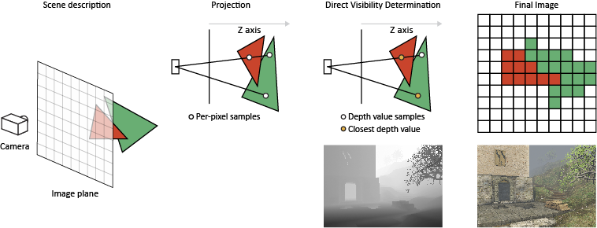
Rasterisation
Part 1.2 Fundamentals
Input: mathematical description of geometric shapes | Output: a set of coloured pixels
Primitives are projected, sampled and generate a set of fragments at a pixel location
Notes:
In its simplest form, a rasterisation process receives as input a mathematical representation of geometric shapes. The output is the raster, a rectangular grid of coloured pixels.
Here, primitives are projected to the image plane and sampled, usually at fixed spatial rate, and generate a set of fragments that overlap a sampling location

Slide 15
Rasterisation
Part 1.2 Fundamentals
The fragment stage is executed in parallel
Fragments are generated in an unsorted order
Employs a primary visibility determination algorithm to produce the correct image
Notes:
What’s important to remember here, the fragment generation stage is executed in parallel, generating fragments in an unsorted order. So, to produce a correct image, a visibility determination algorithm is employed.

Slide 16
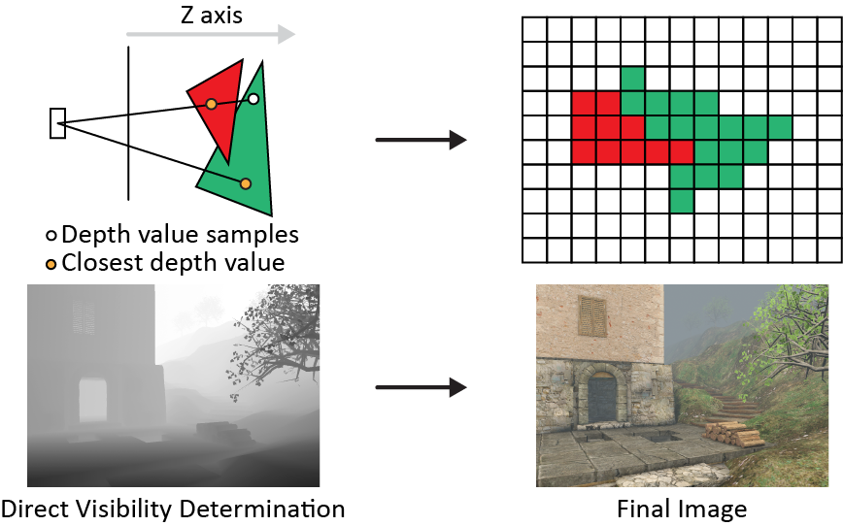
Rasterisation - Direct Visibility Determination
Part 1.2 Fundamentals
Z-buffer [Cat74]
Trivial, implemented in hardware
Stores nearest visible geometry to camera
i.e. a single layer of information
Good choice for direct visibility techniques
Notes:
The most popular algorithm for primary visibility determination is the Z-buffer which is efficiently implemented in commodity graphics hardware.
After processing all fragments, the Z-buffer stores the nearest visible fragment with respect to the camera location. In other words, it stores a single layer of information.
As such, it has widely used and is an excellent choice for a vast number of real-time techniques that work on direct visibility information.
Such algorithms work pretty well in general, however, applications that require samples from hidden (occluded or back-faced) surfaces cannot be properly implemented by relying only on the depth buffer.

Slide 17
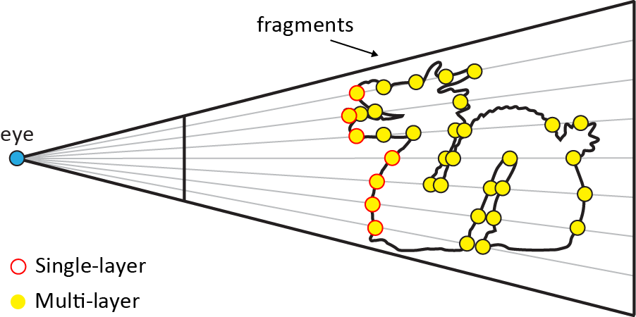
Generalisation
Part 1.2 Fundamentals
MFR: stores multiple per-pixel fragments
Primary visibility: stores one per-pixel fragment
subset of MFR
MFR Application
Construction
Operation
Store
Sort
Image Composition
Notes:
With this information in mind, we can define and generalise this problem as part of multifragment rendering, which is responsible for processing, storing and operating on multiple per-pixel fragments.
In that sense, primary visibility determination is a subset of MFR, in the sense that it processes multiple per-pixel fragments but stores and operates on the closest one, while MFR processes, stores and operates on an arbitrary number of fragments.
At a conceptual level, the MFR pipeline is responsible for generating, storing, processing and evaluating information from incoming fragments.
This pipeline is comprised of three main steps: construction, operation and image composition, which are defined by the context of the particular application in mind.

Slide 18
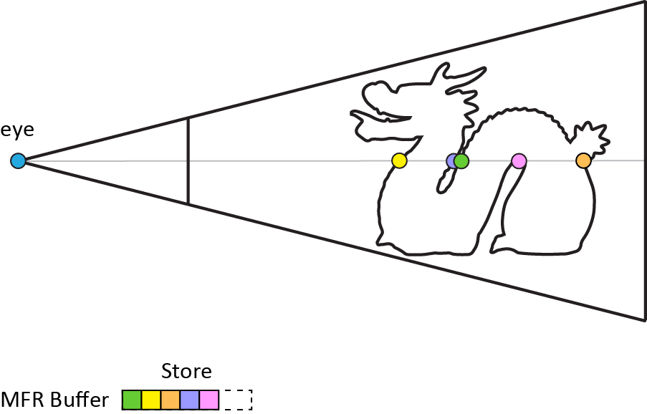
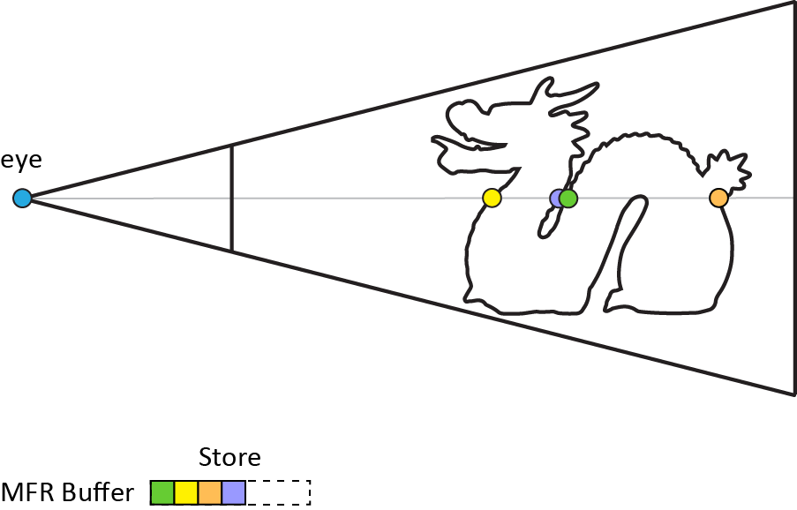
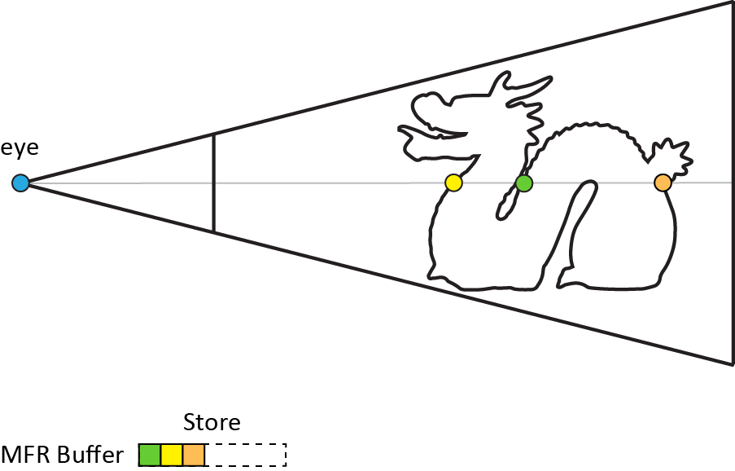
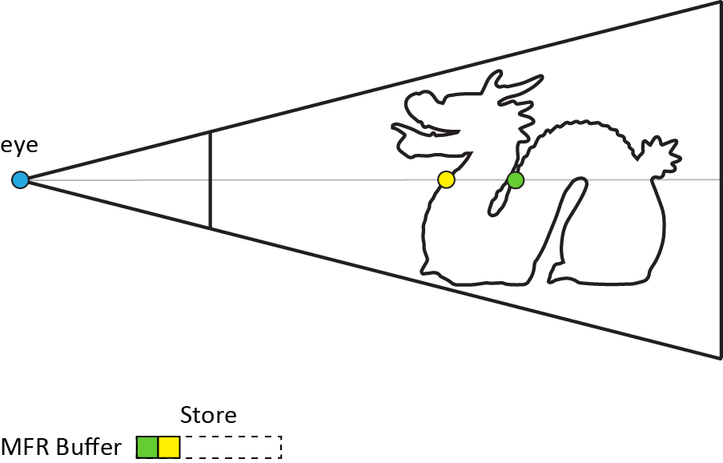
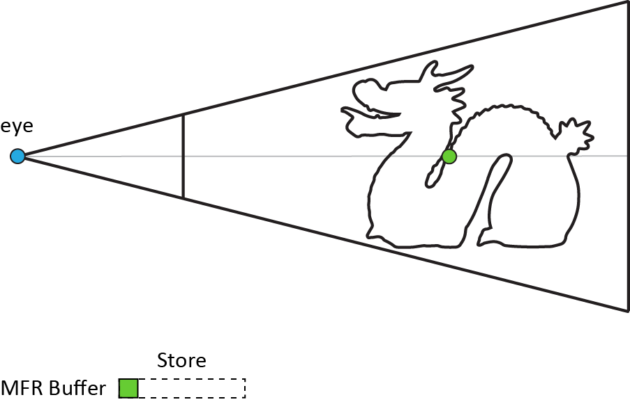
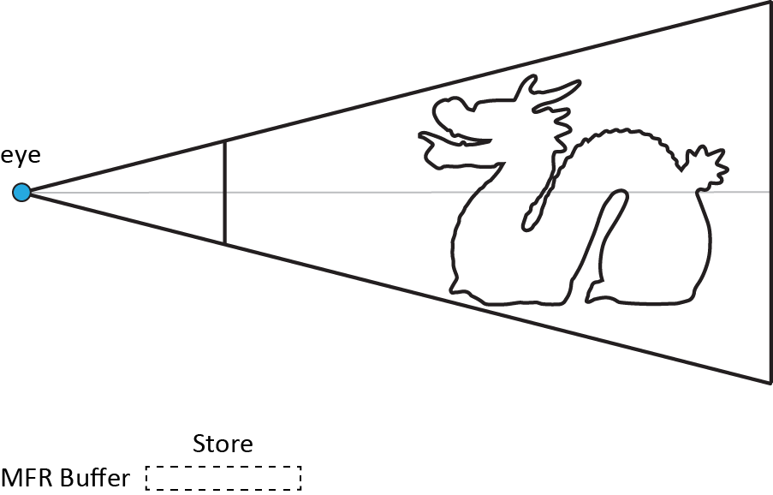
Generalisation - Construction
Part 1.2 Fundamentals
Executed in iterations
Each iteration has one or more geometry passes
In each geometry pass, a fragment subset is stored
MFR Application
Construction
Operation
Store
Sort
Image Composition
Notes:
The construction step is responsible for generating and storing per-pixel fragments through a common rasterisation procedure, which is repeated according to a fixed number of iterations.
Each iteration is executed in one or more geometry rendering passes.
(press LEFT CLICK for animation to start)
In every geometry pass, a fragment subset associated with a specific pixel is selected and eventually stored.

Slide 19
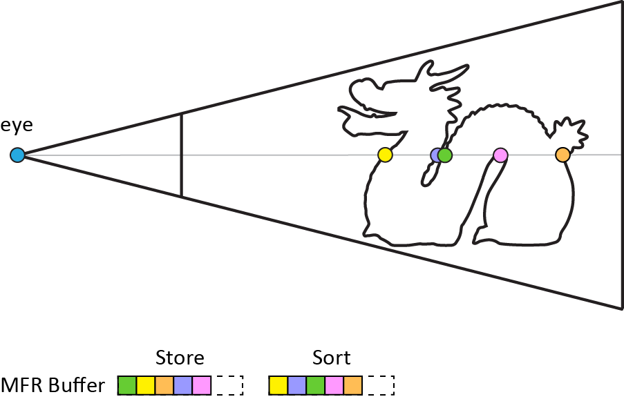
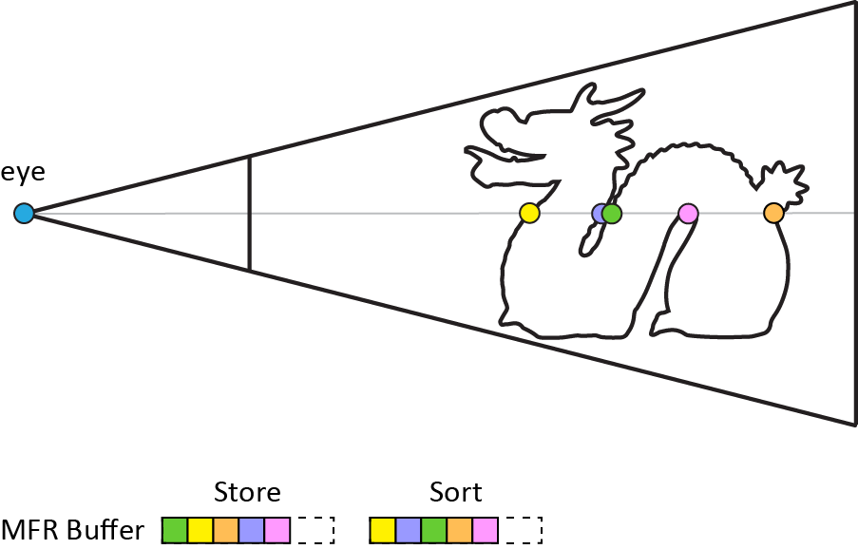
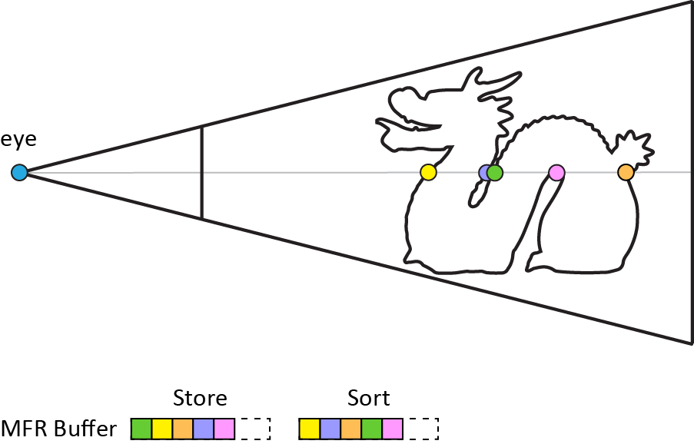
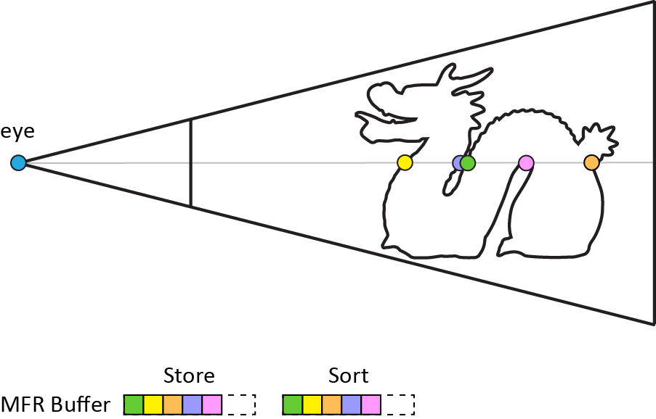
Generalisation - Construction
Part 1.2 Fundamentals
Executed in iterations
Each iteration has one or more geometry passes
In each geometry pass, a fragment subset is stored and sorted
MFR Application
Construction
Operation
Store
Sort
Image Composition
Notes:
Even though storing and sorting are two fundamental building blocks of the construction step, the latter stage is implicitly or explicitly performed.
Concerning implementation, it can be applied either as post-processing step (press LEFT CLICK for animation to start)
or as an online algorithm, i.e. reordering fragments as they arrive.

Slide 20
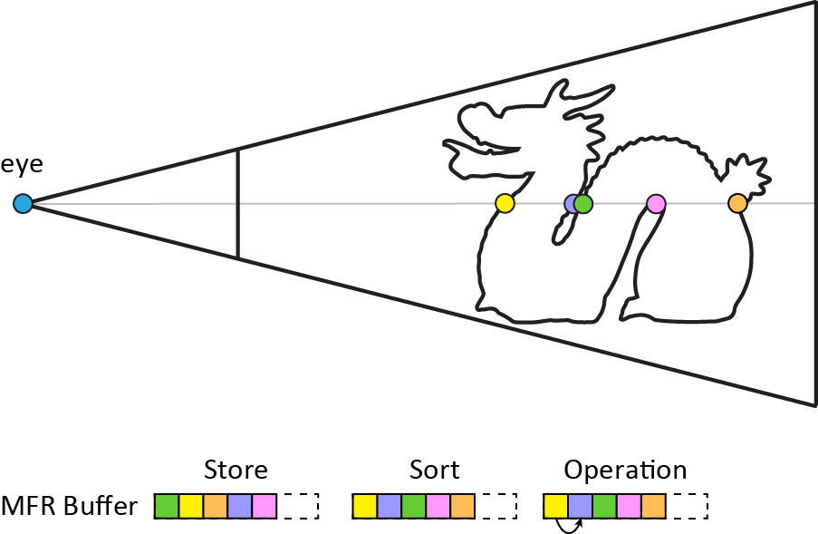
Generalisation - Operation
Part 1.2 Fundamentals
Next, one or more operations are performed on the ordered fragment set
Example: fragment traversal followed by mipmapping, compression, etc.
MFR Application
Construction
Operation
Store
Sort
Image Composition
Notes:
After construction has taken place, the next step performs one or more operations on the ordered fragment data structure.
The most critical operation here is fragment data traversal (press LEFT CLICK for animation to start),
followed by other optional, but more advanced ones, such as mipmapping, compression, etc.

Slide 21
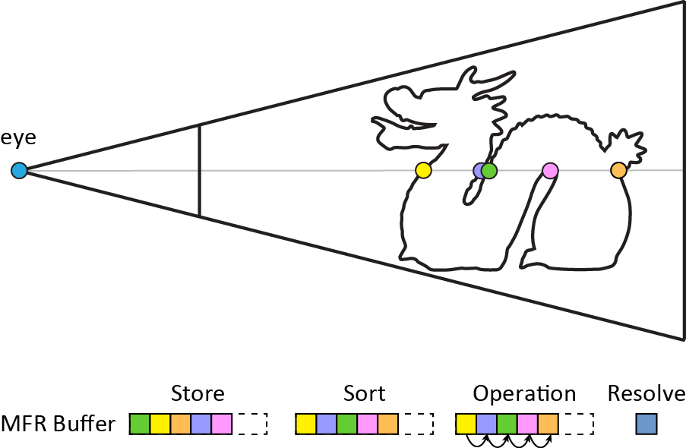
Generalisation - Image Composition
Part 1.2 Fundamentals
Finally, the final image is composed
Example application: transparency operates on the sorted fragment list, e.g. via blending
MFR Application
Construction
Operation
Store
Sort
Image Composition
Notes:
The final part, the image composition, accesses and exploits the fragment information stored in the MFR structure to compose the final output.

Slide 22
Classification
Part 2.1 Construction
Classified into three groups based on the maximum number of per-pixel fragments captured in one iteration of each method
Construction
Depth Peeling
k-buffer
A-buffer
Notes:
Let’s move into more detail for each part of the pipeline.
Construction is the first stage here.
Without loss of generality, the multifragment buffer construction techniques can be classified according to the maximum number of fragment samples per-pixel captured by each method in a single algorithm iteration, in three broad categories: depth-peeling, k-buffer and A-buffer methods.

Slide 23
Classification
Part 2.1 Construction
Classified into three groups based on the maximum number of per-pixel fragments captured in one iteration of each method
Construction
Depth Peeling
k-buffer
A-buffer
# fragments
iterative
post-sorting
1 or 2
yes
no
Notes:
First and foremost, depth-peeling methods process all fragment information through an iterative rendering pipeline using few and bounded memory resources.
Depending on the algorithm, each iteration carries out one geometry pass, to extract a limited fragment batch (up to two fragments) with guaranteed depth order.
Here, sorting happens implicitly in each iteration.

Slide 24
Classification
Part 2.1 Construction
Classified into three groups based on the maximum number of per-pixel fragments captured in one iteration of each method
Construction
Depth Peeling
k-buffer
A-buffer
# fragments
iterative
post-sorting
1 or 2
yes
no
all
no
yes
Notes:
On the other side, A-buffer methods aim at capturing all fragments per pixel in a single iteration step.
Typically, fragments are stored into GPU-accelerated data structures during a single geometry rendering pass, followed by a sorting process that reorders them according to their depth.

Slide 25
Classification
Part 2.1 Construction
Classified into three groups based on the maximum number of per-pixel fragments captured in one iteration of each method
Construction
Depth Peeling
k-buffer
A-buffer
# fragments
iterative
post-sorting
1 or 2
yes
no
k ∊ (1, all)
yes
yes
all
no
yes
Notes:
Finally, k-buffer approaches offer a middle ground between the depth peeling and A-buffer methods (by efficiently combining the best features of both pipelines).
In general, k-buffer approaches are capable of capturing the k-best fragments in each iteration. In most common cases,k-best is the k-nearest fragments to the viewer. Without loss of generality, the k-best fragments in a pixel are defined as the k-subset of the per-pixel fragment set that minimise the value of a specific cost function.
Using a k-buffer requires fewer iterations, when compared to the traditional depth-peeling in order to capture all generated fragments.

Slide 26
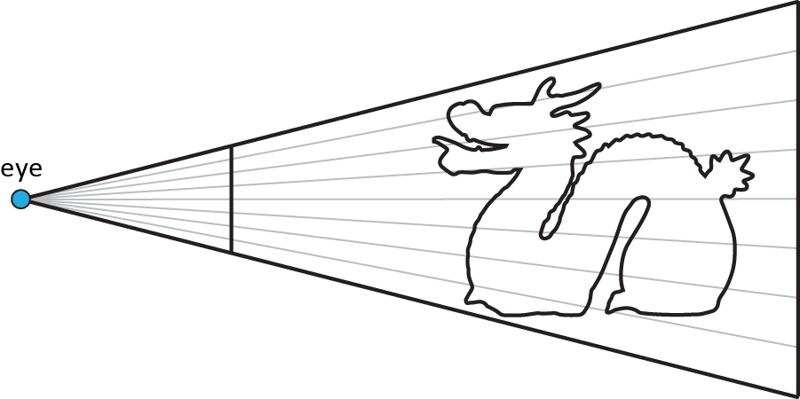
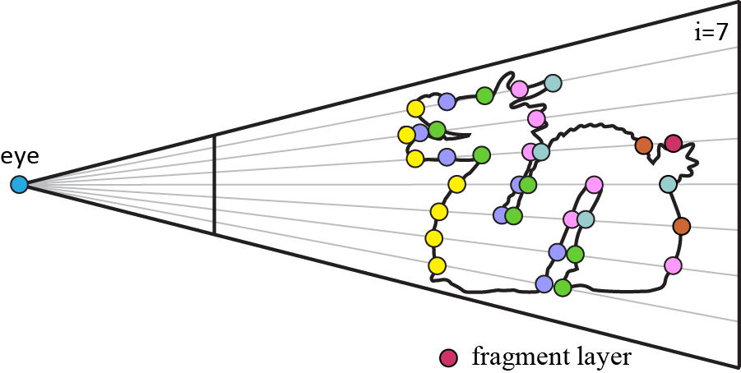
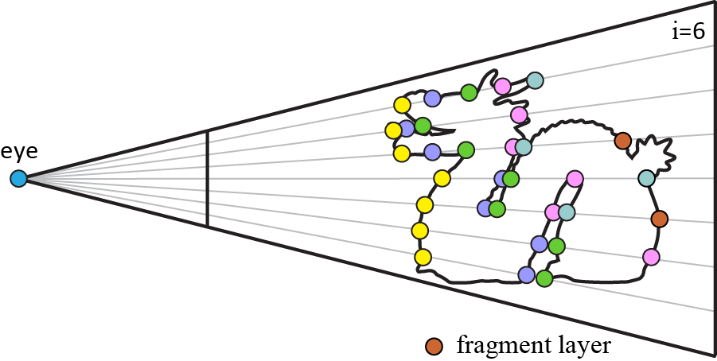
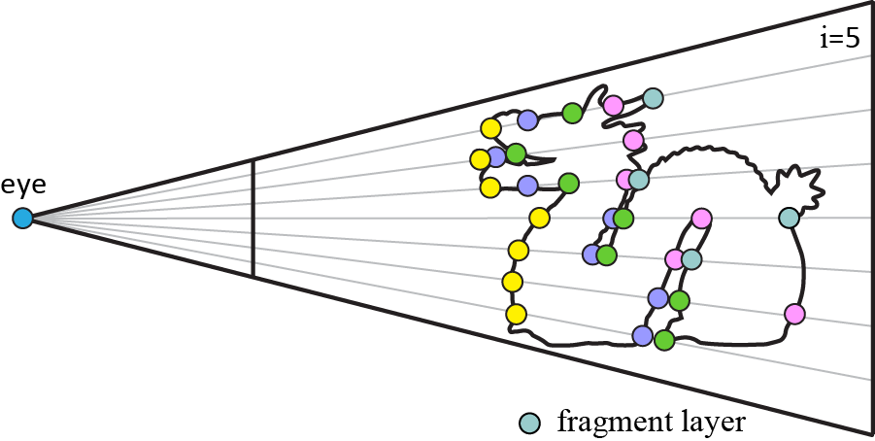
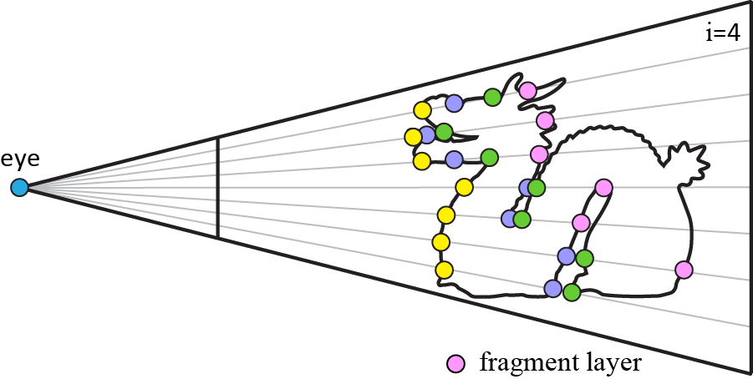
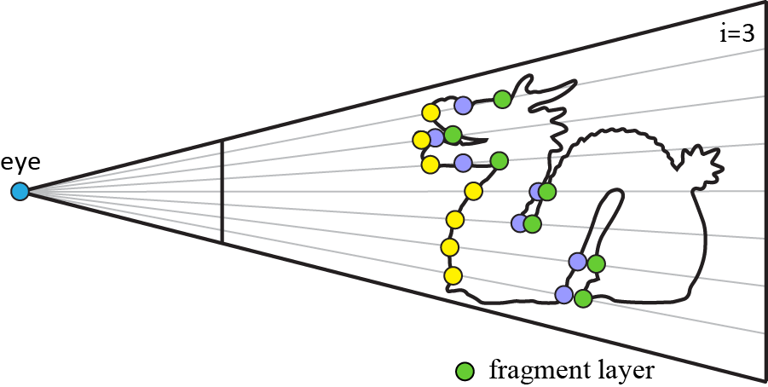
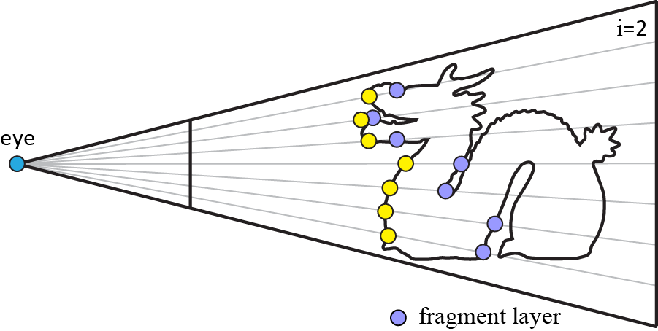
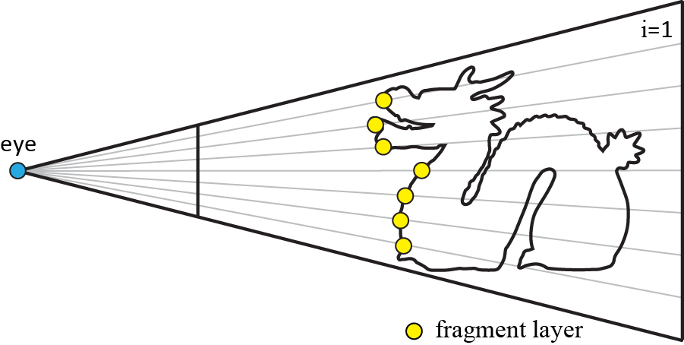
Depth Peeling
Part 2.1 Construction
Front-to-back depth peeling [Eve01]
Algorithm
Num fragments | 1
Max iterations | N
Post-sorting | No
Notes:
Probably the most well-known iterative MFR technique is the front-to-back depth peeling.
F2B DP works by rendering the geometry multiple times and extracting a single fragment layer per iteration, in ascending depth order.
Specifically, the algorithm renders initially the scene and writing to the depth buffer the closest fragment to the camera.
(press LEFT CLICK for animation to start),
Then, it proceeds in an iterative fashion where at each iteration the next closest fragment to the camera is recorded.
The process stops when the maximum number of iterations, set by the user, is reached or if no more fragments are generated.

Slide 27
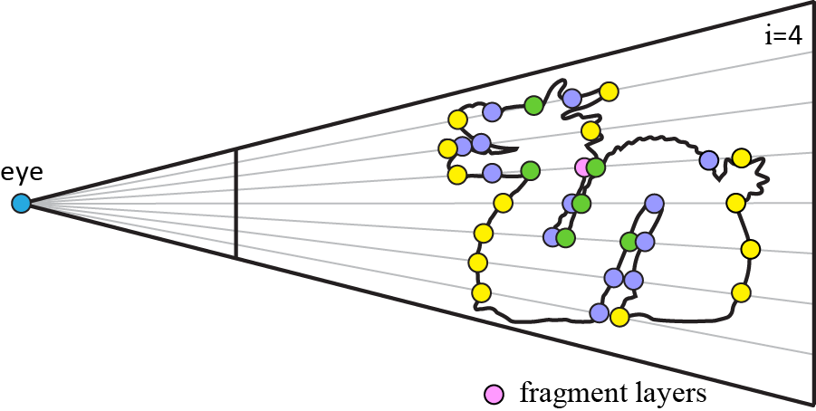
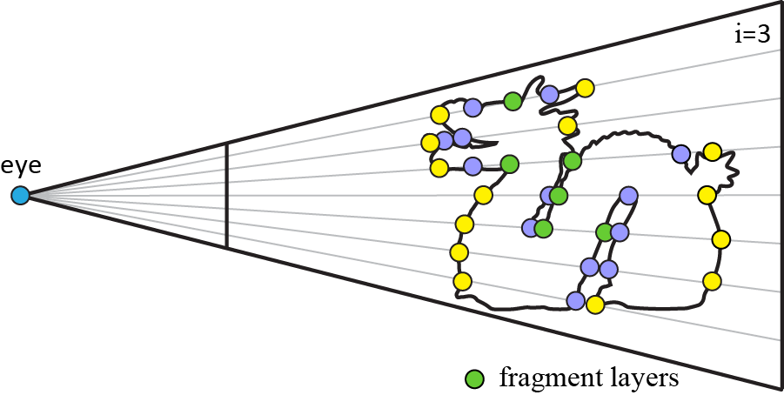
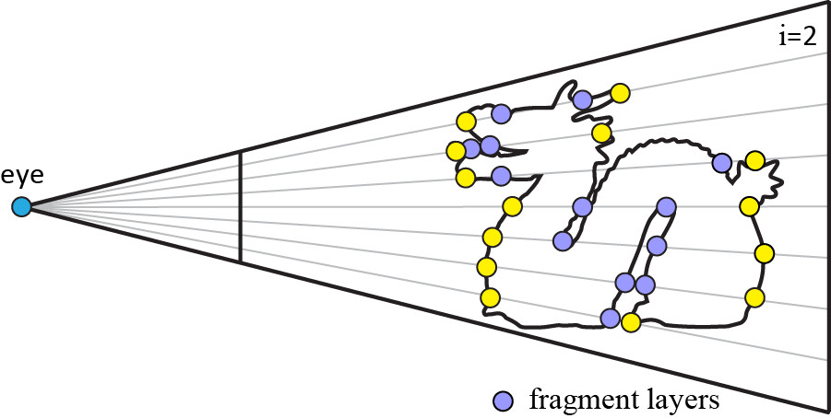
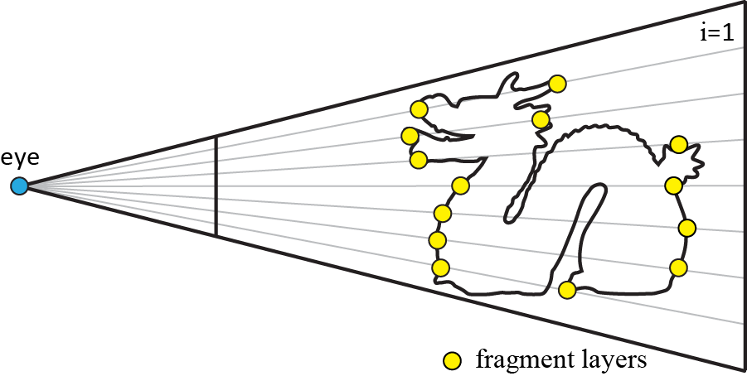
Depth Peeling
Part 2.1 Construction
Front-to-back depth peeling [Eve01]
Dual depth peeling [BMB08]
Algorithm
Num fragments | 2
Max iterations | N/2
Post-sorting | No
Notes:
Next, the dual depth peeling speeds up the rendering process, by bidirectionally capturing both the nearest and furthest fragments in each iteration, thus dropping the complexity to half.
(press LEFT CLICK for animation to start)
The idea here, is to apply the previous depth peeling method for the front-to-back and the back-to-front directions simultaneously.

Slide 28
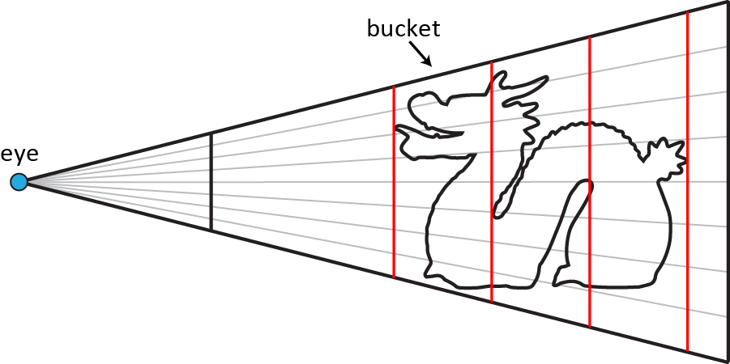
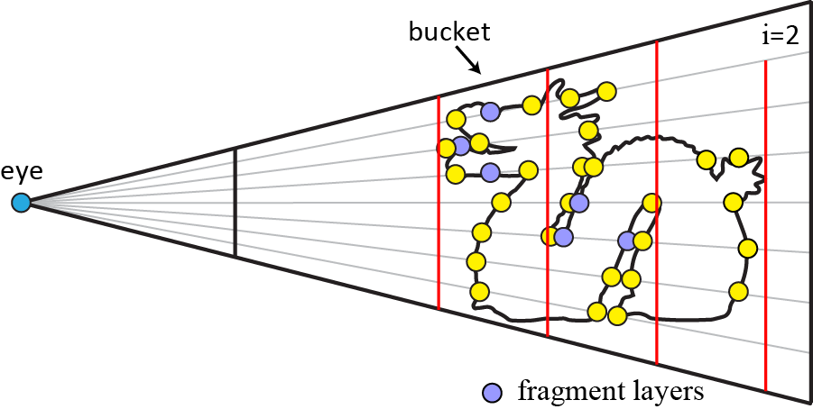
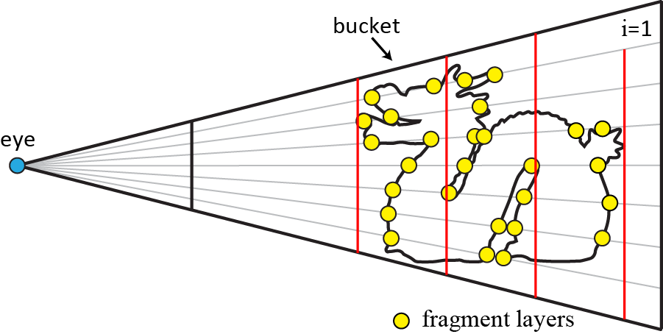
Depth Peeling
Part 2.1 Construction
Front-to-back depth peeling [Eve01]
Dual depth peeling [BMB08]
Uniform bucket depth peeling [LHLW09]
Algorithm
Num fragments | 2 per depth bin
Max iterations | < N/2
Post-sorting | No
Notes:
The dual depth peeling method was later augmented to extract two fragments per uniform depth bin in each iteration, thus reducing further the necessary iterations.
(press LEFT CLICK for animation to start)
Each depth bin corresponds to a uniformly divided interval of the pixel depth range.

Slide 29
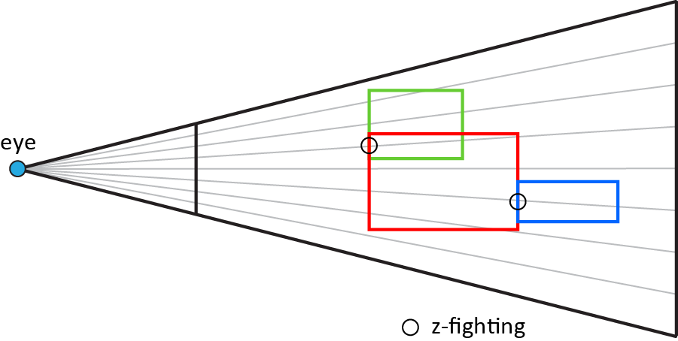
Depth Peeling
Part 2.1 Construction
Front-to-back depth peeling [Eve01]
Dual depth peeling [BMB08]
Uniform bucket depth peeling [LHLW09]
Z-fighting aware depth peeling [VF13]
Algorithm
Notes:
In general, depth peeling methods are susceptible to z-fighting artefacts, as in the z-buffer, when two or more generated fragments in the same pixel have identical depth values.
The authors here, proposed a number of solutions that mitigate the depth coplanarity issues that were present in the previous depth peeling methods.

Slide 30
Depth Peeling
Part 2.1 Construction
Advantages
Low and constant memory
Sorted fragment set
Portability
Ease of implementation
Notes:
In general, the main advantages of depth peeling methods are that they:
- allocate constant memory,
- do not need post-sorting (as it is handled implicitly)
- they support older hardware, offering increasing portability and ease of implementation in diverse architectures.

Slide 31
Depth Peeling
Part 2.1 Construction
Advantages
Low and constant memory
Sorted fragment set
Portability
Ease of implementation
Disadvantages
Low performance due to its multipass behavior
Not suitable for complex operations
Except, ordered fragment processing (e.g. transparency, CSG rendering)
Notes:
In general, the main advantages of depth peeling methods are that they:
- allocate constant memory,
- do not need post-sorting (as it is handled implicitly)
- they support older hardware, offering increasing portability and ease of implementation in diverse architectures.
Their downside is that they can become very computationally expensive due to the overhead imposed on the geometry processing stage for a large number of iteration steps.
Moreover, it is only suitable for applications that rely on sequential fragment processing, such as transparency.

Slide 32
Depth Peeling
Part 2.1 Construction
Advantages
Low and constant memory
Sorted fragment set
Portability
Ease of implementation
Disadvantages
Low performance due to its multipass behavior
Not suitable for complex operations
Except, ordered fragment processing (e.g. transparency, CSG rendering)
In practice
Still in use (mainly the front-to-back algorithm)
Preferable when small number of (nearest) fragments is enough
Notes:
In general, the main advantages of depth peeling methods are that they:
- allocate constant memory,
- do not need post-sorting (as it is handled implicitly)
- they support older hardware, offering increasing portability and ease of implementation in diverse architectures.
Their downside is that they can become very computationally expensive due to the overhead imposed on the geometry processing stage for a large number of iteration steps.
Moreover, it is only suitable for applications that rely on sequential fragment processing, such as transparency.
Nevertheless, depth-peeling algorithms are still used nowadays and is the optimal choice when sufficient visual quality can be achieved by processing a small number of fragments.

Slide 33
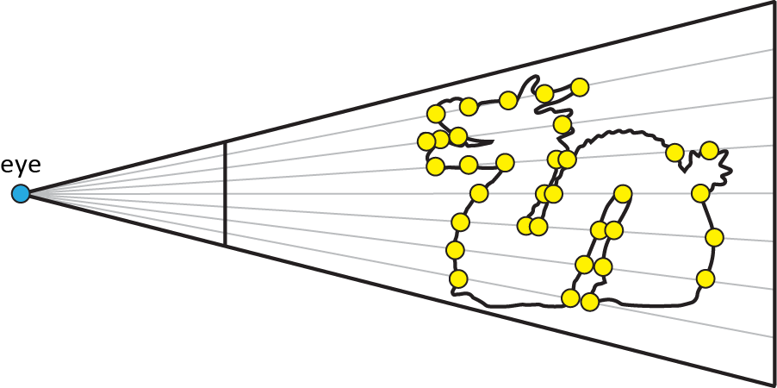
A-buffer
Part 2.1 Construction
Store stage
Geometry pass
Captures all fragments (unordered)
Sort stage
Screen-space pass
Reorders fragments based on depth
Num fragments | all
Max iterations | 1
Post-sorting | Yes
Notes:
Now let’s move to the A-buffer.
Conceptually, the construction of an A-buffer data structure requires two stages:
(i) a store operation, where all fragments are captured in the form of an unsorted sequence, and
(ii) a sorting one, where fragments are sorted according to their depth.

Slide 34
A-buffer
Part 2.1 Construction
Store stage
Geometry pass
Captures all fragments (unordered)
Sort stage
Screen-space pass
Reorders fragments based on depth
Three approaches:
Linked-lists
Fixed-size arrays
Variable-size arrays
Num fragments | all
Max iterations | 1
Post-sorting | Yes
Notes:
Now let’s move to the A-buffer.
Conceptually, the construction of an A-buffer data structure requires two stages:
(i) a store operation, where all fragments are captured in the form of an unsorted sequence, and
(ii) a sorting one, where fragments are sorted according to their depth.
There are three major categories related to the A-buffer construction which will be discussed next. This will be followed by another discussion on the sorting procedure.

Slide 35
A-buffer - Store Stage
Part 2.1 Construction
Linked Lists [Car84,YHGT10]
Algorithm
Notes:
Historically, the first MFR approach was the linked-list A-buffer, where the main idea was to store all generated fragments in linked lists instead of keeping only the closest visible fragment.
The GPU implementation requires two buffers that operate on per-pixel linked lists. A head buffer that contains the heads to each list and a node buffer, that stores their data and connectivity information.
Since the lists are created in parallel, the use of atomic operations are applied to ensure correct modification of shared data.
(press LEFT CLICK for animation to start)

Slide 36
A-buffer - Store Stage
Part 2.1 Construction
Linked Lists [Car84,YHGT10]
Limitations
Manual memory preallocation -> wasted space / memory overflow
Notes:
Historically, the first MFR approach was the linked-list A-buffer, where the main idea was to store all generated fragments in linked lists instead of keeping only the closest visible fragment.
The GPU implementation requires two buffers that operate on per-pixel linked lists. A head buffer that contains the heads to each list and a node buffer, that stores their data and connectivity information.
Since the lists are created in parallel, the use of atomic operations are applied to ensure correct modification of shared data.
However, it suffers from two limitations. First, it requires a memory preallocation operation to reserve the memory space needed, since dynamic memory allocation for new nodes is not possible within a shader.
This is decided manually and can result either in wasted space or memory overflow; the latter manifests as flickering.

Slide 37
A-buffer - Store Stage
Part 2.1 Construction
Linked Lists [Car84,YHGT10]
Limitations
Manual memory preallocation -> wasted space / memory overflow
Random memory access -> cache misses
Notes:
Historically, the first MFR approach was the linked-list A-buffer, where the main idea was to store all generated fragments in linked lists instead of keeping only the closest visible fragment.
The GPU implementation requires two buffers that operate on per-pixel linked lists. A head buffer that contains the heads to each list and a node buffer, that stores their data and connectivity information.
Since the lists are created in parallel, the use of atomic operations are applied to ensure correct modification of shared data.
However, it suffers from two limitations. First, it requires a memory preallocation operation to reserve the memory space needed, since dynamic memory allocation for new nodes is not possible within a shader.
This is decided manually and can result either in wasted space or memory overflow; the latter manifests as flickering.
Second, the non-contiguous allocation patterns of the linked list result in memory indirections and cache misses and can, as a result, cause performance degradation.

Slide 38
A-buffer - Store Stage
Part 2.1 Construction
Linked Lists [Car84,YHGT10]
Variations
Per-pixel memory paging [Cra10a]
Double-linked lists [FMS13,VVP16a]
Tiling [Thi11,TSdSK13]
Notes:
The research community has since focused on ways to alleviate these limitations.
These include
Improved cache coherency by memory paging.
Bidirectional traversal using double-linked lists.
Mitigate memory overflow issues by exploiting tiling mechanisms.

Slide 39
A-buffer - Store Stage
Part 2.1 Construction
Fixed Arrays [LHLW10,Cra10b]
Algorithm
Notes:
A simpler approach allows the storage of all fragments in fixed-size per-pixel arrays. These are usually implemented with the assistance of an additional count buffer.
Compared to a linked list, the need to maintain node pointers is removed and fragments are stored in contiguous memory locations, resulting at improved cache coherence and much faster speeds.
(press LEFT CLICK for animation to start)

Slide 40
A-buffer - Store Stage
Part 2.1 Construction
Fixed Arrays [LHLW10,Cra10b]
Limitations
Huge allocated memory being unused
Notes:
A simpler approach allows the storage of all fragments in fixed-size per-pixel arrays. These are usually implemented with the assistance of an additional count buffer.
Compared to a linked list, the need to maintain node pointers is removed and fragments are stored in contiguous memory locations, resulting at improved cache coherence and much faster speeds.
On the downside, scenes with uneven fragment distribution can cause large blocks of memory space to be wasted, as the size of each array is fixed for all pixels.

Slide 41
A-buffer - Store Stage
Part 2.1 Construction
Variable Arrays [VF12,KLZ12,MCTB14]
Algorithm
Notes:
Finally, variable-size arrays attempt to combine the advantages of fixed-size arrays and linked-list structures.
Essentially, they aim to store information in contiguous regions without over-allocating memory space.
Typically, they require two additional passes before the storing stage.
one geometry pass for counting the exact number of fragments needed which enables us to allocate the exact amount of memory that we shall need and
(press LEFT CLICK for animation to start)
b) a screen-space pass, counting the per-pixel head pointers through a prefix sum operation.
(press LEFT CLICK for animation to start)
c) This is followed by the actual geometry pass which fills the array using the information stored in the head buffer
(press LEFT CLICK for animation to start)

Slide 42
A-buffer - Store Stage
Part 2.1 Construction
Variable Arrays [VF12,KLZ12,MCTB14]
Limitations
Increased complexity
Additional geometry pass
Notes:
Finally, variable-size arrays attempt to combine the advantages of fixed-size arrays and linked-list structures.
Essentially, they aim to store information in contiguous regions without over-allocating memory space.
Typically, they require two additional passes before the storing stage.
one geometry pass for counting the exact number of fragments needed which enables us to allocate the exact amount of memory that we shall need and
b) a screen-space pass, counting the per-pixel head pointers through a prefix sum operation.
c) This is followed by the actual geometry pass which fills the array using the information stored in the head buffer
On the downside, they are more complex to implement and can be less efficient on scenes with high geometric complexity due to the extra geometry pass required for counting the fragments

Slide 43
A-buffer - Store Stage
Part 2.1 Construction
No optimal solution
Notes:
To sum up, the various A-buffer alternatives that exist in the literature cover a broad range of characteristics and, therefore, there is no optimal solution but rather a more suitable match for each application’s requirements.

Slide 44
A-buffer - Store Stage
Part 2.1 Construction
No optimal solution
In practice
Fixed Arrays
Fastest + simple implementation
Huge wasted memory
Suitable for scenes with uniform depth complexity
Notes:
To sum up, the various A-buffer alternatives that exist in the literature cover a broad range of characteristics and, therefore, there is no optimal solution but rather a more suitable match for each application’s requirements.
Fixed-size arrays are the simplest to implement and most efficient in practice but waste a significant amount of memory, which remains unused. So they should be employed on scenes with uniform fragment distribution, or applications where memory is not an actual issue.

Slide 45
A-buffer - Store Stage
Part 2.1 Construction
No optimal solution
In practice
Fixed Arrays
Fastest + simple implementation
Huge wasted memory
Suitable for scenes with uniform depth complexity
Linked Lists
Application-constrained memory
Low cache utilization
Suitable for scenes with high geometry complexity
Notes:
To sum up, the various A-buffer alternatives that exist in the literature cover a broad range of characteristics and, therefore, there is no optimal solution but rather a more suitable match for each application’s requirements.
Fixed-size arrays are the simplest to implement and most efficient in practice but waste a significant amount of memory, which remains unused. So they should be employed on scenes with uniform fragment distribution, or applications where memory is not an actual issue.
Traditional linked lists can accommodate more complex environments at the same memory budget, by trading tighter memory allocation with less efficient cache utilisation.

Slide 46
A-buffer - Store Stage
Part 2.1 Construction
No optimal solution
In practice
Fixed Arrays
Fastest + simple implementation
Huge wasted memory
Suitable for scenes with uniform depth complexity
Linked Lists
Application-constrained memory
Low cache utilization
Suitable for scenes with high geometry complexity
Variable Arrays
Two geometry passes
Tight memory budget
Suitable for scenes with medium geometry complexity
Notes:
To sum up, the various A-buffer alternatives that exist in the literature cover a broad range of characteristics and, therefore, there is no optimal solution but rather a more suitable match for each application’s requirements.
Fixed-size arrays are the simplest to implement and most efficient in practice but waste a significant amount of memory, which remains unused. So they should be employed on scenes with uniform fragment distribution, or applications where memory is not an actual issue.
Traditional linked lists can accommodate more complex environments at the same memory budget, by trading tighter memory allocation with less efficient cache utilisation.
Finally, variable-size arrays are the most elegant, and are preferred for applications with tighter memory budget. Due to the extra geometry pass, they are not the optimal choice for environments with medium geometric complexity.

Slide 47
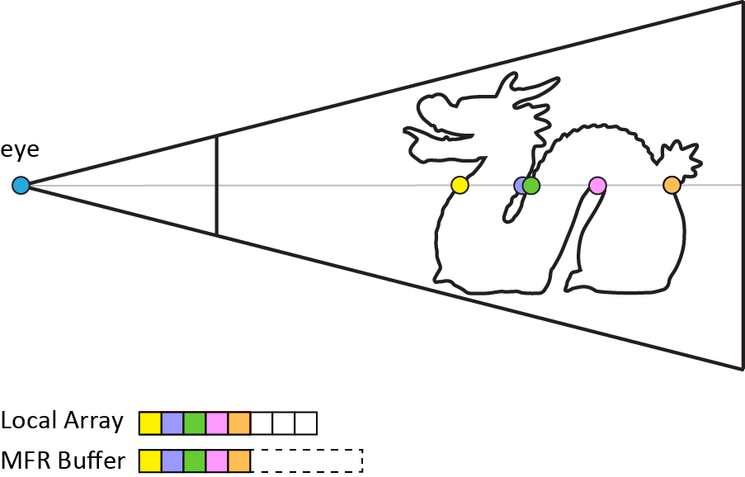
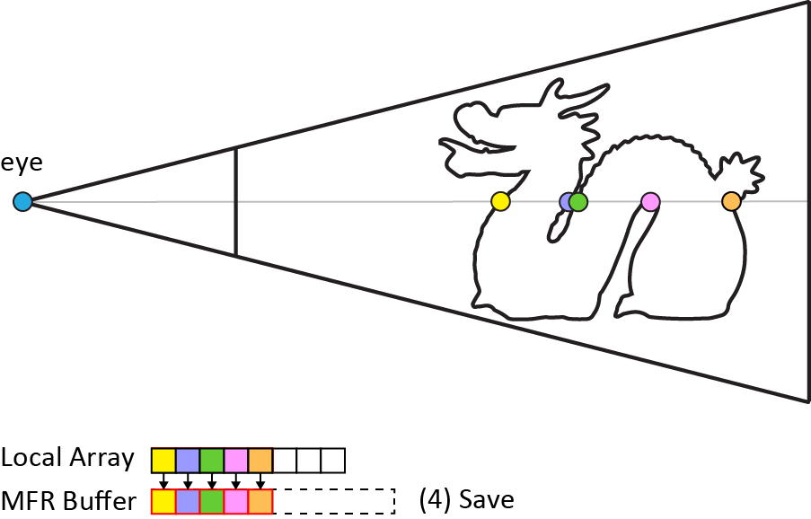
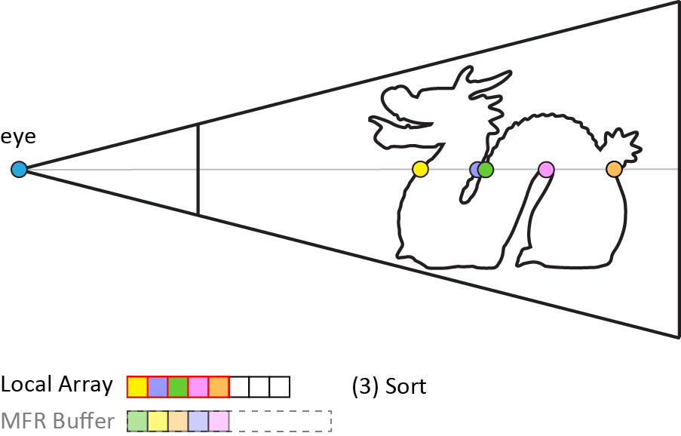
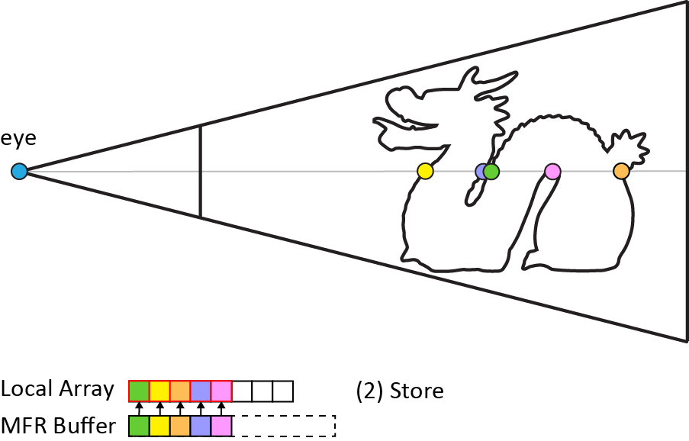
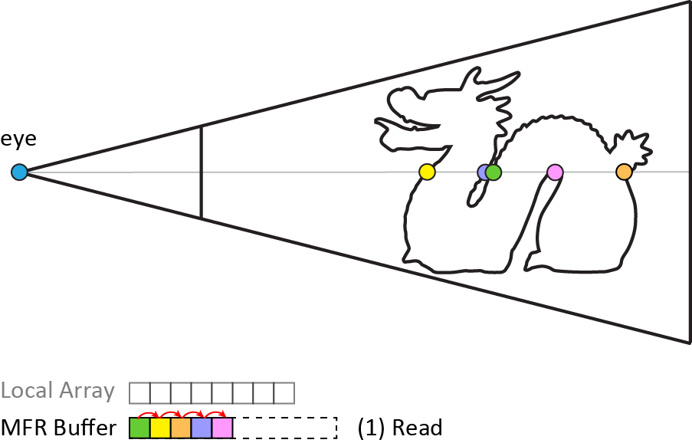
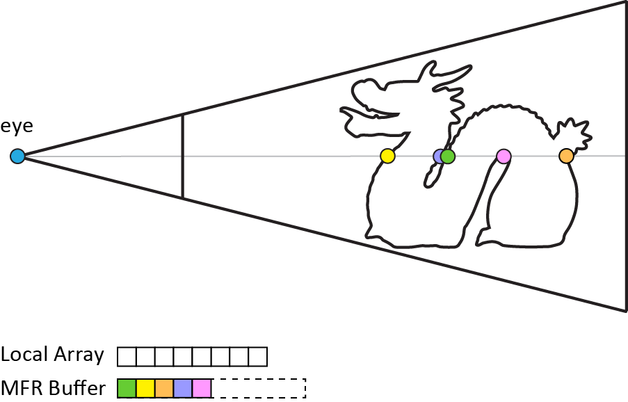
A-buffer - Sort Stage
Part 2.1 Construction
Screen-space pass -> per-pixel fragment sorting by depth
Process into 4 steps:
(1) Read from Global, (2) Store to Local, (3) Sort in Local, (4) Save to Global
Notes:
After all fragments have been stored to the A-buffer, they are sorted by depth in a subsequent screen-space pass.
Conventionally, this process is parallelised across pixels, but serialised along the individual depth fragments.
The process can be divided into four main consecutive steps:
the depth values of the captured fragments are fetched from the global memory,
(press LEFT CLICK for animation to start)
b) the data is stored onto a per-pixel local structure,
(press LEFT CLICK for animation to start)
c) the local now data is sorted based on depth,
(press LEFT CLICK for animation to start)
and finally save the sorted data is stored back into the global memory.

Slide 48
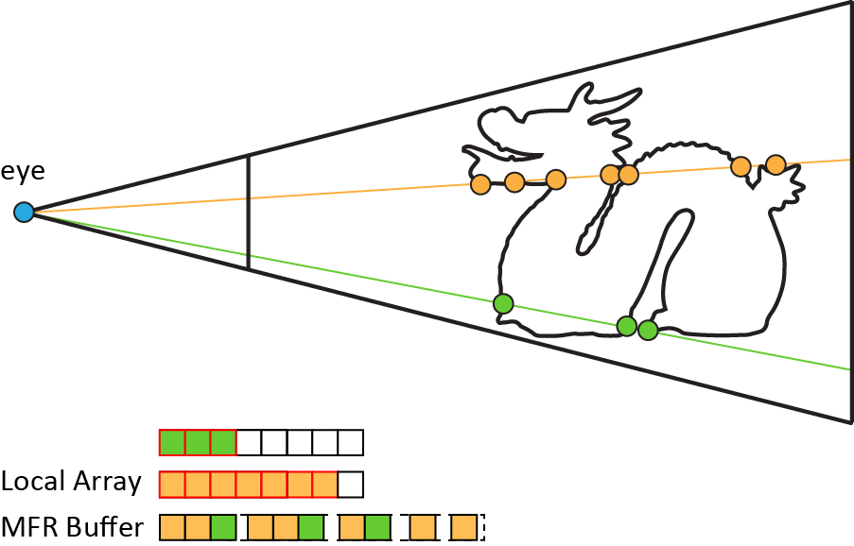
A-buffer - Sort Stage
Part 2.1 Construction
Irregular fragment generation leads to performance bottlenecks due to
Poor coalescing of global memory (in lists) during Read/Save stages (1,4)
Bad local memory utilisation during Store stage (2)
Thread divergence during Sort stage (3)
Thread 1
Thread 2
Notes:
Irregular fragment generation leads to several performance bottlenecks.
a) Poor coalescing of global memory manifesting mainly at LL structures (left)
b) Bad local memory utilisation during the store stage, as neighbouring threads contain different lengths in their fragment lists (right)
c) Thread divergence during the sorting process, for the same reason as before

Slide 49
A-buffer - Sort Stage
Part 2.1 Construction
Bad local memory utilisation
Pre-alloc different length arrays [KLZ13,LFS*15]
Recycling of small-sized fixed array [LFS*15,VPF15]
Notes:
Two novel approaches to improve the management of local GPU caches.
The first approach performing different screen-space passes, each one sorting fragment lists of different length.
The second idea partitions the depth sorting into batches and iteratively sorts the larger list using a smaller amount of local memory.

Slide 50
A-buffer - Sort Stage
Part 2.1 Construction
Bad local memory utilisation
Pre-alloc different length arrays [KLZ13,LFS*15]
Recycling of small-sized fixed array [LFS*15,VPF15]
Thread divergence
Different sorting algorithm per pixel [KLZ12]
Insertion sort → small lists
Merge sort → large lists
Split depth space into buckets [VF13]
Bin sort
Register-based block sort algorithm [KLZ14,AL18]
Notes:
Two novel approaches to improve the management of local GPU caches.
The first approach performing different screen-space passes, each one sorting fragment lists of different length.
The second idea partitions the depth sorting into batches and iteratively sorts the larger list using a smaller amount of local memory.
Sorting millions of irregular-sized fragment lists in parallel is still a difficult task.
To reduce divergence, researchers altered the sorting algorithm per-pixel, based on the list length, or exploited other sorting algorithms, such as bin sort, or register-based block sort.

Slide 51
A-buffer - Sort Stage
Part 2.1 Construction
Bad local memory utilisation
Pre-alloc different length arrays [KLZ13,LFS*15]
Recycling of small-sized fixed array [LFS*15,VPF15]
Thread divergence
Different sorting algorithm per pixel [KLZ12]
Insertion sort → small lists
Merge sort → large lists
Split depth space into buckets [VF13]
Bin sort
Register-based block sort algorithm [KLZ14,AL18]
In practice
Hybrid solutions
Notes:
Two novel approaches to improve the management of local GPU caches.
The first approach performing different screen-space passes, each one sorting fragment lists of different length.
The second idea partitions the depth sorting into batches and iteratively sorts the larger list using a smaller amount of local memory.
Sorting millions of irregular-sized fragment lists in parallel is still a difficult task.
To reduce divergence, researchers altered the sorting algorithm per-pixel, based on the list length, or exploited other sorting algorithms, such as bin sort, or register-based block sort.
In practice, choosing the appropriate sorting mechanism is application dependent and most specifically, related to the generated fragment distribution.
Modern applications can use a combination of the described methods, for example preallocated length arrays with register-based block sorting.

Slide 52
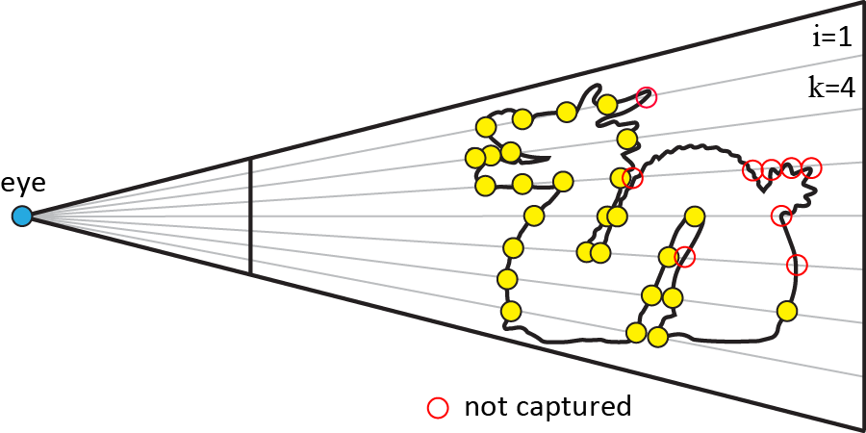
k-buffer
Part 2.1 Construction
Fragment subset per iteration
Less fragments -> tight memory and faster sorting
Practically, only one iteration is used
Num fragments | k ∊ (1, N)
Max iterations | k/N
Post-sorting | Yes
Notes:
The last approach is the k-buffer.
This data structure reduces the computation cost and memory consumption by capturing the k-best subset of all generated fragments, usually the closest to the camera, in a single iteration.
In practical scenarios, where only a specific portion of the fragment pool is enough for plausible results, such as in the case transparency, only a single iteration is usually enough.

Slide 53
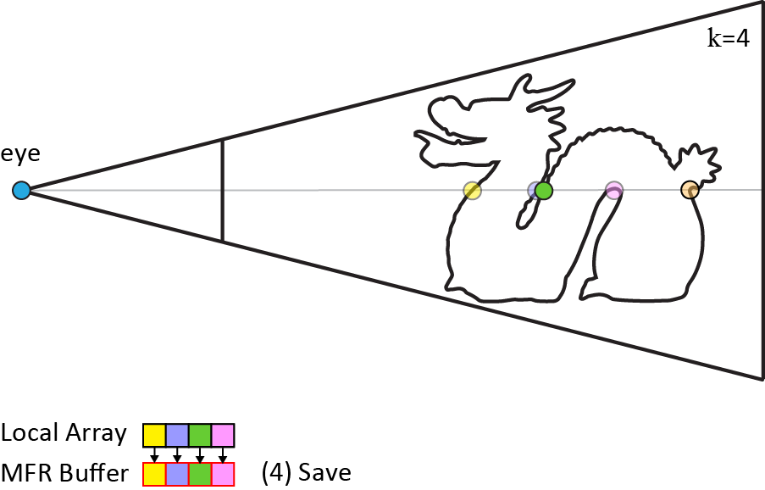
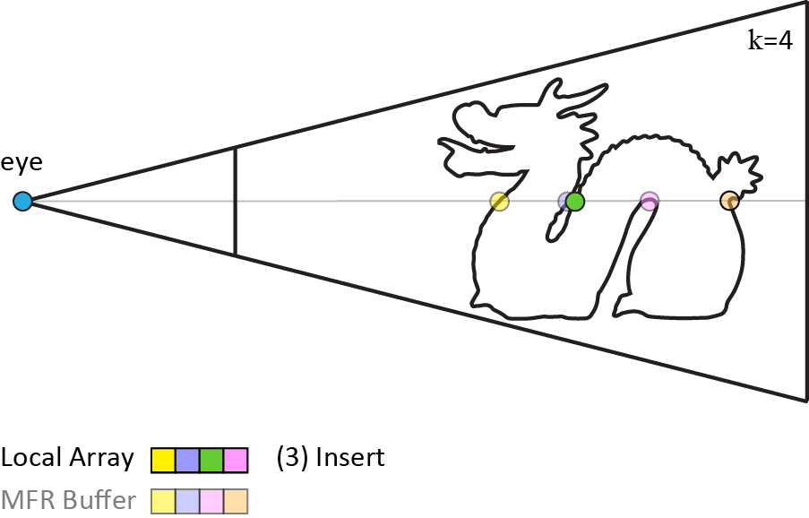
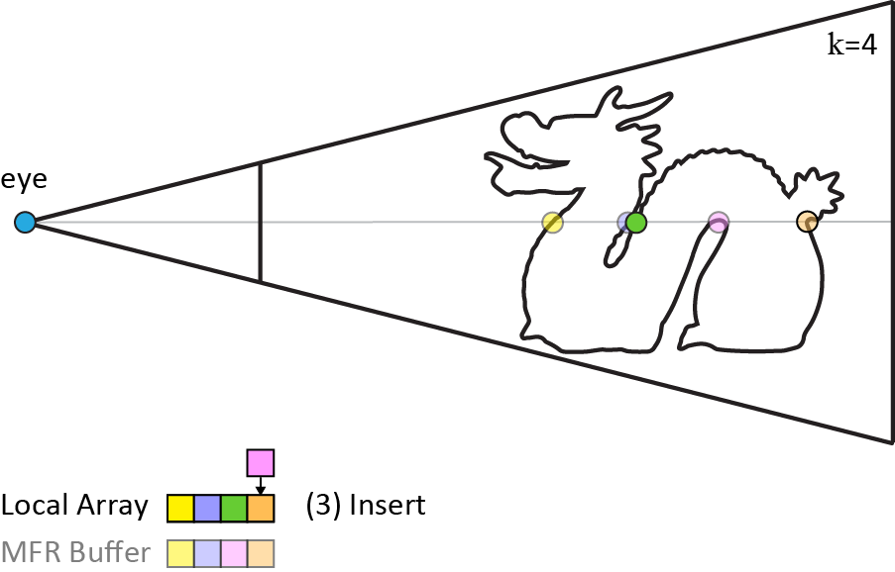
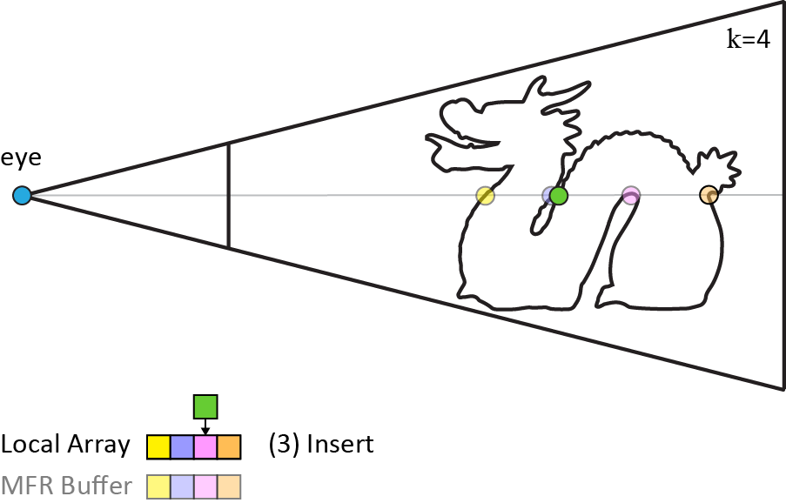
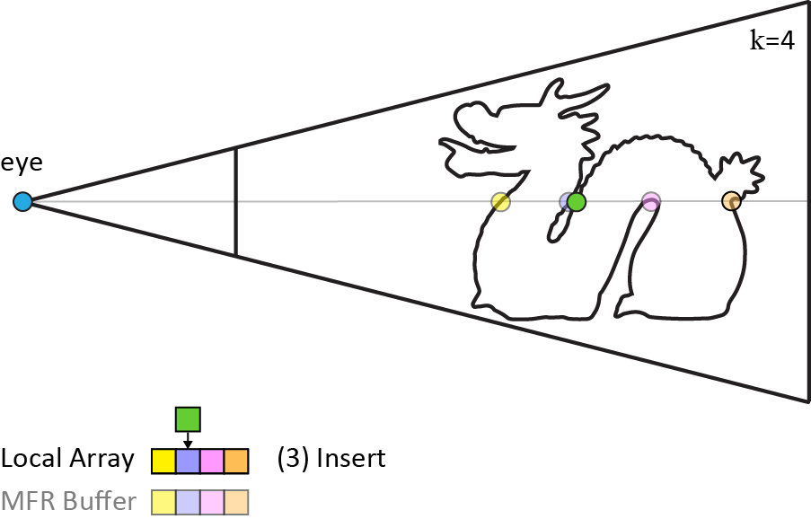
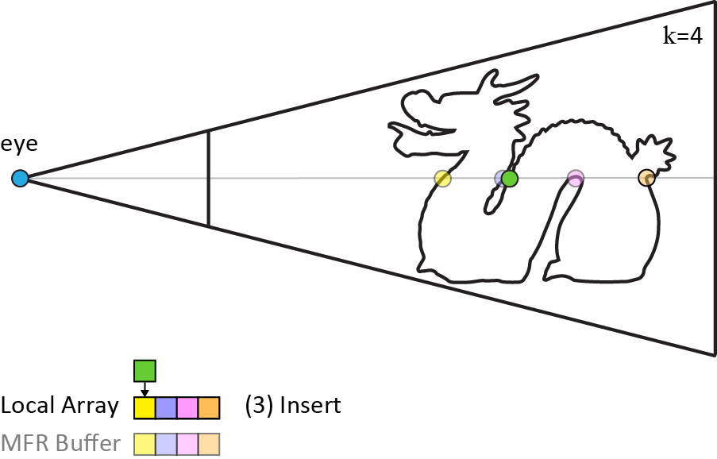
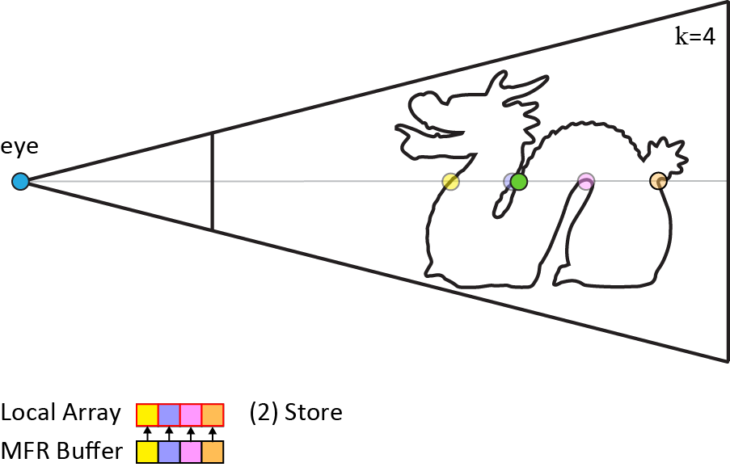
k-buffer
Part 2.1 Construction
Original method [CICS05,BCL*07]
Algorithm
Notes:
In general, the algorithmic structure of any k-buffer variant is as follows.
(press LEFT CLICK for animation to start)
For each incoming fragment,
we initially read the captured elements of k-buffer for each pixel from the global memory
and copy them to the local array.
If this fragment is not important, compared to the existing ones, it can be discarded. Otherwise, the current fragment subset is updated accordingly in the local array and is written back to the global memory.

Slide 54
k-buffer
Part 2.1 Construction
Original method [CICS05,BCL*07]
Limitations
Flickering artifacts
“k” value is set manually
Notes:
However, the original algorithm suffers more or less from disturbing flickering artefacts caused by read-modify-write hazards raised when the generated fragments are inserted in arbitrary depth order.
A second important issue is that the number of k is fixed, and predefined for all pixels, which can lead to various issues.
Using a small k can result in view-dependent artifacts as more than k fragments might be required for a particular viewpoint.
Alternatively, a large value of k can result in wasteful memory allocation and reduced performance.

Slide 55
k-buffer
Part 2.1 Construction
Original method [CICS05,BCL*07]
Flickering artifacts
Multidepth testing [LHLW10,MCTB13,Kub14]
Pixel-sync solutions [Sal13,VF14]
Notes:
Numerous k-buffer variants have been introduced that aim to eliminate any race conditions that can occur with fragments belonging to the same pixel.
Multi-depth testing guarantees correct depth order results by capturing and sorting fragments on the fly using atomic operations
Pixel synchronisation solutions, on the other hand, utilise hardware or software spinlock mechanisms to ensure atomicity.

Slide 56
k-buffer
Part 2.1 Construction
Original method [CICS05,BCL*07]
“k” value is set manually
Dynamic k-buffer [VPF15]
Variable k-buffer [VVPM17]
Fixed-k
Dynamic-k
Variable-k
Notes:
To mitigate problems that arise from using a fixed k value,
the k-value can be either dynamically adjusted by performing a depth-histogram analysis first,
(press LEFT CLICK for animation to start)
or it can be set differently for each pixel according to importance-based criteria, such as foveated or BSDF-based importance, as proposed in the variable k-buffer
(press LEFT CLICK for animation to start)

Slide 57
k-buffer
Part 2.1 Construction
In practice
Only fixed solutions are used (e.g. AMD TressFX [TH14])
Dynamic solutions are more recent and elegant,
Could be useful for e.g. AR/VR and selective rendering
Needs more research
Notes:
In practice, only fixed solutions have been employed, for example in the hair rendering of AMD TressFX
Dynamic solutions are more elegant and could be more useful for problems such as AR/VR or selective rendering, but further research is required to address performance issues and more advanced selection criteria.

Slide 58
2.2. Operations
Construction
Operations
Image Composition
Depth-only
Traversal
Image-space
Traversal
Ray-Pixel Hit
Nearest Neighbours
Composition
Compression
Ray Tracing
Notes:
In this part, we will discuss some of the most widely used operations.
As we mentioned in the beginning, this step happens after the construction stage as it requires the stored fragment dataset and, usually, one or more operations may take place before producing the final image. We have identified several key operations in the literature.
The most widely used ones are the sequential depth traversal and screen and pixel-space traversal. The last two are what is usually called image-space ray tracing. Other operations have also been employed that essentially alter the data structure, either through connectivity, composition or compression operations.

Slide 59
Depth-only Traversal
Part 2.2 Operations
Used in all applications
Sequential fragment access
Algorithm
Notes:
The unidirectional depth traversal is by far the most common operation. Here, per-pixel fragment elements are accessed in sequential front to back or back to front order. (press LEFT CLICK for animation to start)
Due to its simplistic nature, it is used everywhere, but OIT and CSG are the most typical examples of this operation
The ideal data structures for this operation are the array-based ones due to contiguous element access, better cache locality and support of binary search.

Slide 60
Ray Tracing
Part 2.2 Operations
Image-space Traversal
Linear: Object space, Image space
Hierarchical: Image space
Ray-Pixel Hit
Notes:
Image-space traversal is a critical part of image space ray tracing. Essentially, it involves accessing fragment lists at arbitrary pixel locations, allowing the propagation of rays within a virtual scene.

Slide 61
Ray Tracing
Part 2.2 Operations
Image-space Traversal
Linear: Object space [SKS11], Image space [MM14,VVP16a]
Hierarchical: Image space [Ulu14,VVP16b,HBSS17]
Ray-Pixel Hit
Notes:
Image-space traversal is a critical part of image space ray tracing. Essentially, it involves accessing fragment lists at arbitrary pixel locations, allowing the propagation of rays within a virtual scene.
This has been widely used in single-layer techniques, with the most simple and efficient one being the object-space linear ray marching.
Each ray is sampled at fixed object-space locations and tested against the depth-values for intersections. This approach performs well, but suffers from under- and over-sampling issues.

Slide 62
Ray Tracing
Part 2.2 Operations
Image-space Traversal
Linear: Object space [SKS11], Image space [MM14,VVP16a]
Hierarchical: Image space [Ulu14,VVP16b,HBSS17]
Ray-Pixel Hit
Notes:
Image-space traversal is a critical part of image space ray tracing. Essentially, it involves accessing fragment lists at arbitrary pixel locations, allowing the propagation of rays within a virtual scene.
This has been widely used in single-layer techniques, with the most simple and efficient one being the object-space linear ray marching.
Each ray is sampled at fixed object-space locations and tested against the depth-values for intersections. This approach performs well, but suffers from under- and over-sampling issues.
This can be remedied by iterating in single-pixel increments instead, by employing a 2D Digital Differential Analyzer.
This method is able to capture both contact details and distant geometry but moving along each pixel can become prohibitive for real-time applications.

Slide 63
Ray Tracing
Part 2.2 Operations
Image-space Traversal
Linear: Object space [SKS11], Image space [MM14,VVP16a]
Hierarchical: Image space [Ulu14,VVP16b,HBSS17]
Ray-Pixel Hit
Notes:
Image-space traversal is a critical part of image space ray tracing. Essentially, it involves accessing fragment lists at arbitrary pixel locations, allowing the propagation of rays within a virtual scene.
This has been widely used in single-layer techniques, with the most simple and efficient one being the object-space linear ray marching.
Each ray is sampled at fixed object-space locations and tested against the depth-values for intersections. This approach performs well, but suffers from under- and over-sampling issues.
This can be remedied by iterating in single-pixel increments instead, by employing a 2D Digital Differential Analyzer.
This method is able to capture both contact details and distant geometry but moving along each pixel can become prohibitive for real-time applications.
To capture the entire image-space domain effectively, ray traversal can be performed in a hierarchical manner, thus reducing complexity to logarithmic. This is typically accomplished by following a heightfield-based approach, by mipmapping the depth boundaries, or through merging and clustering similar neighbouring fragments

Slide 64
Ray Tracing
Part 2.2 Operations
Image-space Traversal
Linear: Object space [SKS11], Image space [MM14,VVP16a]
Hierarchical: Image space [Ulu14,VVP16b,HBSS17]
Ray-Pixel Hit
Approximate (fragment-based) [MM14,VVP16a]
Notes:
Image-space traversal is a critical part of image space ray tracing. Essentially, it involves accessing fragment lists at arbitrary pixel locations, allowing the propagation of rays within a virtual scene.
This has been widely used in single-layer techniques, with the most simple and efficient one being the object-space linear ray marching.
Each ray is sampled at fixed object-space locations and tested against the depth-values for intersections. This approach performs well, but suffers from under- and over-sampling issues.
This can be remedied by iterating in single-pixel increments instead, by employing a 2D Digital Differential Analyzer.
This method is able to capture both contact details and distant geometry but moving along each pixel can become prohibitive for real-time applications.
To capture the entire image-space domain effectively, ray traversal can be performed in a hierarchical manner, thus reducing complexity to logarithmic. This is typically accomplished by following a heightfield-based approach, by mipmapping the depth boundaries, or through merging and clustering similar neighbouring fragments
Upon visiting a candidate pixel in image-space, identifying a potential intersection between a ray and a pixel can be performed by testing the image-projected ray against all fragment samples assigned to a pixel.
There have been two major approaches here:
First, approximate solutions compare the ray’s depth extents against the depth sample’s depth extents in order to identify a hit

Slide 65
Ray Tracing
Part 2.2 Operations
Image-space Traversal
Linear: Object space [SKS11], Image space [MM14,VVP16a]
Hierarchical: Image space [Ulu14,VVP16b,HBSS17]
Ray-Pixel Hit
Approximate (fragment-based) [MM14,VVP16a]
Analytic [WHL15,VVP16b]
Notes:
Image-space traversal is a critical part of image space ray tracing. Essentially, it involves accessing fragment lists at arbitrary pixel locations, allowing the propagation of rays within a virtual scene.
This has been widely used in single-layer techniques, with the most simple and efficient one being the object-space linear ray marching.
Each ray is sampled at fixed object-space locations and tested against the depth-values for intersections. This approach performs well, but suffers from under- and over-sampling issues.
This can be remedied by iterating in single-pixel increments instead, by employing a 2D Digital Differential Analyzer.
This method is able to capture both contact details and distant geometry but moving along each pixel can become prohibitive for real-time applications.
To capture the entire image-space domain effectively, ray traversal can be performed in a hierarchical manner, thus reducing complexity to logarithmic. This is typically accomplished by following a heightfield-based approach, by mipmapping the depth boundaries, or through merging and clustering similar neighbouring fragments
Upon visiting a candidate pixel in image-space, identifying a potential intersection between a ray and a pixel can be performed by testing the image-projected ray against all fragment samples assigned to a pixel.
There have been two major approaches here:
First, approximate solutions compare the ray’s depth extents against the depth sample’s depth extents in order to identify a hit
Second, analytic approaches operate on primitive indices that are capture in per-pixel linked lists and can offer accurate ray-primitive intersections.

Slide 66
Nearest Neighbours
Part 2.2 Operations
Fragment connectivity of adjacent pixels [CFM*13,ROW14,MGB16]
Notes:
Another interesting operation, that can alter the MFR data structure is the fragment neighbourhood discovery.
This is usually employed to enhance model visualisation applications, for example, for spatially-aware transparency.
Apart from sampling and filtering operations at the fragment level, computing the connectivity between fragments of neighbour pixels also allows the estimation of thickened boundary representations of the surface geometry, and this is useful for example, for more robust collision detection.

Slide 67
Compοsition
Part 2.2 Operations
Combine multifragment buffers [ALvS18,VAN*19]
Notes:
Multifragment composition is a recently used operation for the generation of complex production images from multiple sources.
This allows for great flexibility, since it enables additional capabilities. One example is the efficient insertion additional information without requiring the entire frame to be re-rendered.

Slide 68
Compression
Part 2.2 Operations
Lossless image coding per fragment layer [DL03]
Fragment sampling/aggregation strategies [LV00,SVLL10,SML11,MCTB13,SV14,KS14]
Notes:
Finally, a number of offline and online techniques has been introduced, in which compressed datasets are computed in a way that do significantly impact the visual quality of the target application.
Such applications include OIT, shadows, and antialiasing.
One idea is to perform compression on a per-layer fashion using image coding schemes, where colour and depth information for each layer are compressed separately.
Another idea, is to perform compression on a per-pixel basis, where streaming algorithms have been used to perform on-the-fly rejection or merging of incoming fragments.

Slide 69
Applications
Order-Independent Transparency
Shadows
Global Illumination
Ambient Occlusion
Indirect Illumination
Distribution Effects and Filtering
Defocus Blur
Antialiasing
Denoising
Shape Representation
Constructive Solid Geometry
Scientific Visualisation
Collision Detection
MFR Application
Construction
Operation
Image Composition
Notes:
In this last section, we identify key application domains of MFR.
An application is a complete MFR pipeline. It uses the information that has been stored inside an MFR data structure and, along with the set of operations required, it produces the final image.
Here, we briefly present some of the most important ones, and provide recommendations for choosing an appropriate method for each problem.
There is a large amount of research here, so for more details please refer to the paper.

Slide 70
Order-Independent Transparency
Part 2.3 Applications
Alpha compositing sorted fragments
Construction method
Depth peeling | √
A-buffer | √
k-buffer | √ 👍
Operation
Depth-only Traversal | √
Ray Tracing | -
Other (Compress, N. Neighbors) | √
[MBG16]
[VVPM17]
Notes:
The majority of research ideas in the MFR domain has spurred by the demand for efficient and correct simulation of transparent surfaces, including hair rendering and CAD visualization
The core idea is to traverse the sorted fragment list in a back-to-front manner and apply the over composition operator on the fragments’ color data to compute the final colour of the transparent surfaces.
In this category, all types of MFR data structures have been researched extensively.
However, the shallow representation of the k-buffer is the optimal choice, as the transmittance along the depth axis rapidly attenuates and can be compactly represented using only a few layers.

Slide 71
Shadows
Part 2.3 Applications
Multiple per-pixel fragments from the light view
Soft shadows, volumetric media
Antialiased hard shadows
Construction method
Depth peeling | √
A-buffer | √
k-buffer | √ 👍
Operation
Depth-only Traversal | √
Ray Tracing | -
Other (Compress) | √
[SDMS15]
Notes:
Another important application that the research community has focused on is shadow rendering.
For example, storing multiple levels of occluders on compact buffer representations lists as they are rendered from the light source can enable various effects,
such as soft shadows with varying penumbra filters or for the rendering of volumetric media and semi-transparent surfaces.
Alternatively, storing light receivers in A-buffer linked lists has been shown to produce alias-free shadows for point lights through the concept of irregular z-buffers
In general, shadow generation can benefit from compact buffers, since the stored information may correspond to either an approximate transmittance function or partial occlusion estimate.

Slide 72
Global Illumination
Part 2.3 Applications
Image-space ray tracing
Ray-fragment or ray-primitive intersection tests
Construction method
Depth peeling | √
A-buffer | √ 👍
k-buffer | √
Operation
Depth-only Traversal | √
Ray Tracing | √
Other | -
[VVP16a]
[VVP16b]
Notes:
Traditional single-layer global illumination techniques are fast, but suffer greatly from visual instabilities, due to the missing geometric information inside and outside the viewing frustum.
With MFR, image-space GI can be greatly improved by combining the multilayer information stored in per-pixel data structures with the image-space ray tracing operations discussed previously.
The choice of which type of buffer to use here greatly depends on the application type.
For low-frequency environments, shallow buffers usually suffice for visually convincing results.
For more accurate results or scenes with highly-directional scattering events, it is best to either an A-buffer with analytic primitive intersection tests or a hybrid solution, combining a k-buffer with object-space acceleration data structures.

Slide 73
Distribution Effects and Filtering
Part 2.3 Applications
Antialiasing
Defocus Blur
Denoising
Construction method
Depth peeling | √
A-buffer | √
k-buffer | √ 👍
Operation
Depth-only Traversal | √
Ray Tracing | -
Other (Compress, Composition) | √
[FHSS18]
Notes:
The flexibility offered by storing multiple layers of information, has also driven the community towards improving distribution effects and filtering techniques.
For example, the riddling problem of antialiasing, has been one of the main goals of the very first A-buffer in 1986, where the final colour was computed by merging fragment lists with their coverage masks. This work was also the driving factor for other antialiasing hardware architectures that were proposed later on.
For depth-of-field effects, critical information of out-of-focus objects resides on the hidden fragment layers, making approaches based on multifragment data structures producing highly convincing results.
Finally, denoising techniques have also used contributions from objects at different depth locations, providing an advanced framework towards denoising deep composition workflows in production rendering.
From any of the aforementioned applications mentioned here, we believe that retaining a low-count, fixed-size fragment list is sufficient to produce convincing results.

Slide 74
Shape Representation
Part 2.3 Applications
Constructive Solid Geometry
Scientific Visualisation
Construction method
Depth peeling | √
A-buffer | √ 👍
k-buffer | √
Operation
Depth-only Traversal | √
Ray Tracing | -
Other | -
[RFV13]
[LFS*15]
Notes:
Another diverse set of applications we have identified is Constructive Solid Geometry and Scientific Visualisation.
Without loss of generality, these categories require computationally expensive operations either for the modification of existing objects or the visualisation of large datasets.
Since MFR data structures provide an efficient way to store and traverse lists of per-pixel fragments, they have been used for the classification of surfaces into interior or exterior and the combination of different volumetric and solid models.
The potentially large number of layers in scientific and CAD visualisation tasks, could mandate the use of an A-buffer.
For the visualisation of massive datasets, this could be further improved using techniques that compress the farthest fragments, as their contribution to the final image is most likely negligible.

Slide 75
3. Open Problems / Challenges
Notes:
In the last part of the presentation, we present and briefly discuss a number of of open and challenging issues that we believe remain partially covered or even unresolved in the literature.

Slide 76
Open Problems / Challenges
Part 3. Discussion
Fragment Data Reuse
Notes:
While exploiting spatio-temporal coherence has been shown to greatly improve single-layer techniques, we have observed that similar methodologies have not been applied to the MFR domain.
Therefore, a very promising direction is to exploit reprojection and reuse fragment data from previous frames in order to achieve deep buffer construction at an even lower cost.
Moreover, MFR strategies have not been thoroughly investigated in efficient stereoscopic rendering. Elegant approaches could exploit information of MFR to reproject fragments for the different cameras with greater success ratio and smaller error, compared to single-layer techniques.

Slide 77
Open Problems / Challenges
Part 3. Discussion
Fragment Data Reuse
Fragment Data Compression
Notes:
Another problem is the massive amount of information that has to be processed in every frame and can quickly stretch MFR solutions to their limits.
This has become more evident in the recent years, where applications have become very demanding in terms of content complexity and photorealism.
Even though, some elegant strategies have been proposed to improve rendering on a per-layer, per-pixel or per-application basis but not on a holistic fashion.
Therefore, this is a direction that can be explored further.

Slide 78
Open Problems / Challenges
Part 3. Discussion
Fragment Data Reuse
Fragment Data Compression
Fragment Data Sampling
Rasterisation Sampling Issues
Notes:
The process of rasterisation imposes some very severe limitations in the graphics pipeline, since a continuous primitive is represented by discretised samples at specific locations on the image plane
This results in three main sources of spatial aliasing: (i) polygon edges and oblique geometry are sparsely sampled, while geometry (ii) either parallel to the view direction or (iii) residing outside the view frustum are skipped entirely.
Even though some approaches have been investigated, such as conservative rasterisation, view dependencies are still an open problem in screen-space techniques.
On the other hand, the recent launch of the NVIDIA RTX platform has enabled hardware-accelerated ray tracing computations, enabling a new era of hybrid ray tracing and rasterisation techniques
So, we strongly believe that we should continue harnessing this trend to devise smart, hybrid MFR/ray-tracing methods.

Slide 79
Open Problems / Challenges
Part 3. Discussion
Fragment Data Reuse
Fragment Data Compression
Fragment Data Sampling
Presentation Device
Notes:
The range of devices that can offer highly immersive experiences and high quality graphics has, thankfully, been expanded over the last few years.
Some of these devices, like various mobile platforms or virtual and augmented reality platforms however, are highly constrained.
Therefore, it would be interesting to see the research problems that may arise when MFR approaches are applied in various other architectures with varying latency, bandwidth and memory constraints.

Slide 80
Open Problems / Challenges
Part 3. Discussion
Fragment Data Reuse
Fragment Data Compression
Fragment Data Sampling
Presentation Device
Graphics Hardware
Variable Rate Shading on MFR
Notes:
Although the rapid evolution of GPUs has greatly impacted the multifragment processing capabilities in more that one ways, including atomic operations, dynamic memory location writes and
pixel synchronisation, we believe that novel specialised modifications to the current hardware pipeline are ultimately required to enable full hardware-accelerated support of k-buffer or A-buffer solutions on future GPUs
Some ideas may include,
Hardware-friendly MFR implementations
Expanding variable rate shading to the depth domain (see Figure)

Slide 81
Open Problems / Challenges
Part 3. Discussion
Fragment Data Reuse
Fragment Data Compression
Fragment Data Sampling
Presentation Device
Graphics Hardware
Application Domain
[JCLR19]
[VVP16b]
?
[LFS*15]
Notes:
Lastly, the driving force on MFR research has been the improvement on the quality and performance of transparency applications.
However, the number of graphics applications that progressively rely on MFR solutions have increased, such as in ray tracing and big data visualisation.
Therefore, it would be interesting to see the MFR domain covered to a larger application extent and see what further opportunities for research will be presented.
Finally, we strongly believe that there is a strong need for a generalized MFR framework for prototyping, providing comprehensive benchmarks and validations for the complete MFR spectrum, based on realistic and practical data scenarios.

Slide 82
Conclusion
Part 3. Discussion
Identified different construction strategies
Examined the core operation categories
Presented a number of applications
Provided practical recommendations
Outlined existing problems and challenges
Notes:
With this survey/presentation, we provided an overview of and insight into the extensive, yet active research and respective literature on multifragment rendering.
We presented the multifragment rendering pipeline, identified construction strategies, core image operation categories and their mapping to the respective applications.
We described features and trade-offs for each class of techniques and we provided some practical recommendations for choosing an appropriate method for each application.
Finally, we offered fruitful context for discussion by outlining some existing problems and challenges.

Slide 83
Acknowledgements
This research is co-financed by Greece and the European Union (European Social Fund-ESF) through the Operational Programme "Human Resources Development, Education and Lifelong Learning 2014-2020" in the context of the project "Modular Light Transport for Photorealistic Rendering on Low-power Graphics Processors" (5049904).
http://graphics.cs.aueb.gr
Notes:
This research is co-financed by Greece and the European Union.
We are grateful to all the authors for granting permission to use their images and to the anonymous reviewers for their constructive comments

Slide 84
Questions
Source code related to MFR can be found at our group’s new public repository: https://github.com/cgaueb/MFR
and at our group’s download page:
http://graphics.cs.aueb.gr/graphics/downloads.html
Notes:
More details and source code related to MFR can be found at our research group and corresponding github page.
We would be happy to answer any of your questions.

Slide 85
References
[AL18] Archer, Leach, “Further Improvements to OIT Sort Performance”, CGI, 2018.
[ALvS18] Archer et al., “GPU-based Techniques for Deep Image Merging”, CVM, 2018.
[BMB08] Bavoil, Myers, “Order Independent Transparency with Dual Depth Peeling”, Tech. rep., Nvidia Corporation, 2008.
[BCL*07] Bavoil et al., “Multi-fragment Effects on the GPU Using the k-buffer”, I3D, 2007. [Car84] Carpenter, “The A-buffer, an Antialiased Hidden Surface Method. ACM SIGGRAPH”, 1984.
[Cat74] Catmull, “A subdivision algorithm for computer display of curved surfaces”, PhD thesis, 1974.
[CFM*13] Carnecky et al., “Smart Transparency for Illustrative Visualization of Complex Flow Surfaces”, TVCG, 2013.
[CICS05] Callahan et al., “Hardware-Assisted Visibility Sorting for Unstructured Volume Rendering”, TVCG, 2005.
[Cra10a] Crassin, “Linked lists of fragment pages”, Blog post, 2010.
[Cra10b] Crassin, “Fast and accurate single-pass A-buffer”, Blog post, 2010.
[DL03] Duan, LI, “Compression of the layered depth image”, IEEE TIP, 2003. [Eve01] Everitt, “Interactive Order-Independent Transparency”, Tech. rep., Nvidia Corporation, 2001.
[FHSS18] Franke et al., “Multi-Layer Depth of Field Rendering with Tiled Splatting”, I3D, 2018.
[FMS13] Fiirst et al., “Real-Time Deep Shadow Maps”, GPU Pro 4, 2013.
[HBSS17] Hofmann et al., “Hierarchical Multi-layer Screen-space Ray Tracing”, HPG, 2017.
[JCLR19] Jansson et al., “Real-Time Hybrid Hair Rendering”, EGSR (DL-only and Industry Track), 2019. [KLZ12] Knowles et al., “Efficient Layered Fragment Buffer Techniques”, OpenGL Insights, 2012. [KLZ13] Knowles et al., “Backwards Memory Allocation and Improved OIT”, Pacific Graphics (Short Papers), 2013. [KLZ14] Knowles et al., “Fast sorting for exact OIT of complex scenes”, Vis. Comp., 2014.
[KS14] Kerzner, Salvi, “Streaming G-buffer Compression for Multi-sample Anti-aliasing”, HPG, 2014.
[Kub14] Kubisch, “Order Independent Transparency In OpenGL 4.x”, GTC, 2014.
[LFS*15] Lindholm et al., “Hybrid Data Visualization Based on Depth Complexity Histogram Analysis”, CGF, 2015.
[LHL15] Lefebvre et al., “Per-Pixel Lists for Single Pass A-Buffer”, GPU Pro 5, 2015. [LHLW09] Liu et al., “Efficient Depth Peeling via Bucket Sort”. High Performance Graphics 2009. [LHLW10] Liu et al., “FreePipe: A Programmable Parallel Rendering Architecture for Efficient Multifragment Effects”, I3D, 2010. [LV00] Lokovic, Veach, “Deep Shadow Maps”, SIGGRAPH, 2000.
[MBG16] Murray et al., “Shape Depiction for Transparent Objects with Bucketed k-Buffer”, EGSR (Experimental Ideas & Implementations), 2016.

Slide 86
References
[MCTB13] Maule et al., “Hybrid Transparency”, I3D, 2013.
[MCTB14] Maule et al., “Memory-optimized order-independent transparency with Dynamic Fragment Buffer”, Comp. & Graph., 2014.
[MM14] McQuire, Mara, “Efficient GPU Screen-Space Ray Tracing”, JCGT, 2014.
[MMNL16] Mara et al., “Deep G-buffers for Stable Global Illumination Approximation”, HPG, 2016.
[RFV13] Rossignac et al., “Direct rendering of Boolean combinations of self-trimmed surfaces”, CAD, 2013.
[ROW14] Radwan et al., “Efficient Collision Detection While Rendering Dynamic Point Clouds”, GI, 2014.
[Sal13] Salvi, “Advances in Real-Time Rendering in Games: Pixel Synchronization: Solving old graphics problems with new data structures.”, SIG. Course, 2013.
[SDMS15] Selgrad et al., “Filtering Multi-Layer Shadow Maps for Accurate Soft Shadows”, CGF, 2015.
[SGHS98] Shade et al., “Layered Depth Images”. Computer Graphics and Interactive Techniques, 1998.
[SKS11] Sousa et al., “Secrets of cryengine 3 graphics technology”, SIGGRAPH Talks, 2011.
[SML11] Salvi et al., “Adaptive Transparency”, HPG, 2011.
[SV14] Salvi, Vaidyanathan, “Multi-layer Alpha Blending”, I3D, 2014.
[SVLL10] Salvi et al., “Adaptive Volumetric Shadow Maps”, EGSR, 2010.
[Thi11] Thibieroz, “Order-independent transparency using per-pixel linked lists”, GPU Pro 2, 2011.
[TH14] Thibieroz, Hillesland, “Grass Fur and All Things Hairy”, GDC, 2014. [TSdSK13] Tokuyoshi et al., “Adaptive Ray-bundle Tracing with Memory Usage Prediction: Efficient Global Illumination in Large Scenes”, CGF, 2013.
[Ulu14] Uludag, “Hi-Z Screen-Space Cone-Traced Reflections”, GPU Pro 5, 2014.
[VAN*19] Vicini et al., “Denoising Deep Monte Carlo Renderings”, CGF, 2019.
[VF12] Vasilakis, Fudos, “S-buffer: Sparsity-aware multifragment rendering”, EG (Short Papers), 2012. [VF13] Vasilakis, Fudos, “Depth-Fighting Aware Methods for Multifragment Rendering”, TVCG, 2013. [VF14] Vasilakis, Fudos, “k⁺-buffer: Fragment Synchronized k-buffer”, I3D, 2014. [VPF15] Vasilakis et al., “k⁺-buffer: An Efficient, Memory-Friendly and Dynamic k-buffer Framework”, TVCG, 2015. [VVP16a] Vardis et al., “A Multiview and Multilayer Approach for Interactive Ray Tracing”, I3D, 2016. [VVP16b] Vardis et al. “DIRT: Deferred Image-based Ray Tracing”, HPG, 2016.
[VVPM17] Vasilakis et al., “Variable k-buffer using Importance Maps.”, EG (Short Papers), 2017.
[WHL15] Wyman et al., Frustum-traced Raster Shadows: Revisiting Irregular Z-buffers. I3D, 2015. [YHGT10] Yang et al., “Real-Time Concurrent Linked List Construction on the GPU”, CGF, 2010.

