Slide 1
Eurographics 2014 – Strasbourg – France
Notes:
Instructions for technical presentation:
* The provided Windows-based PowerPoint 2010 presentation is to be used for the fast-forward session. You may use it as a template for the technical session. This not mandatory.
Instructions for fast-forward session:
* The use of the provided Windows-based PowerPoint 2010 presentation is mandatory for the fast-forward session.
* During this session, each of you will have 30 seconds to summarize your paper. Every paper must be represented by one or more of its authors.
* You may insert any number of slides, each of which must automatically advance to the slide beyond it (including the last one), adding up to a maximum of 30 seconds.
* Your slides may contain audio, and video.
* Try to keep the total size of your materials (PowerPoint, audio, and video) to 40 MB or less.
* We will concatenate all of the presentations into one large presentation, which will be played on a Windows-based computer.
* To avoid problems with the final presentation, no last minute changes can be accepted. Please test your slides on setup similar to the target environment (fonts, animations, and video may behave differently).
Details:
Assembling these presentations is a huge task, and we request that you help by adhering to the following guidelines:
* Each presentation begin with a 5 seconds slide (showing the EG2014 logo) : it provides time for next authors to get to the podium, while previous ones get off the stage.
* Then, a second 5 seconds slide will show your paper title with the names of authors and affiliations : you are responsible to complete this slide
* Then, your own slides will be display : you should use the provided template, but change will be accepted as long as the two first slides remain unchanged. The total time for your slide is limited to a total of 30 seconds.
* Your presentation will end with the next EG2014 logo slide lasting 5 seconds, during which you should leave the stage allowing the next presenter to hop on and reach the podium in time.
* The entire fast forward presentation will be pre-recorded, with all timings and slide changes built in. You will not have the ability to go back to a previous slide or to make a slide last longer. Be prepared to simply let the presentation run.
* There might be a keyboard and mouse on stage, but the whole show is automated. Presenters WILL NOT be able to manually control slide changes.
* Some slides corresponding to Session Title slides will be inserted. These slides will last 10 seconds on screen and are intended to let the audience catch their breath.
Technical Guidelines:
* As stated above, all slides in your presentation must automatically advance to the next with a fixed time, the last one included.
* Audio is welcome. If you use audio in your slides, please have it be in mp3 format.
* Video files are also welcome, these should be in WMV format exclusively; please do NOT use QuickTime (.mov) formats for your video, since unfortunately these will not play in PowerPoint running under Windows.
* When importing video, please make sure to select the option "Start Playing Automatically", when prompted.
* If you plan to include mathematical equations, we suggest that you embed them as images and not active objects, since font discrepancies may cause parts or all of your equations to be shifted or entirely changed in some cases.
* More generally, we suggest that when introducing regular text you use only the standard fonts that ship with Windows. If you wish to use any other fonts, you should convert the text to an image and then embed the image in place of the text.

Slide 2
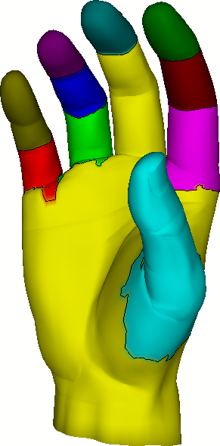
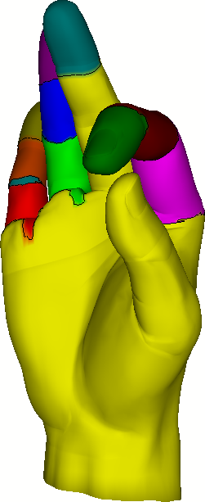
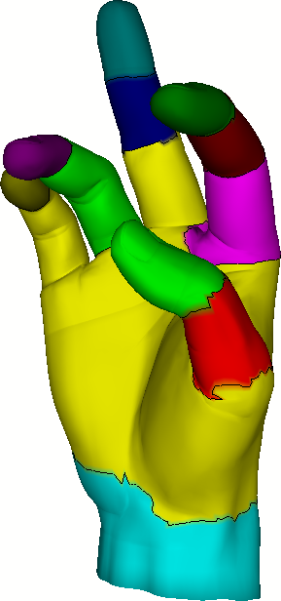
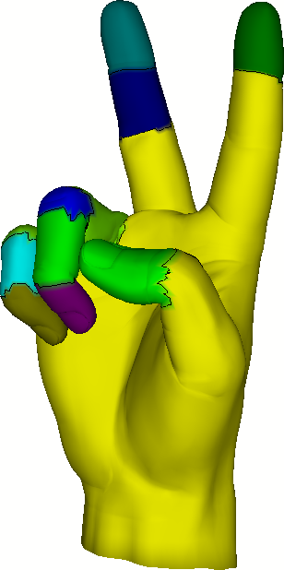
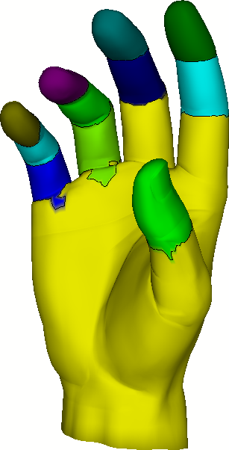
Pose Partitioning for Multi-resolution Segmentation of Arbitrary Mesh Animations
Andreas A. Vasilakis & Ioannis Fudos
Department of Computer Science & Engineering
University of Ioannina, Greece
Notes:
Thanks for the introduction…
At this talk, we will show how we can efficiently derive coherent, variable and multi-resolution segmentations of arbitrary animated meshes.

Slide 3
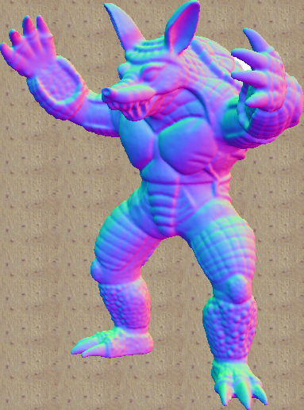
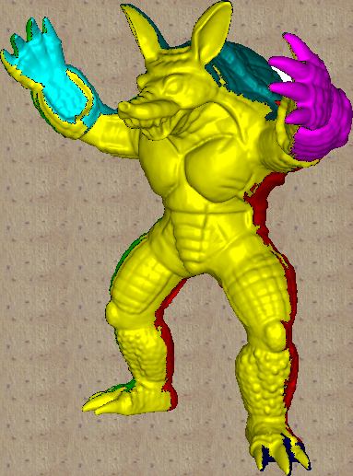
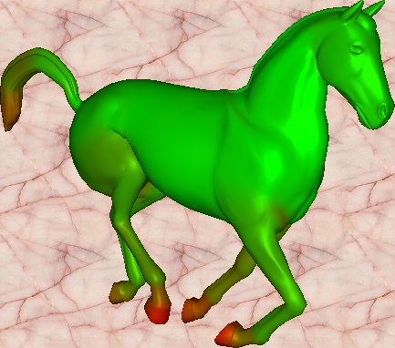
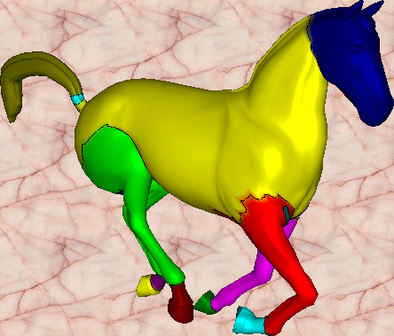
Segmentation Problem
Static
Dynamic
Notes:
The main goal of the segmentation is to partition the mesh into regions with similar characteristics.
Contrary to static meshes where a partitioning is derived based on local geometry attributes, segmentation of mesh animations focus on detecting regions with similar motion.

Slide 4
Mesh Animation
A sequence of key-frames representing how a static 3D shape is evolving through time
Rigid
High-deformable
Hybrid
{human, quadrupeds,…}
{cloth, facial,…}
{dancer,…}
Notes:
A 3D mesh animation consists of a sequence of poses, representing how a static 3D shape is evolving through time.
Although rigid animations assumes the existence of some underlying skeletal hierarchy that guide the animation,
highly deformable animations are used to describe objects that deform under no skeletal influence, independently or in conjunction with skeletal animation.

Slide 5
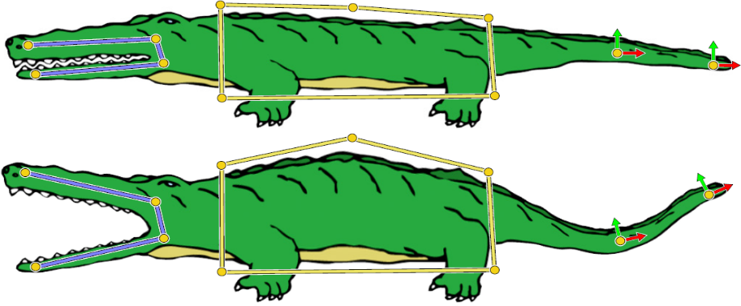
Production of Mesh Animations
Automatic:
User intervention:
time-varying
off-line
[Anguelov et al. TOG`05]
temporal-coherent
real-time
[Jacobson et al. TOG`11]
Notes:
While the production of such a sequence can be done by advanced scanning machinery or multiple video cameras,
in most cases it is the result of tedious work from the part of artists, who dynamically create the animation pose by pose.
Note that since each pose of the MA may be independently reconstructed, sequence of meshes with varying connectivity as well as varying topology may result.
These MAs are commonly called time-varying. On the other hand, if the connectivity is constant over the whole sequence, then MA is called temporal-coherent.
From a different perspective, MAs can be divided into two categories:
(i) off-line which consists of a fixed number of stored consecutive animated meshes and
(ii) real-time which is either streamed from a shared distributed virtual environment or
dynamically generated from interactive manipulation of a deformable object.

Slide 6
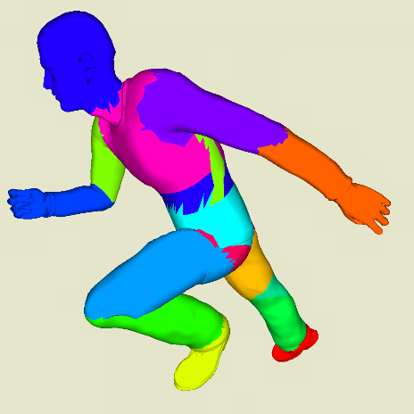
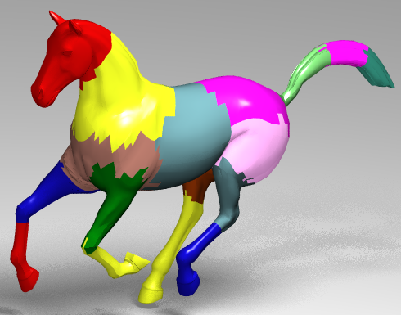
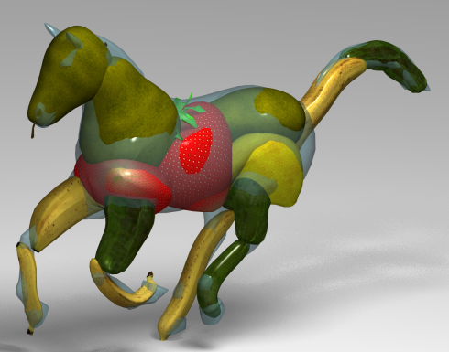
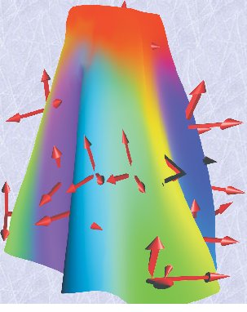
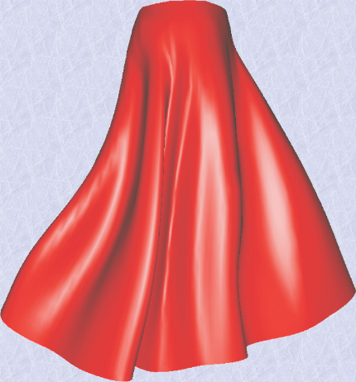
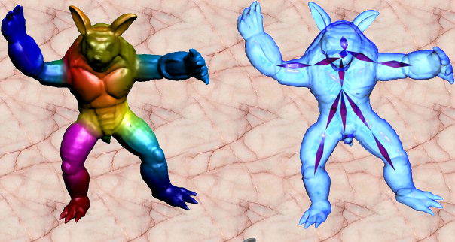
Why segmenting animated meshes?
Ray Tracing
Animation Collage
[Günther et al., CGF’06]
[Theobalt et al., SCA’07]
Skinning
Skeletonization
[Kavan et al., CGF’10]
[Le & Deng, TOG`11]
[De Aguiar et al., CGF`08]
[Hasler et al., I3D’10]
Notes:
Segmentation of mesh animations has become a key component in a number of computer graphics applications.
Skeletonization, Skinning and Collision detection are the most representative applications enabled by partitioning a deforming mesh sequence.

Slide 7
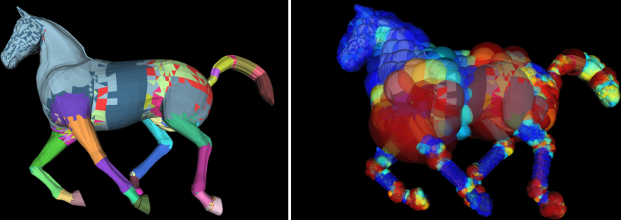
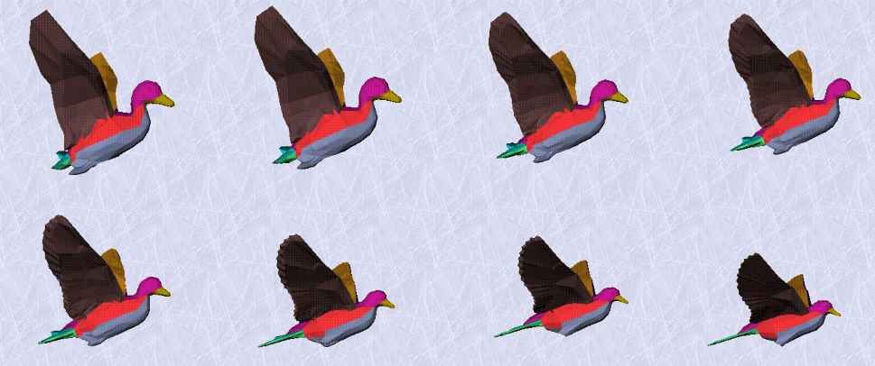
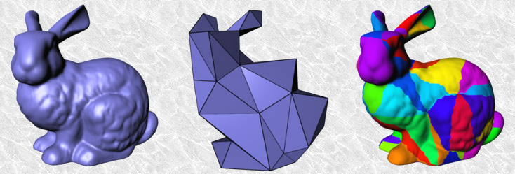
Why segmenting animated meshes?
Collision Detection
[James & Twigg, TOG`05]
[Wong et al., I3D’14]
Morphing
Geometry Images
[Shlafman et al., CGF`02]
[Feng et al., TOG`11]

Slide 8
Prior Art: Global Segmentation Methods
Feature Space
Clustering method
[Euclidean, geodesic, angular distances,…]
[k-means, hierarchical, spectral,…]
Notes:
A large variety of 3D mesh segmentation methods has been introduced the last few years to detect significant features by exploiting one of the numerous available clustering algorithms, such as k-means, hierarchical, spectral, region-growing.
We denote them as global segmentation methods, because they work with average motion measures (like Euclidean, geodesic or angular distances) that represent the degree of deformation during the entire animation sequence.

Slide 9
Prior Art: Limitations
detect segments with mostly [rigid] behavior
creation of [irregular shapes]
fail when feature space is [flat] or [anisotropic]
[uniform clustering] - [one feature dominates the other]
work only with [off-line] animations
[extend] or [edit] original animation
cannot offer smooth [multi-resolution] segmentations
[re-computation] is needed
cannot support [variable] segmentations
[detect motion changes]
Notes:
Regardless the clustering criteria, current methods focus on detecting segments with mostly rigid behavior, failing in partitioning correctly high-deformable objects.
Moreover, they are rather limited in cases where the feature space is either flat, which leads at an inability to separate regions with similar values or when
one or more features dominate the others due to higher variation.
Unfortunately, the entire segmentation process must be executed again when the user requests a different segmentation resolution, or the mesh sequence is arbitrary modified.
Finally, they cannot support temporal-consistent segmentations, which can be very useful in order to detect motion changes.
Variable segmentation can be considered as the problem of clustering data over time in a way that we remain faithful to the past-data and effectively alter when moving on to future data.

Slide 10
Framework Overview
Given a mesh animation: $A=\left\{p_{0},p_{1},⋯,p_{k}\right\}$ with rest-pose $p_{0}:$
Feature Space of each pose${ p}_{i}$
Partitioning of each pose${ p}_{i}$
Over-Segmentation (OS)
Progressive Simplification of OS
OS(A)
Notes:
To this end, we introduce a general framework to efficiently generating multi-resolution segmentations of arbitrary animated objects.
Based on the observation that only a limited part of the surface region is modified from frame-to-frame,
we initially construct an over-segmentation by combining a set of individual partitionings corresponding to each input pose of the animation sequence.
The desired segmentation resolution is dynamically determined by the user by applying a fast progressive simplification process which aims at cleaning insignificant segments.

Slide 11
(1,2) Per-pose Partitioning
Feature space computation
deformation measure from reference ($p_{0}$ or $p_{t−1}$) to target pose ($p_{t}$)
deformation gradient¹ → rotation angles
¹[Sumner et al., TOG`04]
Notes:
So at the first part of our pipeline, a pose partitioning feature, usually a deformation measure, is computed from a target and a reference pose.
The reference frame can be either the previous or the first frame.
In this work, we have selected rotation angles, extracted from the deformation gradients computed with respect to the rest-pose, to define the feature-space.

Slide 12
(1,2) Per-pose Partitioning
Feature space computation
deformation measure from reference ($p_{0}$ or $p_{t−1}$) to target pose ($p_{t}$)
deformation gradient¹ → rotation angles
Partitioning computation
pose independence (parallelism)
top-down hierarchical clustering²
$C_{i}=\left\{C_{i}^{0},⋯,C_{i}^{l_{i}}\right\},∀p_{i}∈\left[1,⋯,k\right]$
¹[Sumner et al., TOG`04], ²[Günther et al., CGF'06]
Notes:
Then, partitioning of each pose can be computed using any of the numerous available clustering methods.
Due to the independence between poses, we can perform this operation in parallel.
For primary pose-decomposition in our experiments, we have utilized a top-down hierarchical clustering technique.

Slide 13
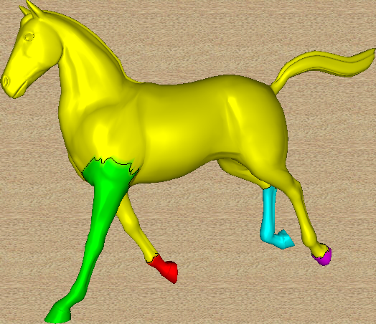
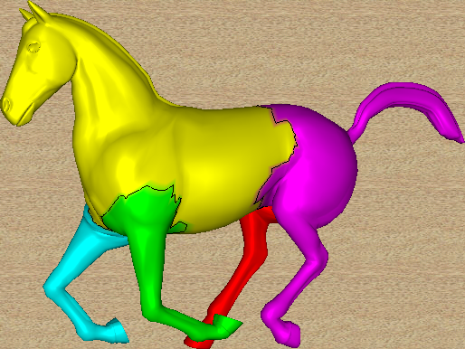
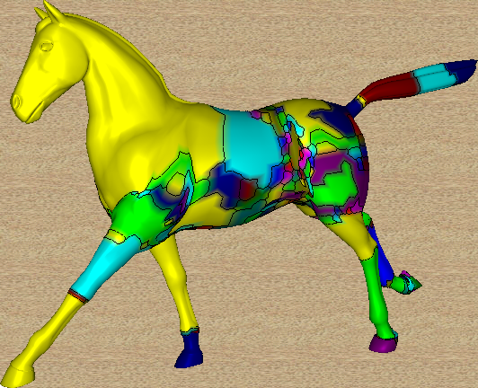
(3) Pose Partitioning-aware OS
Cluster Animation Vector (CAV)
$∀v∈V:cav\left(v\right)=\left\{m_{1},m_{2},⋯,m_{k}\right\},m_{j}∈\left[1,⋯,\left|C_{j}\right|\right]$
BFS: detect connected vertices with same CAV$→O\left(\left|V\right|\right) complexity$
$OS(A)=\left\{S_{0},S_{1},⋯,S_{r}\right\}$
$$cav\left(v_{j}\right)= \left\{0,4,⋯\right\}$$
0
0
$$v_{j}$$
…
4
3
1
3
1
2
4
2
$$C_{1}$$
$$C_{2}$$
$$OS(A)$$
Notes:
In order to build the over-segmentation, we define a clustering animation vector for each vertex, such that each entry corresponds to the cluster index that the vertex belongs to, in each pose.
To algorithmically obtain the final segments of the over-segmentation, we can easily perform a pruned breadth-first-search to detect connected vertices with the same clustering animation vector.
It can be easily shown that the over-segmentation computation has linear complexity on the number of vertices.

Slide 14
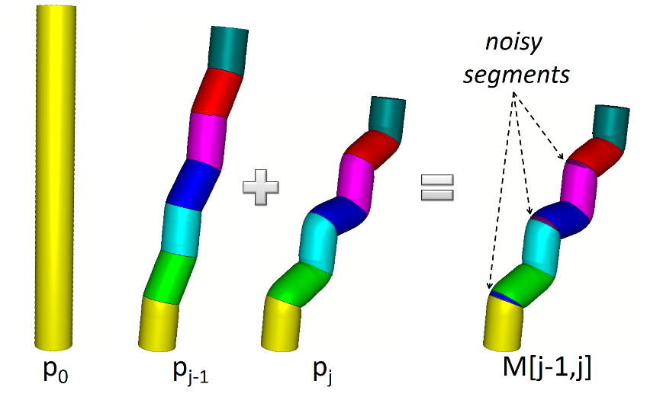
(4) Progressive Decimation of OS
Pose-to-pose Cleaning $R_{i}\left(h\right),h∈\left[0,1\right]$
$p_{k}→p_{k−1}→⋯→p_{1}$
Notes:
Following the generation of the over-segmentation, we perform a progressive decimation process using a parameter h, starting from the last animation pose towards the first one aiming at cleaning noisy segments erroneously created when merging successive partitionings, due to small cluster border differences.
Intuitively, the more h is increased, the larger the parts to be removed.

Slide 15
(4) Progressive Decimation of OS
Pose-to-pose Cleaning $R_{i}\left(h\right),h∈\left[0,1\right]$
$p_{k}→p_{k−1}→⋯→p_{1}$
$C_{i}+C_{j}= ?$
Notes:
Given a pair of neighbor segments at an arbitrary pose that belong to the same cluster in all poses from the first until the previous one, meaning that were split to represent separate segments in this pose,
the first segment absorb the other one based on the following reduction rules:
The first condition states that tested segment is small as compared to the cluster that contains it in this pose.
The second condition states that tested segment is small as compared to the cluster that contains it in
Over-segmentation generated until previous pose which consists of the absorbing segment including the components that have been removed from the merging from the current pose.
To clarify these rules lets see this example. The red clusters at the left figure corresponds to the partitioning of the current pose, (we have highlighted just one of them), while the blue ones corresponds to over-segmentation computed until the previous one. After joining them in the middle figure, two new clusters are generated. In the case where we are trying to merge the resulted blue cluster with the generated s_two green cluster, we observe that the area of s_two is small from its father (the red cluster) and is small from the segment that contains the blue cluster and the two green ones (which is the initial blue cluster). So that means that the s_two cluster is not a significant part and should be absorbed.
We would like to note that we have also explored global rules, not temporal coherent, and we have observed that they tend to favor larger clusters without respecting other characteristics.

Slide 16
Applications I
Smooth Visualization of Cluster Transitions
minimize “close” colors assigned to neighbors
propagate colors between consecutive frames
(a) Initial painting
(b) Color propagation
Notes:
Since clusters may vanish, shift or arise when moving through time, we introduce a perceptually friendly visualization scheme to propagate as mush as possible the segment colors between consecutive frames.
We follow a strategy that aims at covering a high distribution of the color space minimizing the possibility of close colors be assigned to neighbor clusters.
The algorithm starts by initially painting the partitioning of the first pose followed by a area-based propagation of the cluster colors from pose-to-pose.
Note that the same algorithm can also be used for any segmentation pair without the need of any history context. Thus, we have applied it to demonstrate the color transition results between clusters of variable and multi-resolution segmentations.
In this video comparison, notice the perceptual improvement with the pose-to-pose coloring when moving throughout the sequence.

Slide 17
Applications II
Multi-resolution Segmentation
adjusting parameter $h:0 \left(high\right)→1\left(low\right)$
efficient: do not depend on mesh tessellation
bounded by $\left\{C_{1},\left|OS(A)\right|\right\}$- high similarity of $\left\{C_{i}\right\}$ ?
Notes:
As I mentioned earlier, we provide users with an interactive tool to adapt the resolution of the final segmentation by simply adjusting the h parameter.
We have to note that we can generate segmentations only between the resolution range of the first partitioning (if we set h to one) and the over-segmentation (if we set h to zero).
When there is a high similarity between individual pose partitionings then this range is significantly reduced.
Finally, this operation is very fast since it does not depend on the mesh geometry size.
Here, we illustrate different resolution segmentations from high-to low detail of the hand animation.

Slide 18
Applications III
Variable (temporal-consistent) Segmentation
$\left.\begin{aligned}\left(a\right) remain faithful to past data \\ \left(b\right) alter to future data\end{aligned} \right\}merge \{P_{t−1},P_{t}\}:M\left[t−1,t\right]→$ real-time
(a) Color propagation
(b) Variable segmentation
Notes:
Despite clustering independence between individual poses, we offer users with a smooth transition between pose-to-pose partitionings, by merging the partitioning of the current pose with that of the next pose.
Using our method we can achieve interactive performance when a fast per-pose segmentation is employed.
We can observe in this video comparison that the temporal coherency is better preserved when the joined clustering sequence is used as compared to the color-propagated pose clusterings.
An interesting extension of this approach in order to improve more temporal coherency could be to increase the joining in a larger frame-time window.

Slide 19
Applications IV
Real-time Segmentation
$\left.\begin{aligned}\left(∗\right) streamed/dynamic MA \\ \left(∗\right) out−of−core algorithm\end{aligned} \right\}merge \left\{M\left[1,t−1\right],P_{t}\right\}=M\left[1,t \right]→cost of C_{t}$
Real-time segmentation (left) without and (right) with p2p-cleaning
Notes:
A key feature that is not supported by previous approaches, is that our framework can efficiently handle segmentations of streamed or dynamically created mesh animations without the need of storing the processed animations for off-line segmentation.
This algorithm can also be applied when we want to segment extremely large mesh animations that cannot be maintained in the memory.
The idea is very simple, we just merge the newly arrived pose partitioning with the segmentation resulted from merging the partitioning of all previous poses.
In this video, we provide a comparison of the real-time segmentation results without and with performing pose-to-pose cleaning. We clearly observe that the intermediate segmentations are enhanced by the cleaning procedure.

Slide 20
Experimental Study I
Performance Analysis @Intel Core i7-870 Quad (2.83 Ghz)
linear behavior on the geometry size
linear scale when increasing per-pose partitionings
pose partitionings consume most of the time
tiny cost when moving from high to low resolutions
Notes:
We evaluate our proposed framework with respect to performance and quality under a broad set of testing inputs.
This table presents a comparative performance overview of the intermediate steps employed by our method to produce a final segmentation.
We can conclude that the computation times for all steps exhibit a linear behavior on the mesh geometry size.
The over-segmentation and cleaning performance scales linearly when the number of per-pose segments increases.
The efficiency of our framework is constrained by the individual pose partitionings which take more than 90% of the total computation time.
Finally, we observe that changing the segmentation resolution is a very fast operation.

Slide 21
Experimental Study II
Quality Analysis I - Hand animation
$\left.\begin{aligned}\left[rigid\right]→[volumetric parts] \\ \left[highly deformable\right]→[surface parts]\end{aligned}\right\} [hybrid]$
$$[our method]$$
$$[per pose feature space]$$
$$[\text{Schaefer}\text{ \& }\text{Yuskel}\text{, }\text{EG} \text{symp}\text{. }\text{on} \text{Geom}\text{.}\text{Pr}\text{. `07}]$$
Notes:
Intuitively, when mesh movement is defined as a function of an underlying skeleton, the segmentation objective is to partition the surface into meaningful volumetric parts.
This video shows the comparison of our method with a global segmentation method for several resolutions in terms of extracting rigid parts when segmenting an animated hand.
Observe that the segmentations computed from the global segmentation method failed to accurately partition most of the articulations.
For example, observe that the red middle finger is wrongly partitioned in low resolutions .
Finally, it is clear that our method better preserves the rigidity in the segmentation when the level of detail is increasing.

Slide 22
Experimental Study II
Quality Analysis I - Horse gallop animation
$\left.\begin{aligned}\left[rigid\right]→[volumetric parts] \\ \left[highly deformable\right]→[surface parts]\end{aligned}\right\} [hybrid]$
$$[our method]$$
$$[per pose feature space]$$
$$[\text{Gunther} \text{et} \text{al}\text{., }\text{CGF}\text{ `0}6]$$
Notes:
Similarly, here are the results for segmenting a horse gallop mesh animation.
Observe that the right back and front legs are not accurately partitioned in same cases from the global segmentation method.

Slide 23
Experimental Study III
Quality Analysis II – Flowing cloth animation
$\left.\begin{aligned}\left[rigid\right]→[volumetric parts] \\ \left[highly deformable\right]→[surface parts]\end{aligned}\right\} [hybrid]$
$$[per pose feature space]$$
$$[our method]$$
$$[\text{Kavan} \text{et} \text{al}\text{., }\text{CGF}\text{ `}\text{1}\text{0}]$$
Notes:
On the other hand, segmentation of a highly-deformable object is targeted at decomposing the mesh into surface patches with similar motion characteristics.
In this cloth animation, our segmentations preserves better spatial coherency without creating irregular shapes when compared to the global segmentation output.

Slide 24
Experimental Study III
Quality Analysis II – Horse collapse animation
$\left.\begin{aligned}\left[rigid\right]→[volumetric parts] \\ \left[highly deformable\right]→[surface parts]\end{aligned}\right\} [hybrid]$
$$[our method]$$
$$[per pose feature space]$$
$$[\text{Gunther} \text{et} \text{al}\text{., }\text{CGF}\text{ `0}6]$$
Notes:
We observe similar results when trying to decompose a horse collapse animation.
Note the inaccurate stripe-like clusters created from the global segmentation method.

Slide 25
Experimental Study IV
Quality Analysis III – Samba animation
$E_{RMS}:$ skinning approximation error
$\left.\begin{aligned}\left[rigid\right]→[volumetric parts] \\ \left[highly deformable\right]→[surface parts]\end{aligned}\right\} [hybrid]$
$$[our method]$$
$$[per pose feature space]$$
$$[\text{Schaefer}\text{ \& }\text{Yuskel}\text{, }\text{EG} \text{symp}\text{. }\text{on} \text{Geom}\text{.}\text{Pr}\text{. `07}]$$
Notes:
Highly-deformable objects can be used to model clothes in conjunction with skeletal motion.
This video illustrates how our approach produces segmentations that accurately partition the rigid parts ( the head, arms and legs of the dancer ) as well as the highly-deformed surfaces (the dress which follows the dancer’s motion)
On the other hand, the right leg is wrongly connected to the dress at the low-detail segmentation created from a global segmentation method.
Moving to higher resolutions, we observe that head and legs are significantly being pruned creating meaningless parts.

Slide 26
Experimental Study IV
Quality Analysis III – Handstand animation
$E_{RMS}:$ skinning approximation error
$\left.\begin{aligned}\left[rigid\right]→[volumetric parts] \\ \left[highly deformable\right]→[surface parts]\end{aligned}\right\} [hybrid]$
$$[our method]$$
$$[per pose feature space]$$
$$[\text{Schaefer}\text{ \& }\text{Yuskel}\text{, }\text{EG} \text{symp}\text{. }\text{on} \text{Geom}\text{.}\text{Pr}\text{. `07}]$$
Notes:
Similar results are observed when segmenting the handstand animation.

Slide 27
Limitations
Performance Analysis
depends on computation time of individual pose partitionings:
$>90\%$ of the total time
GPU-accelerated clustering ?
Notes:
As I mentioned earlier, the total performance of our framework mostly depends on the computation time of the individual pose partitionings.
Taking advantage of gpu-based clustering implementations may be an interesting option to improve performance.

Slide 28
Limitations
Performance Analysis
depends on computation time of individual pose partitionings:
$>90\%$ of the total time
GPU-accelerated clustering ?
Quality Analysis
$depends on quality/number of individual pose partitionings$
Efficient low-detail segmentation output → similar per-pose partitionings
Accurate high-detail segmentation output → increased per-pose segments
Notes:
While we have generally noticed that our method produces better segmentations when focusing on the visual quality, the final output highly depends on the quality and the number of the individual partitionings.
For example, high similarity between per-pose partitions is required in order to achieve a high-quality low-detail segmentations.
Furthermore, per-pose segments have to be maintained at increased levels to compute accurate high-detail segmentations.

Slide 29
Limitations
Performance Analysis
depends on computation time of individual pose partitionings:
$>90\%$ of the total time
GPU-accelerated clustering ?
Quality Analysis
$depends on quality/number of individual pose partitionings$
Efficient low-detail segmentation output → similar per-pose partitionings
Accurate high-detail segmentation output → increased per-pose segments
$$[per pose partitioning]$$
$$[final]$$
Notes:
In this elephant gallop example, we observe in the top row the poor quality of the final segmentation when merging partitions that do not capture the desired information.
Increasing the number of per-pose extracted parts, the final segmentation is highly enhanced.

Slide 30
Conclusions & Future Work
Conclusions
handles off-line, real-time and editable mesh animations
supports rigid, highly-deformable and hybrid mesh animations
enables interactive multi-resolution & variable segmentations
introduces smooth visualization of segment transitions
Notes:
So, we have introduced a framework to generating coherent, variable and multi-resolution segmentations of arbitrary mesh animations.
The resulted segments are painted on the fly by an efficient color propagation scheme.

Slide 31
Conclusions & Future Work
Conclusions
handles off-line, real-time and editable mesh animations
supports rigid, highly-deformable and hybrid mesh animations
enables interactive multi-resolution & variable segmentations
introduces smooth visualization of segment transitions
Future Work
support of time-varying meshes by exploiting vertex mapping
cluster similar poses to
handle extreme resolutions of OS
reduce computation/memory costs
increase the segmentation quality:
use of sophisticated mesh clustering algorithms
retain important (subset) per-pose partitions
rectify the generated segment boundaries
Notes:
There is an number of research directions that could be explored further to improve the limitations of the current work.
Our approach may easily be extended to support time-varying meshes by exploiting vertex mapping techniques.
To tackle the problem of the increased resolution of the over-segmentation, we may organize similar poses into clusters and pick one of them, thereby reducing significantly the number of the merged partitionings.
Moreover, this will also reduce the computation and memory requirements of the algorithm.
Finally, we can explore a number of directions to improve pose clustering quality with the burden of additional computation cost and parameter tuning.
We can employ a more sophisticated clustering algorithm, retain only important segments per pose or rectify the generated segment boundaries.

Slide 32
End();
thank_you();
answer_questions();
Acknowledgements
This research has been co-financed by the European Union (European Social Fund ESF) and Greek national funds through the Operational Program Education and Lifelong Learning of the National Strategic Reference Framework (NSRF) – Research Funding Program: Heracleitus II. Investing in knowledge society through the European Social Fund.

