Slide 1
Eurographics 2014 – Strasbourg – France
Notes:
Instructions for technical presentation:
* The provided Windows-based PowerPoint 2010 presentation is to be used for the fast-forward session. You may use it as a template for the technical session. This not mandatory.
Instructions for fast-forward session:
* The use of the provided Windows-based PowerPoint 2010 presentation is mandatory for the fast-forward session.
* During this session, each of you will have 30 seconds to summarize your paper. Every paper must be represented by one or more of its authors.
* You may insert any number of slides, each of which must automatically advance to the slide beyond it (including the last one), adding up to a maximum of 30 seconds.
* Your slides may contain audio, and video.
* Try to keep the total size of your materials (PowerPoint, audio, and video) to 40 MB or less.
* We will concatenate all of the presentations into one large presentation, which will be played on a Windows-based computer.
* To avoid problems with the final presentation, no last minute changes can be accepted. Please test your slides on setup similar to the target environment (fonts, animations, and video may behave differently).
Details:
Assembling these presentations is a huge task, and we request that you help by adhering to the following guidelines:
* Each presentation begin with a 5 seconds slide (showing the EG2014 logo) : it provides time for next authors to get to the podium, while previous ones get off the stage.
* Then, a second 5 seconds slide will show your paper title with the names of authors and affiliations : you are responsible to complete this slide
* Then, your own slides will be display : you should use the provided template, but change will be accepted as long as the two first slides remain unchanged. The total time for your slide is limited to a total of 30 seconds.
* Your presentation will end with the next EG2014 logo slide lasting 5 seconds, during which you should leave the stage allowing the next presenter to hop on and reach the podium in time.
* The entire fast forward presentation will be pre-recorded, with all timings and slide changes built in. You will not have the ability to go back to a previous slide or to make a slide last longer. Be prepared to simply let the presentation run.
* There might be a keyboard and mouse on stage, but the whole show is automated. Presenters WILL NOT be able to manually control slide changes.
* Some slides corresponding to Session Title slides will be inserted. These slides will last 10 seconds on screen and are intended to let the audience catch their breath.
Technical Guidelines:
* As stated above, all slides in your presentation must automatically advance to the next with a fixed time, the last one included.
* Audio is welcome. If you use audio in your slides, please have it be in mp3 format.
* Video files are also welcome, these should be in WMV format exclusively; please do NOT use QuickTime (.mov) formats for your video, since unfortunately these will not play in PowerPoint running under Windows.
* When importing video, please make sure to select the option "Start Playing Automatically", when prompted.
* If you plan to include mathematical equations, we suggest that you embed them as images and not active objects, since font discrepancies may cause parts or all of your equations to be shifted or entirely changed in some cases.
* More generally, we suggest that when introducing regular text you use only the standard fonts that ship with Windows. If you wish to use any other fonts, you should convert the text to an image and then embed the image in place of the text.

Slide 2
Pose Partitioning for Multi-resolution Segmentation of Arbitrary Mesh Animations
Andreas A. Vasilakis & Ioannis Fudos
Department of Computer Science & Engineering
University of Ioannina, Greece

Slide 3
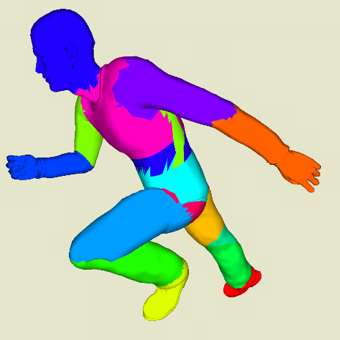
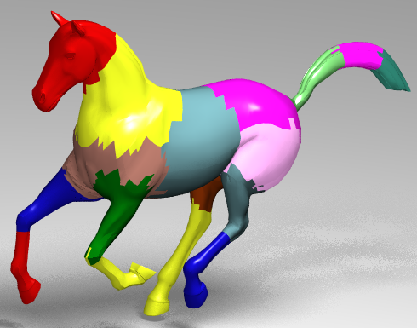
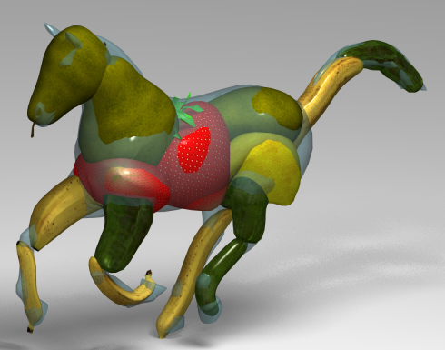
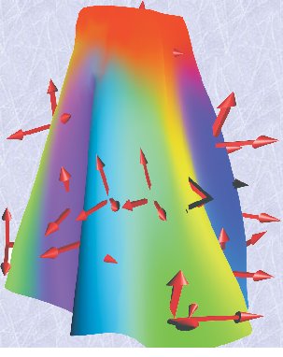
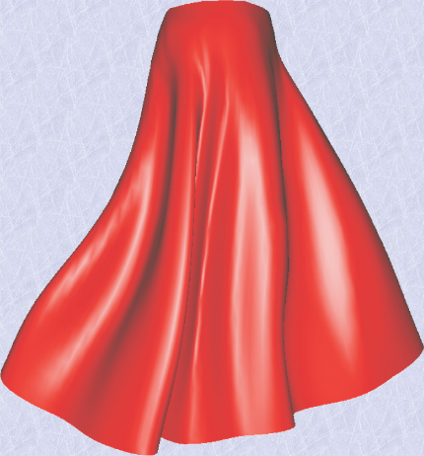
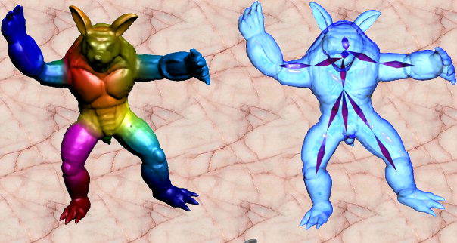
Segmenting Animated Meshes
Ray Tracing
Animation Collage
[Günther et al., CGF’06]
[Theobalt et al., SCA’07]
Skinning
Skeletonization
[Kavan et al., CGF’10]
[Hasler et al., I3D’10]
Notes:
Segmentation of mesh animations has become a key issue in a number of computer graphics applications…
(4 sec)

Slide 4
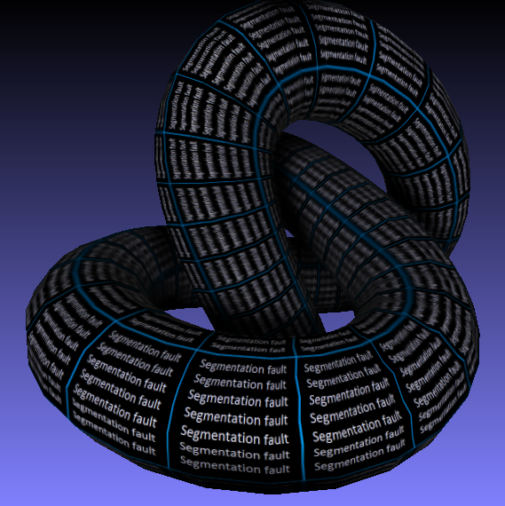
Prior Art
Notes:
To avoid segmentation-faults of previous partitioning methods,
(3 sec)

Slide 5
Framework Overview
Per-pose Partitioning
Variable
Real-time
Multi-resolution
[high]
[medium]
[low]
Notes:
we present a general framework to efficiently generating coherent, variable and multi-resolution segmentations of arbitrary off-line and real-time mesh animations by initially combining per-pose partitionings followed by a fast progressive refinement process.
(15 sec)

Slide 6
FP9: Animation II (Motion Data Processing)
Thursday, April 10th, 09:20
in Room Schweitzer
Notes:
If you want to find out more details about our method, see you at Thursday…
(5 sec)

