Slide 1
Variable k-buffer using Importance Maps
Eurographics 2017 – Short Papers
Andreas A. Vasilakis^{1,*} K. Vardis^{2,*} G. Papaioannou^{2,*} K. Moustakas³
¹ Centre of Research & Technology Hellas, Greece
² Athens University of Economics & Business, Greece
³ University of Patras, Greece
*contributed equally to this work

Slide 2
Rasterization – Ray Casting
Problem: generation of more than one out-of-order fragments per pixel.
Notes:
I think that everyone is familiar with how GPUs execute the traditional rasterization process…
…A number of fragment samples per pixel is the result of the surface intersections generated when sampling the geometry at a pixel level.

Slide 3
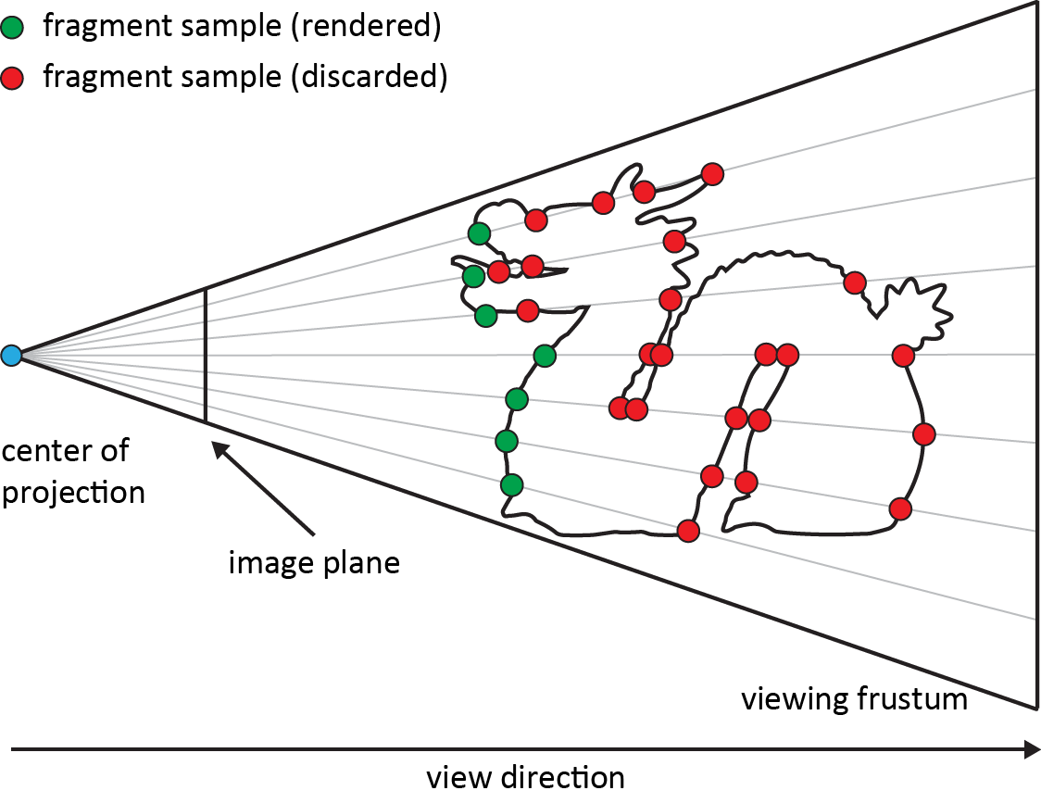
Single-fragment Visibility Determination Problem
Well-known Solution: Z-buffering (Hidden surface elimination)
Transparency ???
Notes:
Commonly, only one fragment, and to be more clear, the one that is closest to the eye, is picked and rendered to the viewer via hardware-accelerated z-buffering…
However, the key disadvantage of single-fragment rendering is the inability to handle, among others, transparency effects…

Slide 4
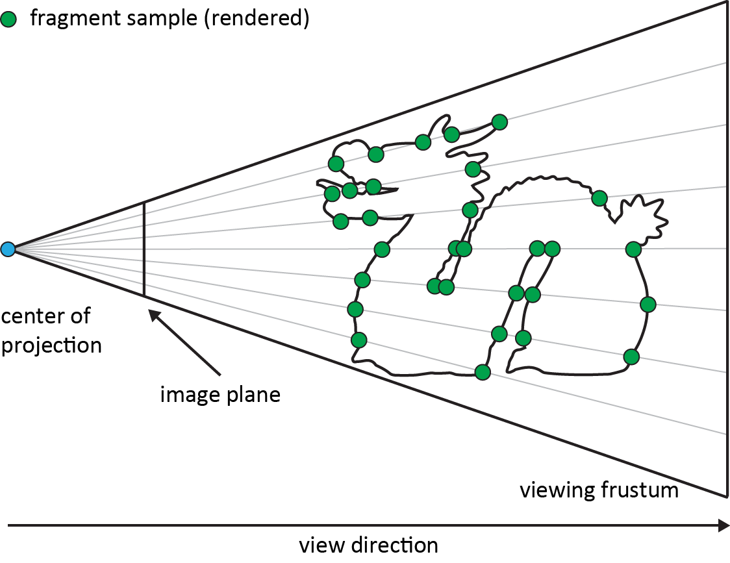
Multi-fragment Visibility Determination Problem
A vast number of different GPU-based buffer solutions
STORE
SORT
RESOLVE
Notes:
On the other hand, Multi-fragment rendering is increasingly becoming an important aspect of real-time image generation for supporting not only Transparency but also more complex effects in graphics and games.
Traditionally, a family of GPU-accelerated buffers is responsible on treating the problem storing, and subsequently sorting, the out-of-order fragments before generating the final effect.

Slide 5
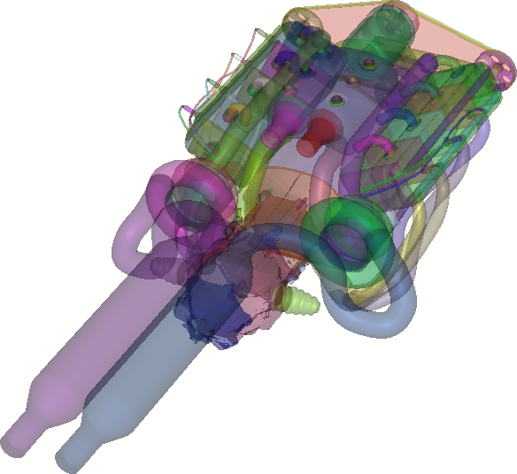
Order-Independent Transparency
[Vasilakis & Fudos, I3D’14]
[Vasilakis & Papaioannou, EG Short’15]
Notes:
Order independent transparency can be considered as the most typical example of image-based techniques.
commonly used as benchmark case for testing new multi-fragment processing methods in scenes with high depth complexity.

Slide 6
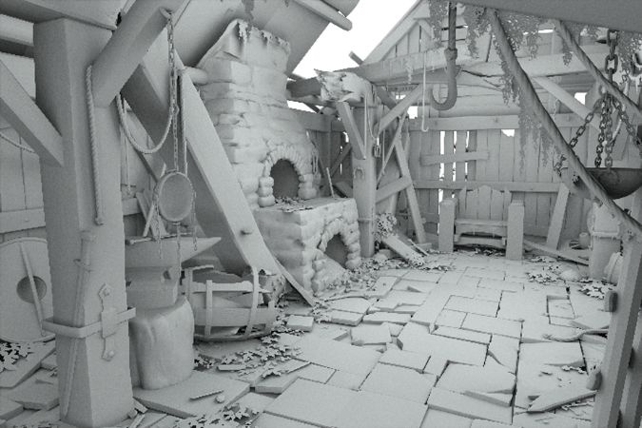
Ambient Occlusion
[Vardis et al., I3D’16]
Notes:
Moreover, Typical global illumination algorithms that rely on ray tracing can benefit from multi-fragment processing,
ranging from robust global illumination effects such as Ambient Occlusion

Slide 7
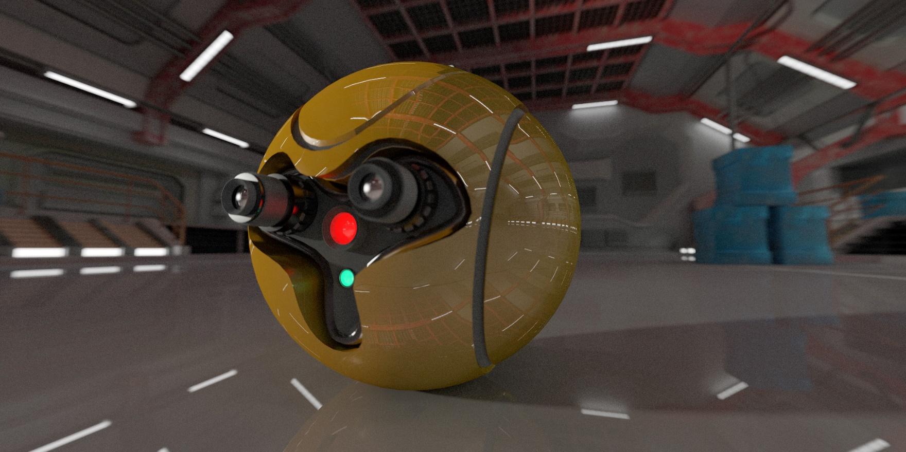
Path Tracing
[Vardis et al., HPG’16]
Notes:
And path tracing for fully dynamic and complex environments…

Slide 8
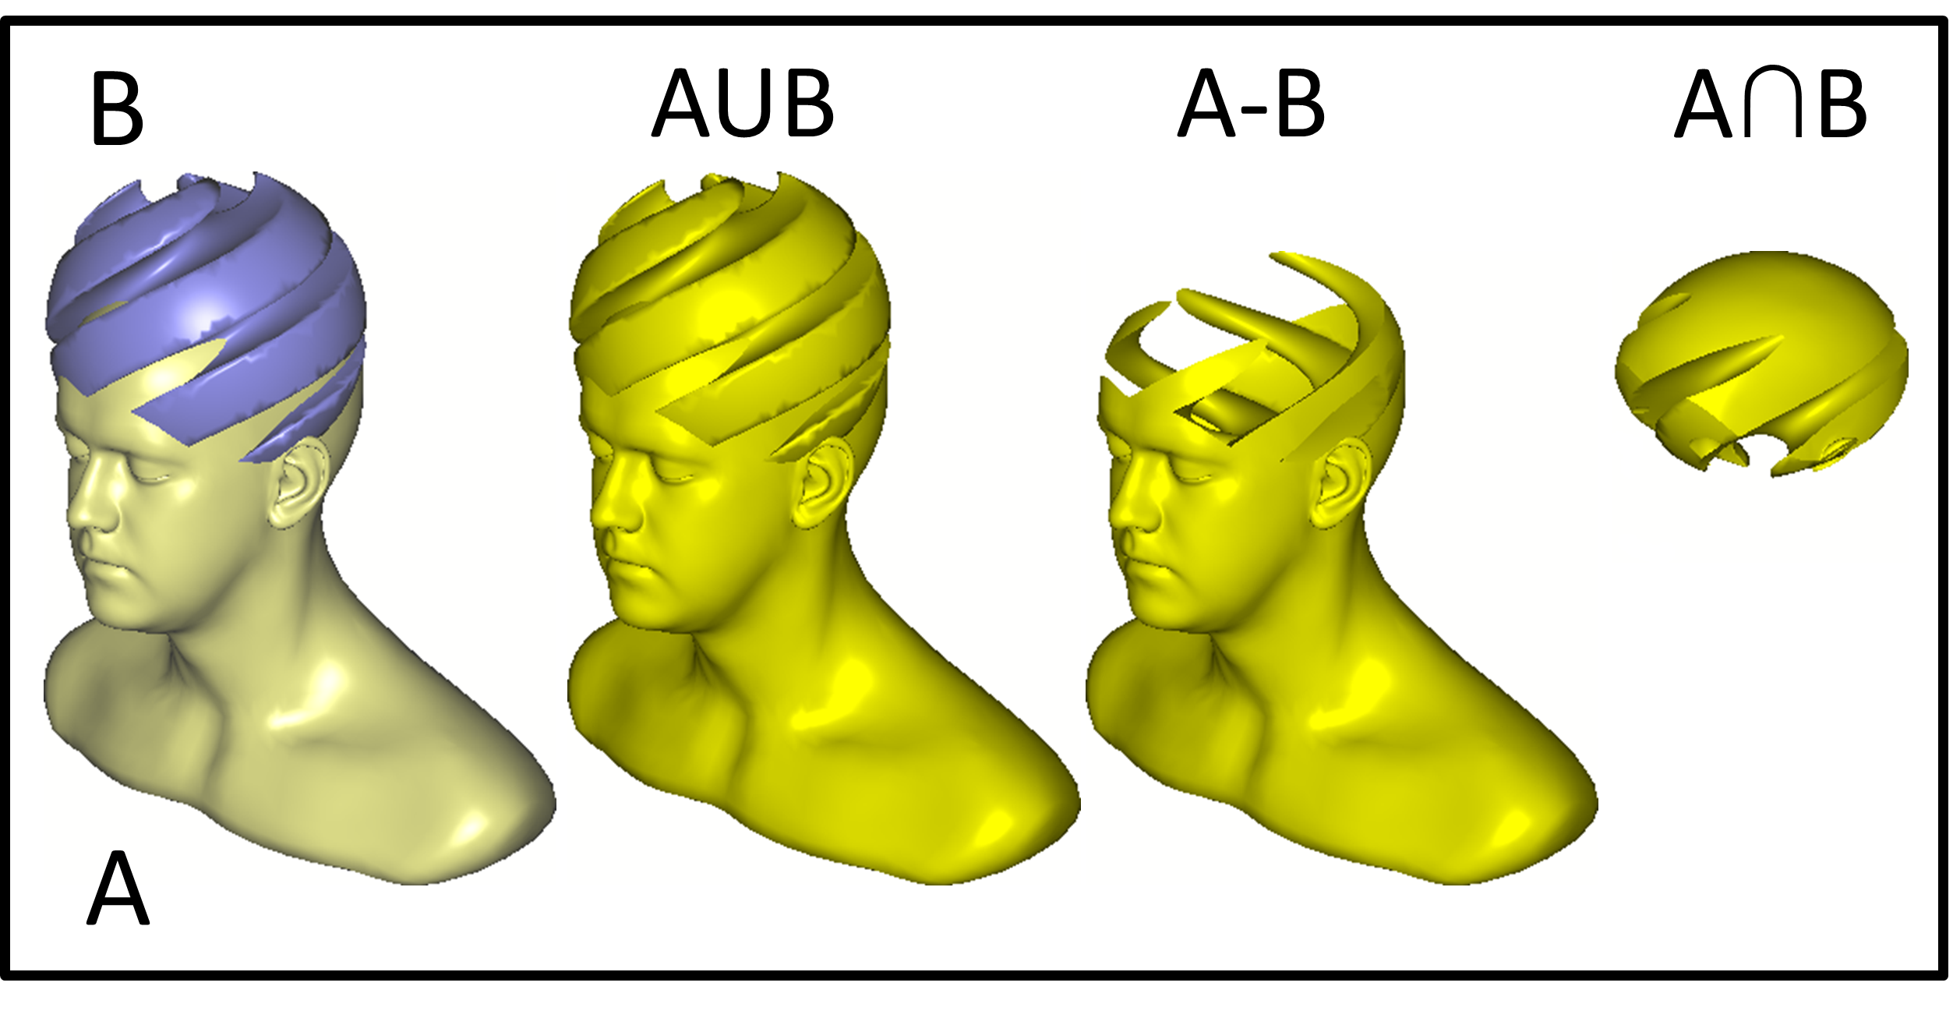
Constructive Solid Geometry
[Rossignac et al., CAD’13]
Notes:
to the support of accurate constructive solid geometry rendering…

Slide 9
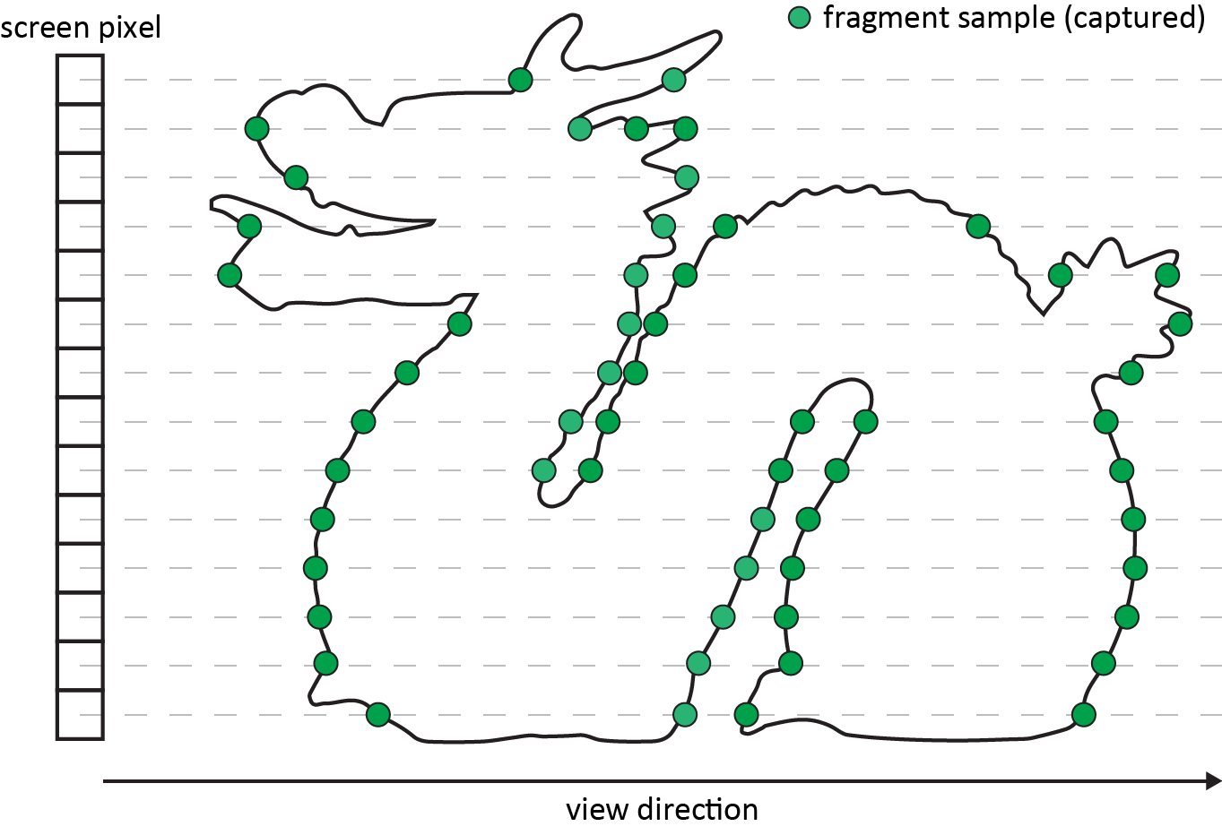
Multi-fragment Rendering Solutions (1)
A-buffer via per-pixel fragment linked lists [Yang et al., CGF’10]
S-buffer via per-pixel fragment bins [Vasilakis & Fudos, EG Short’12]
Goal:
Store all fragments
Sort them by depth
Notes:
While the GPU-accelerated A-buffer, as well as S-buffer, a variant that exploit dynamic paged memory management,
are the dominant structures for maintaining all generated fragments.

Slide 10
Multi-fragment Rendering Solutions (1)
A-buffer via per-pixel fragment linked lists [Yang et al., CGF’10]
S-buffer via per-pixel fragment bins [Vasilakis & Fudos, EG Short’12]
Goal:
Store all fragments
Sort them by depth
Limitations:
Memory
wasteful allocation
potential overflow
Performance
sorting
Notes:
they suffer from
(i) memory overflows as a result of the unbounded buffer needed to store all generated fragments and
(ii) performance bottlenecks that arise when the number of per-pixel fragments to be post sorted increases significantly.

Slide 11
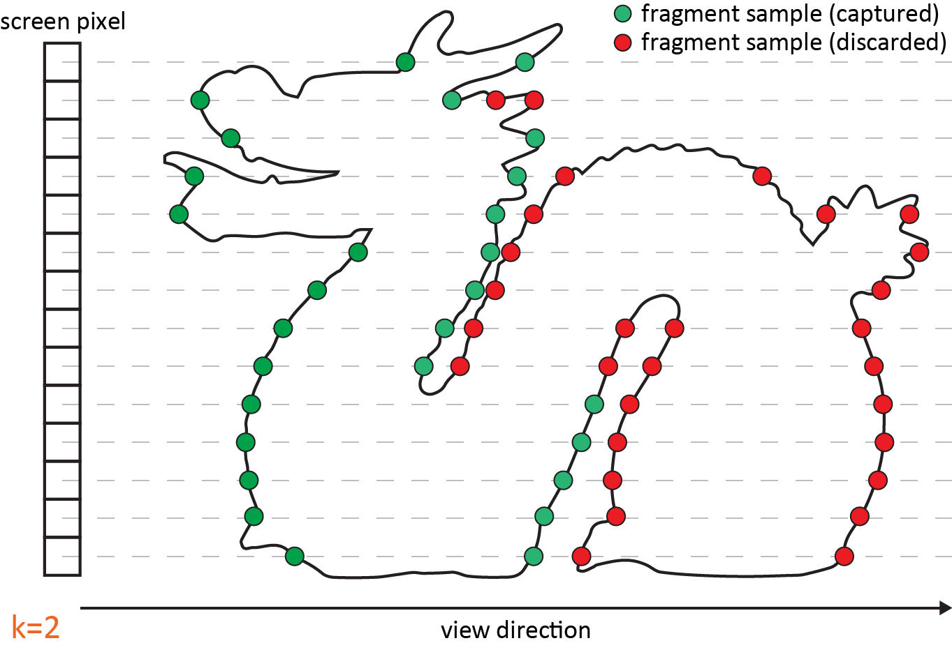
Multi-fragment Rendering Solutions (2)
k-buffer [Bavoil et al., I3D’07] [Salvi, SIG’13] [Vasilakis & Fudos, I3D’14]
Goal:
Manual set of k
Store k fragments
Sort them by depth
Notes:
When low graphics memory requirements are of the utmost importance, the fixed k-buffer with its more recent robust variations can objectively be considered as a viable alternative to the A-buffer,
which at least ensures the correct depth order on the closest subset of all generated fragments.
In other words, k-buffer methods aim at maintaining the k-closest to the eye fragments…

Slide 12
Multi-fragment Rendering Solutions (2)
k-buffer [Bavoil et al., I3D’07] [Salvi, SIG’13] [Vasilakis & Fudos, I3D’14]
Goal:
Manual set of k
Store k fragments
Sort them by depth
Limitations:
k is user-dependent
Notes:
However, the k-buffer assumes a pre-assigned, and global, value of k fragments across the entire image.
Unfortunately, this practice can lead to various quality and memory issues.

Slide 13
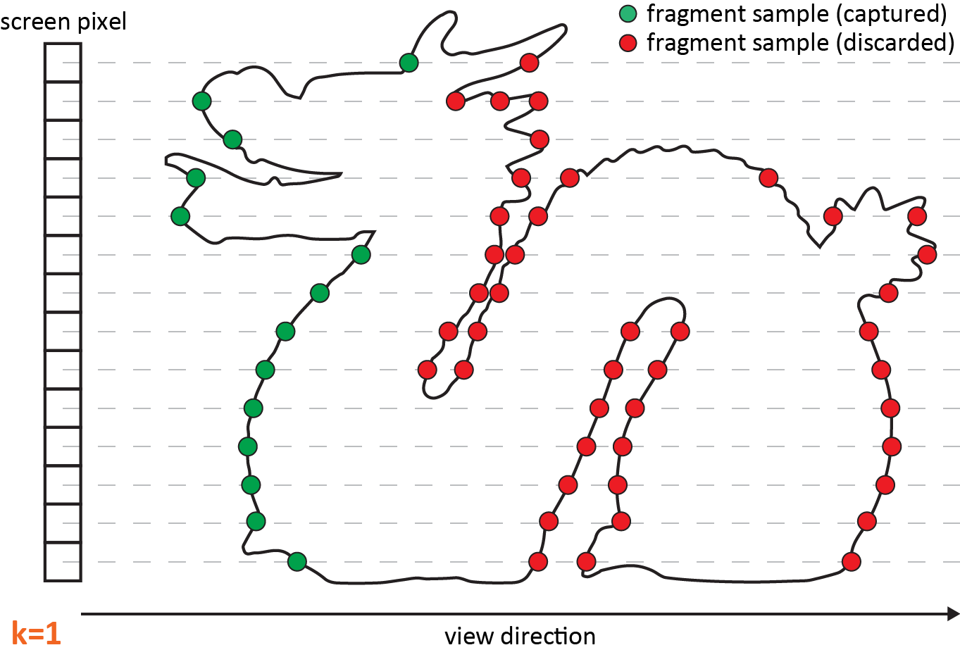
Multi-fragment Rendering Solutions (2)
k-buffer [Bavoil et al., I3D’07] [Salvi, SIG’13] [Vasilakis & Fudos, I3D’14]
Goal:
k (small)
Store k fragments
Sort them by depth
Limitations:
View-dependent
artifacts
Notes:
On one hand, setting k to a small number, can result in view-dependent artifacts as more than k fragments might be required for some pixels at a particular viewing configuration to correctly simulate the desired effect.

Slide 14
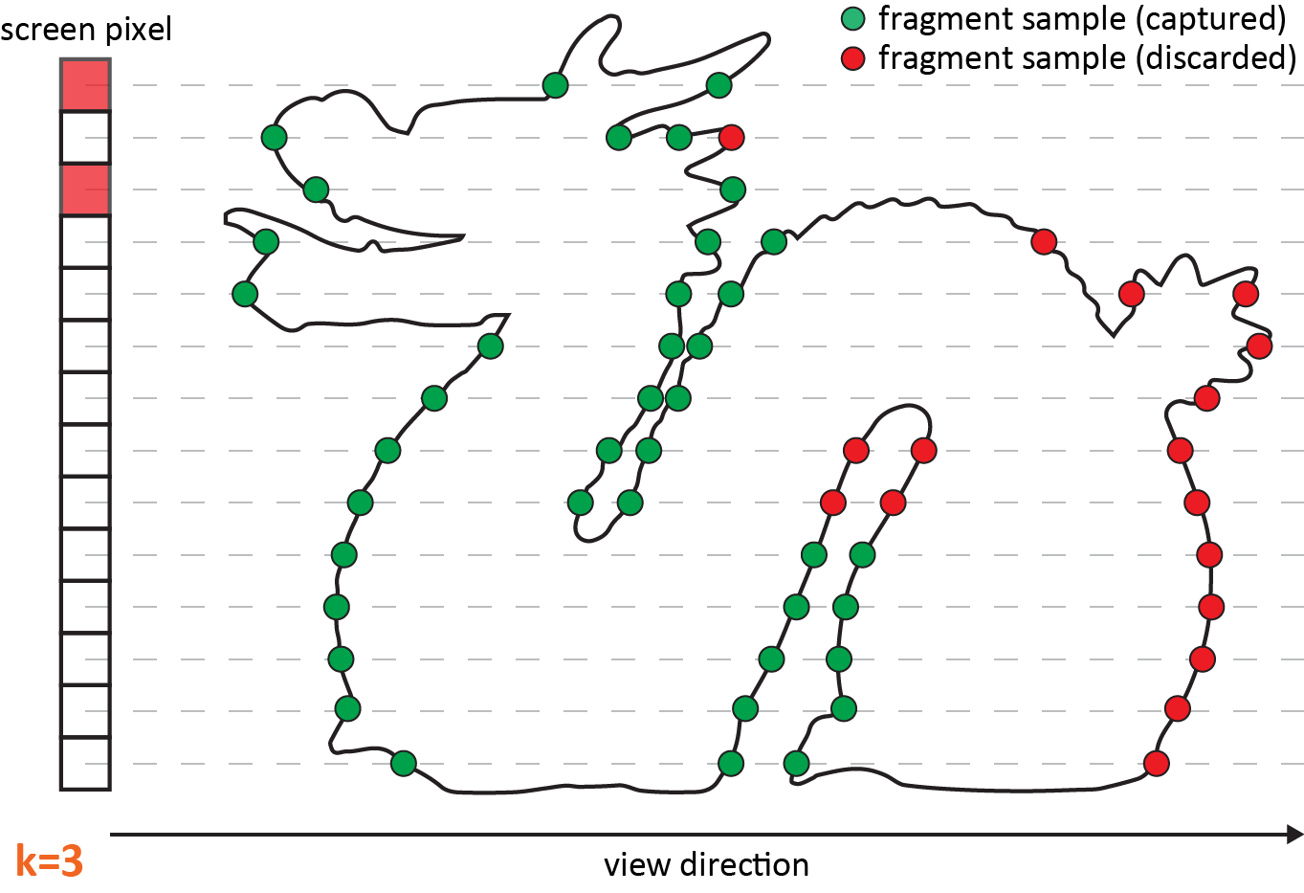
Multi-fragment Rendering Solutions (2)
k-buffer [Bavoil et al., I3D’07] [Salvi, SIG’13] [Vasilakis & Fudos, I3D’14]
Goal:
k (large)
Store k fragments
Sort them by depth
Limitations:
Large and unused
memory
Notes:
On the other hand, employing a large value of k can result in excessive memory demands, as potentially unused storage is pre-allocated for pixels that contain less than k fragments as the ones highlighted with pink-color.

Slide 15
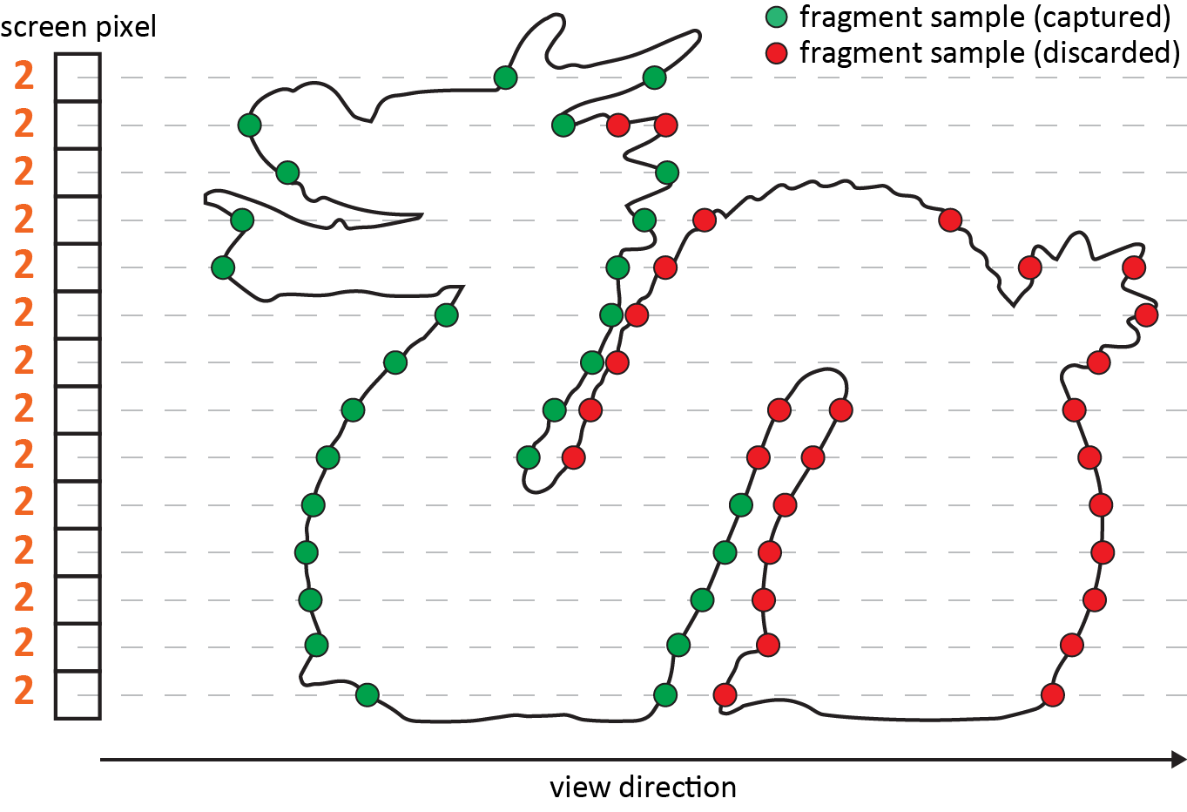
Multi-fragment Rendering Solutions (3)
Dynamic k-buffer via depth complexity histogram analysis [Vasilakis et al., TVCG’15]
Goal:
Estimate k
Store k fragments
Sort them by depth
Notes:
More recently, a dynamic k-buffer has been introduced, solving previous issues by performing an intuitive and automatic method for
the optimal estimation of k value under constrained memory budget via on-the-fly depth complexity histogram analysis.

Slide 16
Multi-fragment Rendering Solutions (3)
Dynamic k-buffer via depth complexity histogram analysis [Vasilakis et al., TVCG’15]
Goal:
Estimate k
Store k fragments
Sort them by depth
Limitations:
Fixed k per pixel
(upper-bound)
Notes:
However, again the computed value of k is considered to be the same for all pixels…

Slide 17
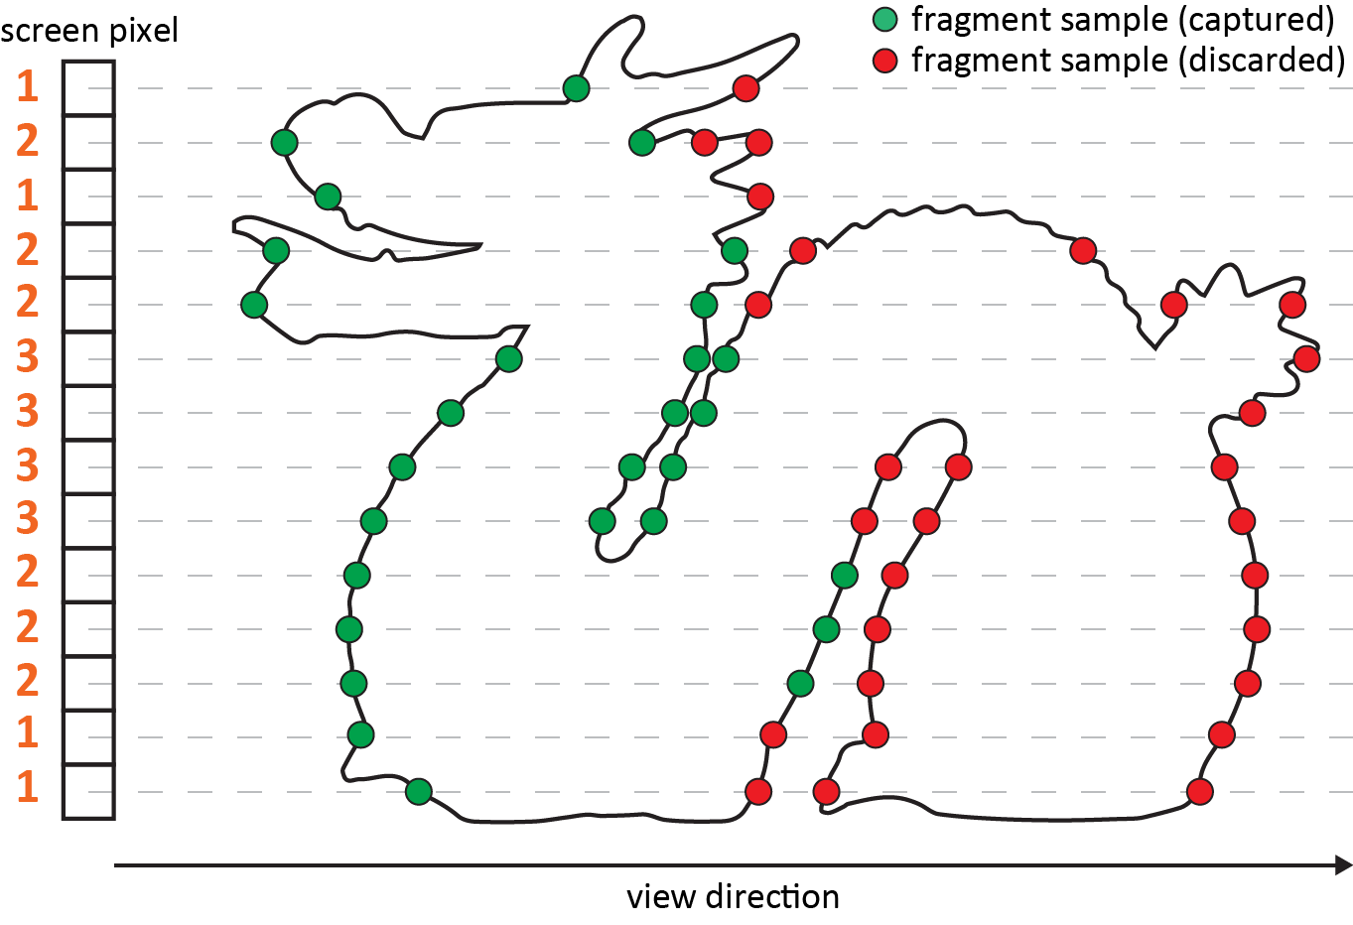
Our Idea
Variable k-buffer solution
Goal:
Estimate k
Store k fragments
Sort them by depth
Advantages:
Variable k per pixel
Notes:
Wouldn’t be ideal if we can dynamically adjust and distribute k across the image according to the available storage space?
Wouldn’t be ideal if we can allocate more fragment layers in parts of the image that we need them most or contribute more significantly to the visual result ?

Slide 18
Selective ‘Multi-fragment’ Rendering
Variable k-buffer solution
Optimize, not minimize, fragment distribution
Notes:
Inspired by selective rendering where image synthesis can be significantly accelerated by reducing computation on perceptually non-important regions,
We introduce variable k-buffer, an importance-based approach that aims at optimizing the fragment distribution in the allocated space, rather than minimizing it.

Slide 19
Selective ‘Multi-fragment’ Rendering
Variable k-buffer solution
Optimize, not minimize, fragment distribution…
…via pixel importance distribution function
Notes:
The key idea in this work is that, given a fixed memory budget for MFR, the value of k can be dynamically assigned on a per-pixel level, according to a pixel importance distribution function.

Slide 20
Selective ‘Multi-fragment’ Rendering
Variable k-buffer solution
Optimize, not minimize, fragment distribution…
…via pixel importance distribution function.
Notes:
This importance distribution is calculated in image-space, stored in an importance map, and passed on the k-buffer before the generation of the fragment data.
Any k-buffer alternative that exploits pixel synchronization can be used for the depth-sorted fragment determination.

Slide 21
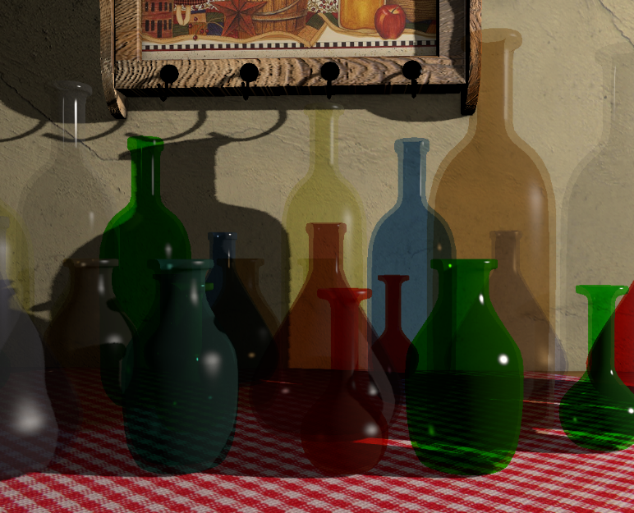
Importance Map Estimation
Variable k-buffer solution
Importance value per pixel using several metrics [McNamara et al., SIG’14]
Three metrics:
Depth-complexity heuristic
Periphery heuristic
Fresnel heuristic
Reference Scene
Notes:
In our implementation, we estimate the importance value of each pixel based on three general factors.
(a) the expected depth complexity, (b) the distance of pixel from the fovea region and finally the Fresnel term of the nearest fragment.
It is important to note that the above selection of heuristics was based on the available information in our current rendering pipeline.
Other attributes, such as low- or high-level saliency predictors can potentially contribute or even replace the factors involved.

Slide 22
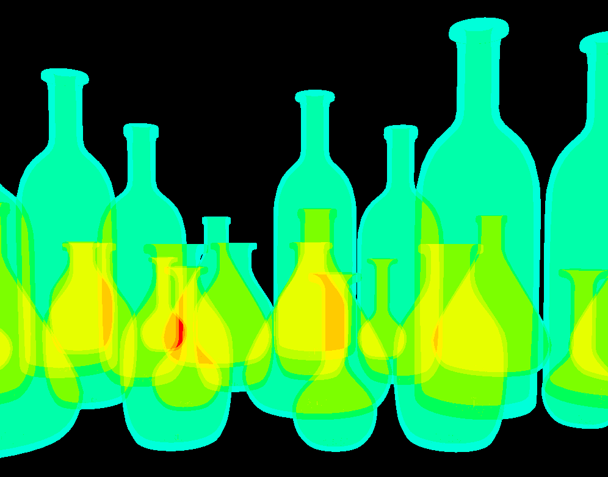
Importance Map Estimation
Variable k-buffer solution
Importance value per pixel using several metrics [McNamara et al., SIG’14]
Three metrics:
Depth-complexity heuristic
Reference Scene
Notes:
The first, and most important, is the depth-complexity heuristic where stores the number of visible layers that should be drawn at each pixel.
From the heatmap in the left Figure, we can clearly observe that more importance is given to pixels with more generated fragments when rendering a scene that contains a number of transparent bottles placed on a opaque table.

Slide 23
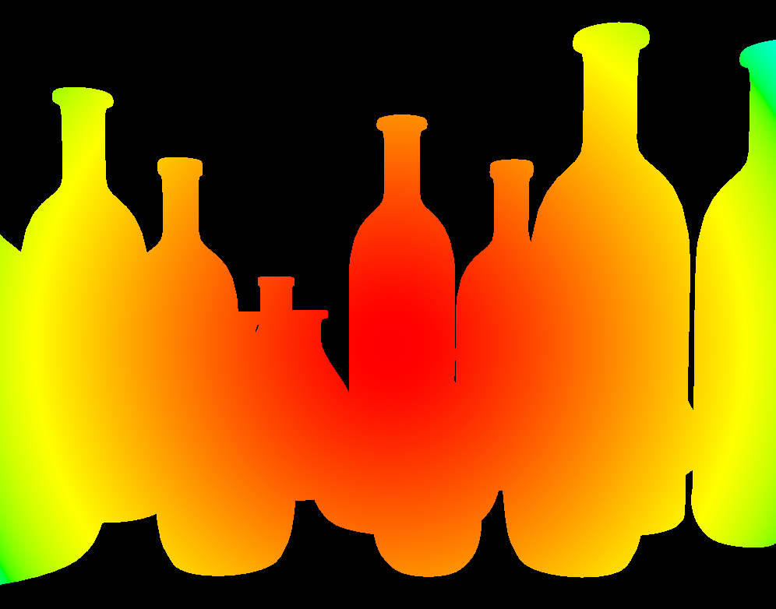
Importance Map Estimation
Variable k-buffer solution
Importance value per pixel using several metrics [McNamara et al., SIG’14]
Three metrics:
Periphery heuristic
Reference Scene
Notes:
Secondly, the periphery heuristic gradually lowers the signiﬁcance of pixels towards the edges of the frame buffer, by assuming that the information near the center of the image is perceptually more important.
In a more elaborate setup, the point of interest could be derived from other mechanisms, such as an eye tracking input.
Note that this metric does not depend on the scene input.

Slide 24
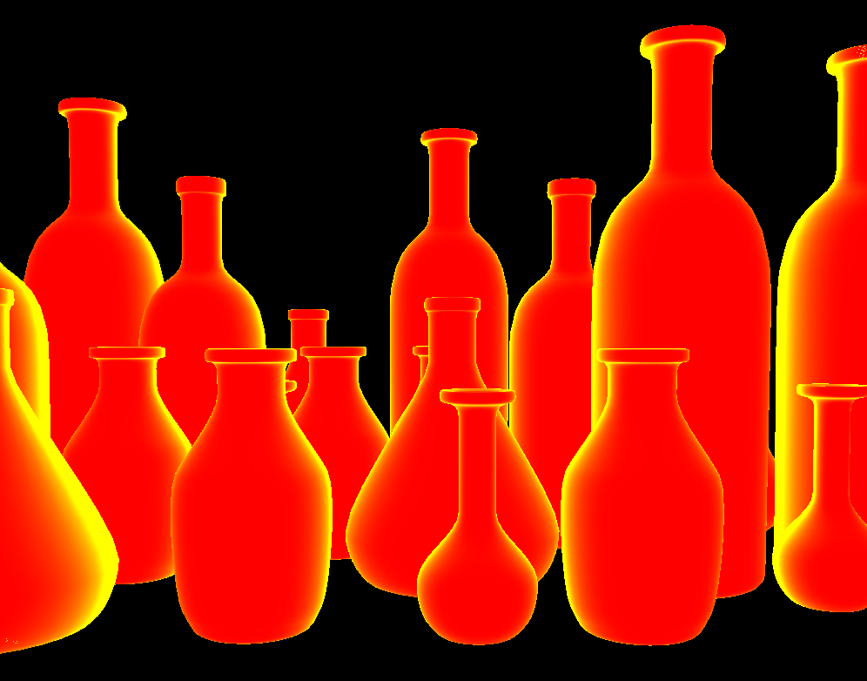
Importance Map Estimation
Variable k-buffer solution
Importance value per pixel using several metrics [McNamara et al., SIG’14]
Three metrics:
Fresnel heuristic
Reference Scene
Notes:
Finally, Fresnel heuristic is based on the observation that near the grazing viewing angle of a transparent surface, the reﬂected radiance prevails over the transmitted one and no matter how many transparent layers show through the respective fragments, the transmitted energy in a physically-based renderer will be signiﬁcantly dimmer than the (more important) reﬂected light.

Slide 25
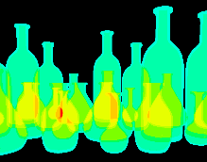
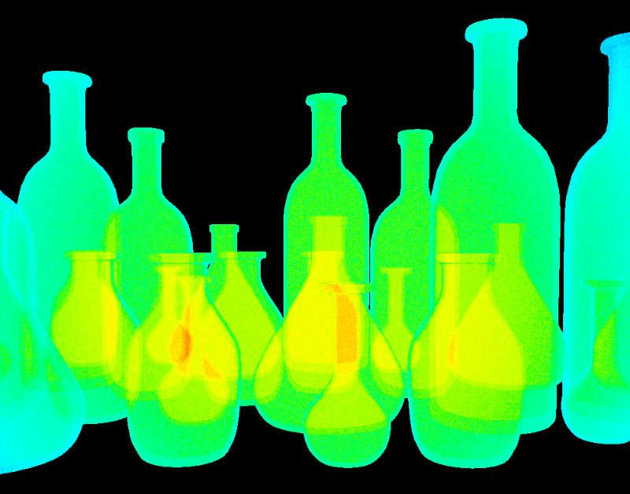
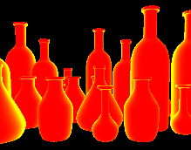
Importance Map Estimation
Variable k-buffer solution
Importance value per pixel using several metrics [McNamara et al., SIG’14]
Three metrics:
Final Importance Factor
Reference Scene
Notes:
The final importance factor is the product of the above three heuristics, since if at least one of the factors is sufficiently low, the quality precision can be reduced.
Additionally, a noise bias is added to mask potentially visible abrupt transition zones across otherwise smooth image regions,

Slide 26
Results
Hairy Scene (20MB), Total Layers = 92
Fixed
Dynamic
Variable
k
Frags Used
Frags Loss
Time
1
232K
87%
1.4ms
1-4
714K
60%
7.3ms
1-7
840K
53%
11.8ms
Notes:
So, lets see some results…
I will show you an experimental analysis of our variable k-buffer approach when compared with both a fixed k-buffer and a dynamic one with respect to performance, image quality under different memory budget testing configurations and scenes with wide range of depth complexity.
For this example, the hairy scene contains maximum 92 fragments per pixel and we have constrained the memory budget to 20MB.

Slide 27
Results
Hairy Scene (20MB), Total Layers = 92
Fixed
Dynamic
Variable
k
Frags Used
Frags Loss
Time
1
232K
87%
1.4ms
1-4
714K
60%
7.3ms
1-7
840K
53%
11.8ms
Notes:
In terms of quality, The ﬁxed k-buffer produced the lowest quality images (due to the lowest k) due to its strategy to allocate memory for both empty and occupied fragments in the image.
This is logical since the largest percentage of fragments are not captured using this solution.

Slide 28
Results
Hairy Scene (20MB), Total Layers = 92
Fixed
Dynamic
Variable
k
Frags Used
Frags Loss
Time
1
232K
87%
1.4ms
1-4
714K
60%
7.3ms
1-7
840K
53%
11.8ms
Notes:
The dynamic k-buffer was able to provide an increase in the number of layers, and therefore the quality of the image, due to its histogram based k estimation.
However, by using a global and ﬁxed k value that bounds the fragment complexity in each pixel we cannot achieve convincing transparency results.

Slide 29
Results
Hairy Scene (20MB), Total Layers = 92
Fixed
Dynamic
Variable
k
Frags Used
Frags Loss
Time
1
232K
87%
1.4ms
1-4
714K
60%
7.3ms
1-7
840K
53%
11.8ms
Notes:
Finally, our variable k-buffer outperformed the aforementioned approaches due to its ability to assign a larger range of k values in the important regions of the image under the same memory budget.

Slide 30
Results
Hairy Scene (20MB), Total Layers = 92
Fixed
Dynamic
Variable
k
Frags Used
Frags Loss
Time
1
232K
87%
1.4ms
1-4
714K
60%
7.3ms
1-7
840K
53%
11.8ms
Notes:
On the contrary, in terms of performance, the ﬁxed-k approach outperforms the other two methods due to its ability to exploit atomic hardware instructions during the store step, while the other two methods currently require the use of a spinlock mechanism.
Last but not least, an additional overhead is imposed on the variable k-buffer due to the irregular and most of the times larger fragmental complexities when compared to the rest methods that consequently increases the thread divergence.

Slide 31
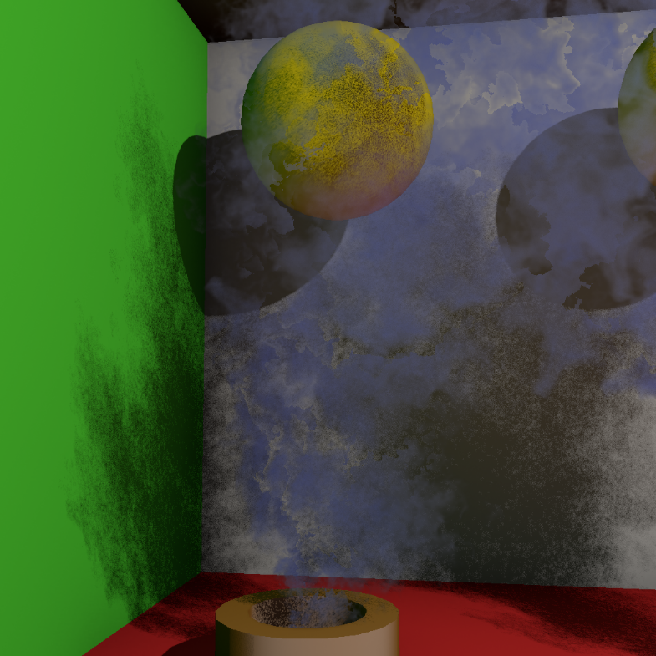
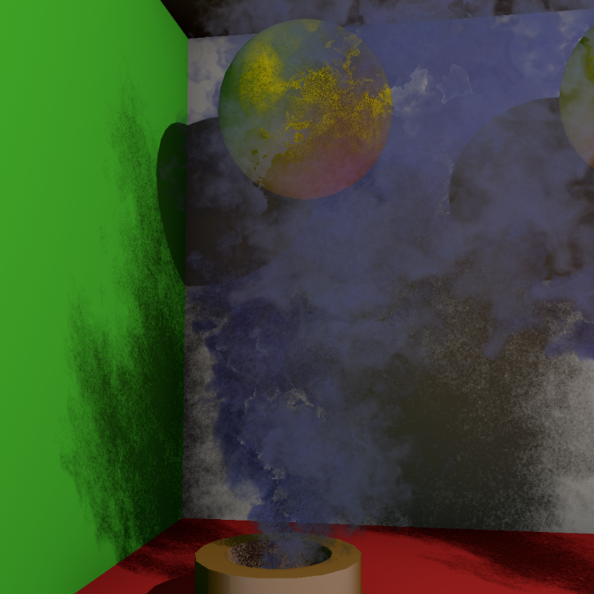
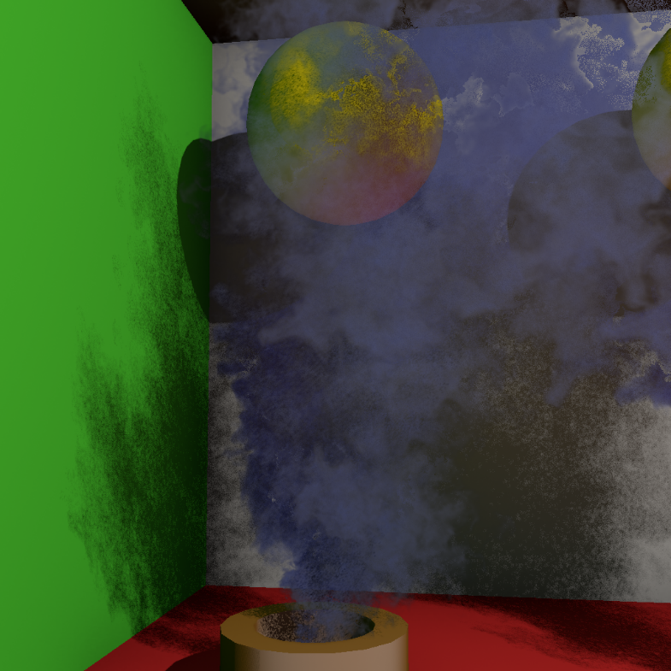
Results
Smoke Scene (35MB), Total Layers = 16
Fixed
Dynamic
Variable
k
Frags Used
Frags Loss
Time
2
1M
62%
0.8ms
1-4
1.4M
47%
5.4ms
1-5
1.7M
39%
6.5ms
Notes:
Similar results can be observed from the rest scenes…
Accumulating additional fragment information results to a significant reduction of the view-dependent artifacts, of course with the extra performance cost.

Slide 32
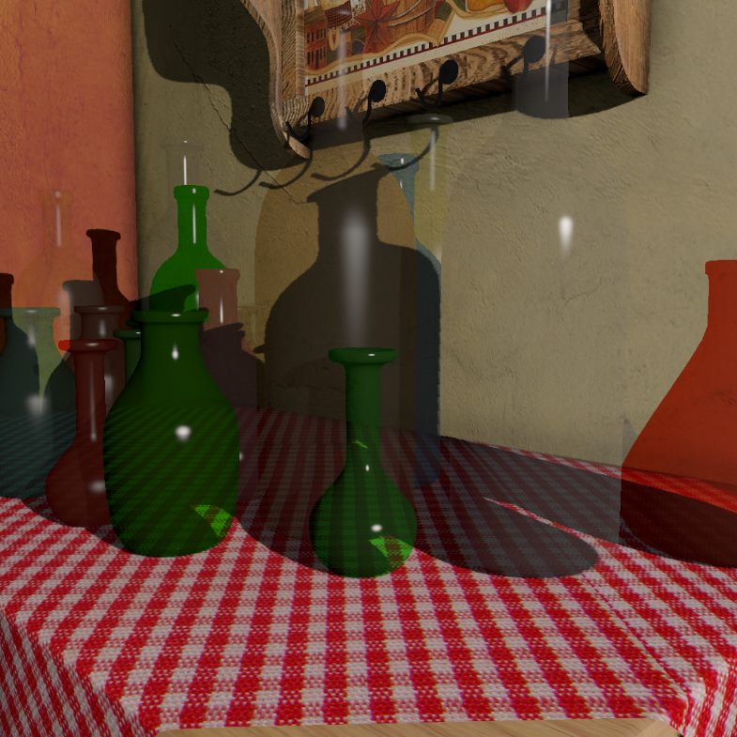
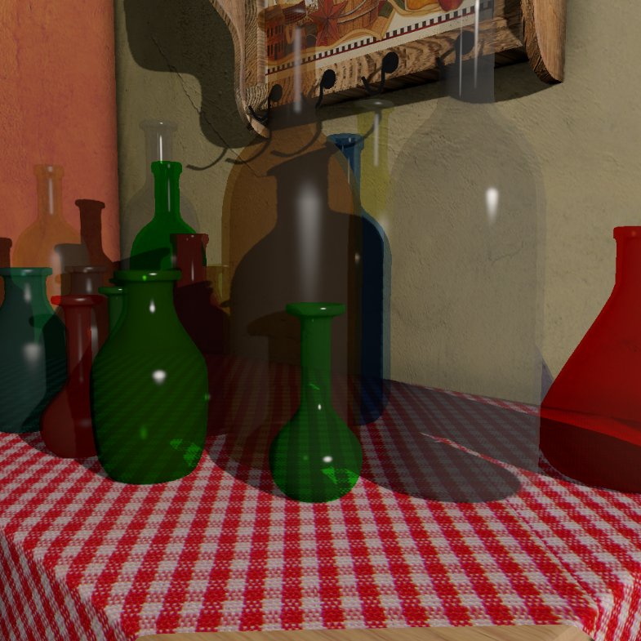
Results
Bottles Scene (35MB), Total Layers = 22
Fixed
Dynamic
Variable
k
Frags Used
Frags Loss
Time
2
1M
70%
1ms
1-3
1.4M
55%
5.7ms
1-5
1.8M
46%
6.8ms
Notes:
Here we can clearly observe the missing bottles from fixed and dynamic k-buffer methods as highlighted inside the insets.

Slide 33
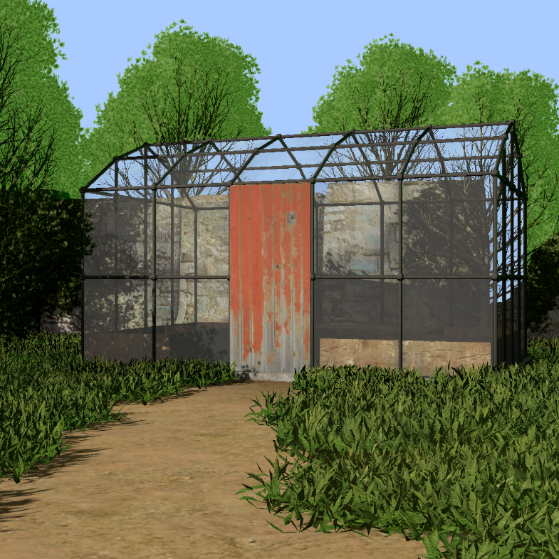
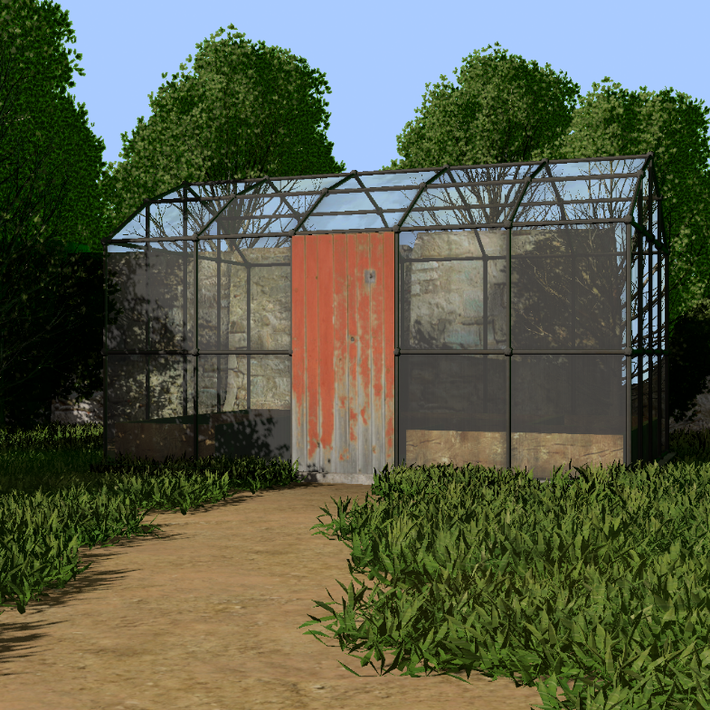
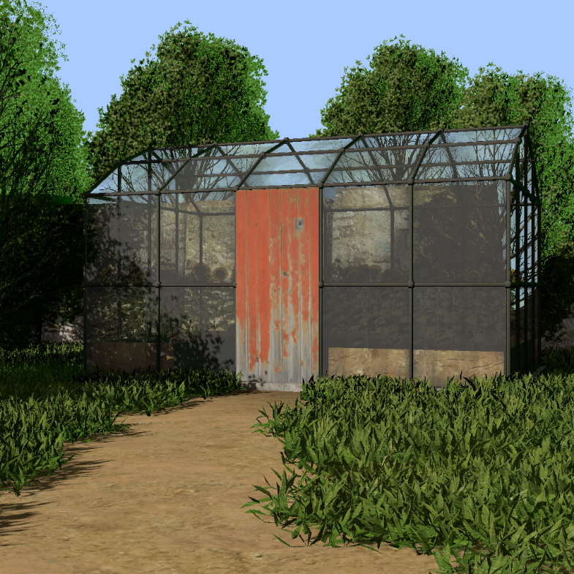
Results
Greenhouse Scene (35MB), Total Layers = 106
Fixed
Dynamic
Variable
k
Frags Used
Frags Loss
Time
3
1.9M
80%
15ms
1-5
2.5M
74%
47ms
1-10
2.7M
72%
58ms

Slide 34
Conclusions & Future Work
The first k-buffer method that
enables “selective multi-fragment rendering”,
alters the classic construction procedure from a fixed to a variable per-pixel fragment allocation (k)…
…according to “pixel importance maps”.
Notes:
In a nutshell, we have introduced the first k-buffer method that dynamically distributes the desired storage space instead of assuming the same value of k for all pixels.
Our approach assigns k on a per pixel basis according to an importance-based distribution function, thus, allowing higher depth complexity in regions that are deemed
important.

Slide 35
Conclusions & Future Work
The first k-buffer method that
enables “selective multi-fragment rendering”,
alters the classic construction procedure from a fixed to a variable per-pixel fragment allocation (k)…
…according to “pixel importance maps”.
Future directions
Include information from other metrics [McNamara et al., SIG’14]
“motion-based” - dynamic scenes
“eye tracking” - areas of interest
Enhance screen-space rendering problems
Ray Tracing [Vardis et al., I3D’16, Vardis et al., HPG’16]
Motion blur, Depth of field, and others…
Notes:
In the future, we aim to explore further directions for improving various screen-space rendering problems, such as motion blur, depth-of-field and ray-tracing,
by investigating new importance maps such as motion-based for scenes consisting of animated models and regions of interest extracted from eye tracking data.

Slide 36
Shader Code Available: www.iti.gr/~abasilak http://graphics.cs.aueb.gr
Acknowledgements:
This research has received funding from the European Union’s Horizon 2020 research and innovation programme “FrailSafe” under grant agreement No 690140 and the Athens University of Economics and Business Research Centre (AUEB-RC).

Slide 37
Questions

Slide 38
References (sorted by appearance)
[Vasilakis & Fudos, I3D’14] “k⁺-buffer: Fragment synchronized k-buffer”
[Vasilakis & Papaioannou, EG Short’15] “Improving k-buffer methods via occupancy maps”
[Vardis et al., I3D’16] “A multiview and multilayer approach for interactive ray tracing”
[Vardis et al., HPG’16] “DIRT: deferred image-based ray tracing”
[Rossignac et al., CAD’13] “Direct rendering of boolean combinations of self-trimmed surfaces”
[Yang et al., CGF’10] “Real-time concurrent linked list construction on the GPU”
[Vasilakis & Fudos, EG Short’12] “S-buffer: Sparsity-aware multi-fragment rendering”
[Bavoil et al., I3D’07] “Multi-fragment effects on the GPU using the k-buffer”
[Salvi, SIG’13] “Pixel synchronization: Solving old graphics problems with new data structures”
[Vasilakis et al., TVCG’15] “k⁺-buffer: An efficient, memory-friendly and dynamic k-buffer framework”
[McNamara et al., SIG’14] “Attention-aware rendering, mobile graphics and games”

