Slide 1
Improving k-buffer methods via Occupancy Maps
Andreas A. Vasilakis and Georgios Papaioannou
Dept. of Informatics, Athens University of Economics & Business, Greece

Slide 2
Multi-fragment Visibility Determination
A number of screen-space applications require operations on more than one fragments per pixel:
[ray casting]
Notes:
Multi-fragment visibility determination is fundamental for a number of image-based applications…

Slide 3
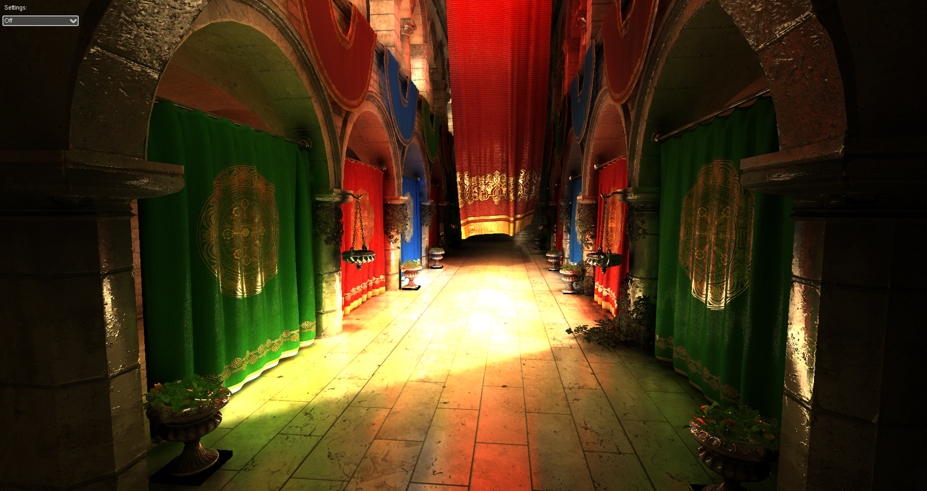
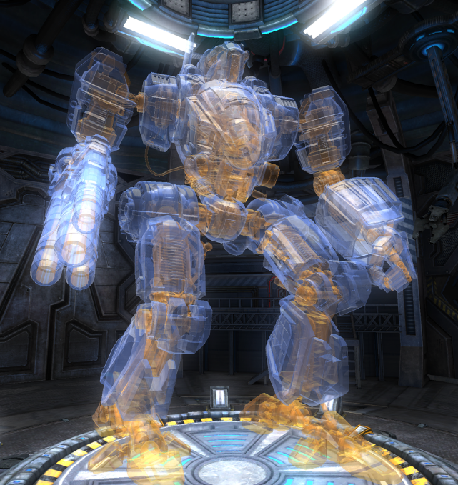
Image-based Applications
Photorealistic Rendering
[global illumination]
[transparency]
Notes:
From photorealistic rendering…

Slide 4
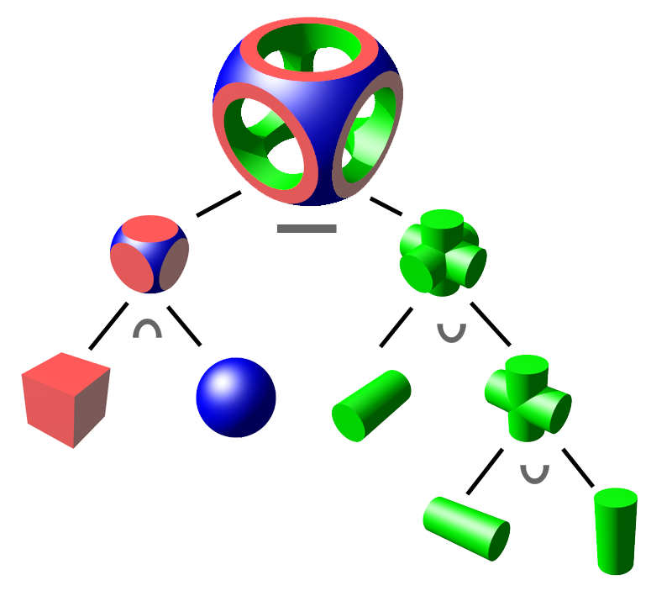
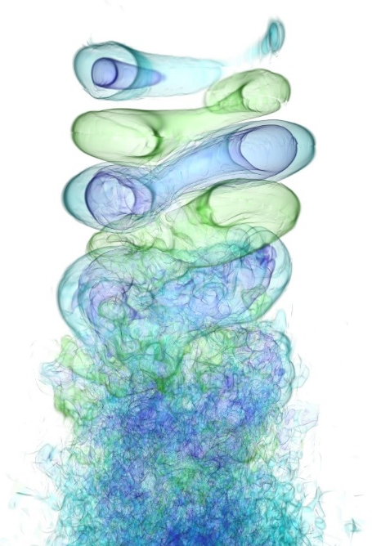
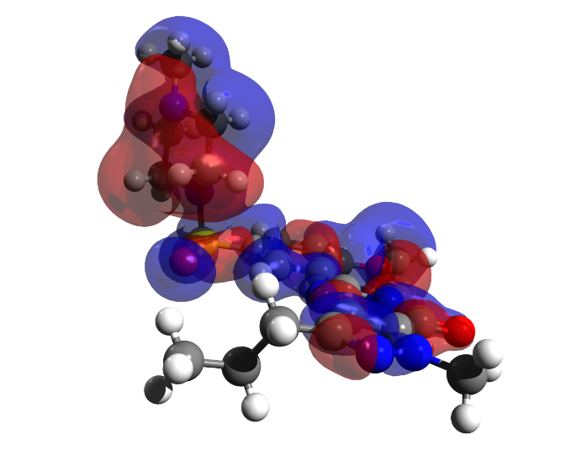
Image-based Applications
Visualization & Processing
[flow]
[molecular]
[hair]
[solid]
Notes:
To visualization & processing of different geometry representations…

Slide 5
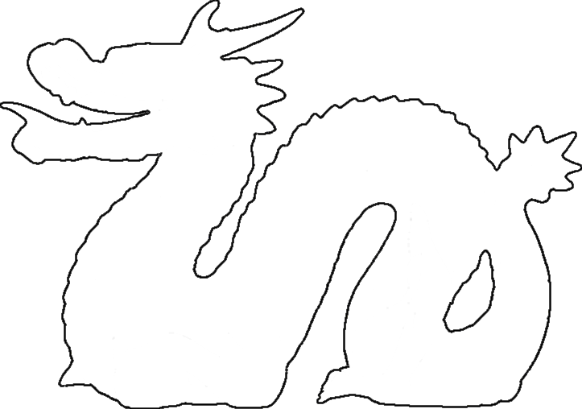
Multi-fragment Rendering Solutions
k-buffer methods: Store & Sort [k-closest] fragments
k=4
pixels
Notes:
k-buffer can be considered as the most preferred framework to ensure the correct depth order on a subset of all generated fragments…

Slide 6
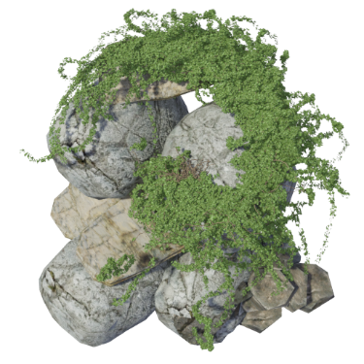
SP3: Rendering and Images
Tuesday May 5, 2015 [14:20 - 16:00] @Vortragssaal Room
Notes:
If you want to find out how we improve k-buffer methods in terms of performance, memory and quality
when rasterizing scenes with high-depth-complexity, see you Tomorrow…

